Slide 1
Computational Propaganda/ Political Disinformation
MIS 689
Cyber Warfare
Capstone

Slide 2
Acknowledgements
Symantec Threat Intelligence
U.S. House of Representatives Permanent Select Committee on Intelligence
Indiana University Network Science Institute
University of Oxford Computational Propaganda Research Project

Slide 3
Module Objectives
Understand what computational propaganda is
Who the primary groups employing these campaigns are
How propaganda has evolved
What the motivations are for manipulating media
How propaganda is used
Primary groups
Mitigation
How is this related to cyber warfare?

Slide 4
Overview
Computational Propaganda:
The use of algorithms, automation, and big data to influence and shape public opinions about social and political landscapes.
Cyber Troops:
Government or political party actors tasked with manipulating public opinion online (Bradshaw and Howard, 2017).
Misinformation and Manipulation
Computational Propaganda
Automate Suppression
Cyber Troops
Social Media
Computational Propaganda
Cyber Troops
Manipulation and Misinformation
Notes:
Around the world, government actors are using social media to manufacture consensus, automate suppression, and undermine trust in the liberal international order.

Slide 5
Overview (Cont.)
Main Platforms Used
Facebook
Twitter
YouTube
WhatsApp
Reddit
Instagram
Weibo
How are they used?
“Astroturfing”
Message Amplification/ Disproportionate representation
Notes:
Astroturfing – the masking of sponsorship or authorship of a message or organization that appears to come from a grass roots community; Russian group setting up IG account creating polarizing content around the black lives matter movement – Russians creating Chicano Rights FB page posting about Hispanic heritage

Slide 6
Examples of Astroturfing
Political disinformation is often difficult to discern from real community pages
Can you spot the real post vs. the fake post?
https://www.nytimes.com/interactive/2018/09/04/technology/facebook-influence-campaigns-quiz.html
Notes:
Disinformation actors frequently use divisive language and images in their content. They often evoke historical figures and context in an attempt to sway public opinion and create division. Spotting disinformation is not always straight forward. In the image above, the post on the right is the disinformation image.
Source: https://www.nytimes.com/interactive/2018/09/04/technology/facebook-influence-campaigns-quiz.html

Slide 7
Examples of Astroturfing
Political disinformation is often difficult to discern from real community pages
Can you spot the real post vs. the fake post?
https://www.nytimes.com/interactive/2018/09/04/technology/facebook-influence-campaigns-quiz.html
Notes:
Disinformation actors frequently use divisive language and images in their content. They often evoke historical figures and context in an attempt to sway public opinion and create division. Spotting disinformation is not always straight forward. In the image above, the post on the right is the disinformation image.
Source: https://www.nytimes.com/interactive/2018/09/04/technology/facebook-influence-campaigns-quiz.html

Slide 8
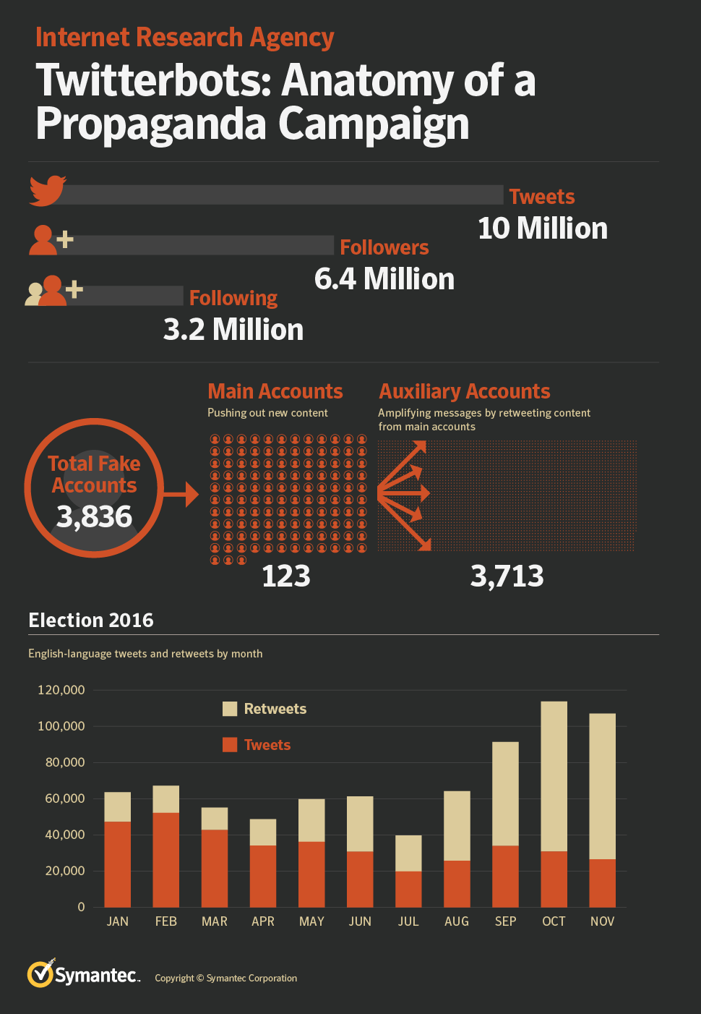
Message Amplification/ Disproportionate Representation
Bots are used extensively by disinformation actors.
Automation is employed to retweet, follow, like, or otherwise deceptively promote content creation accounts.
Automated behavior and the use of bot accounts are available at extremely low cost from a competitive market of providers.

Slide 9
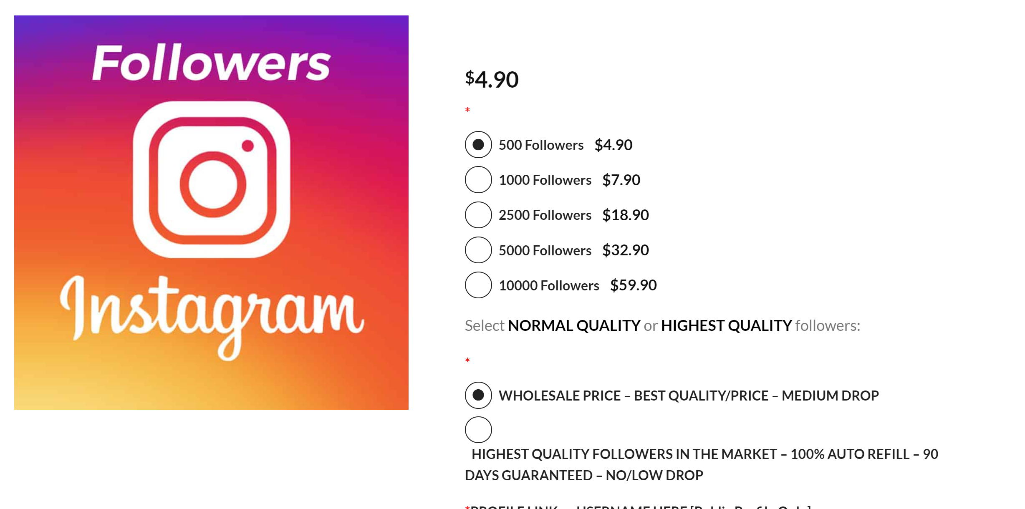
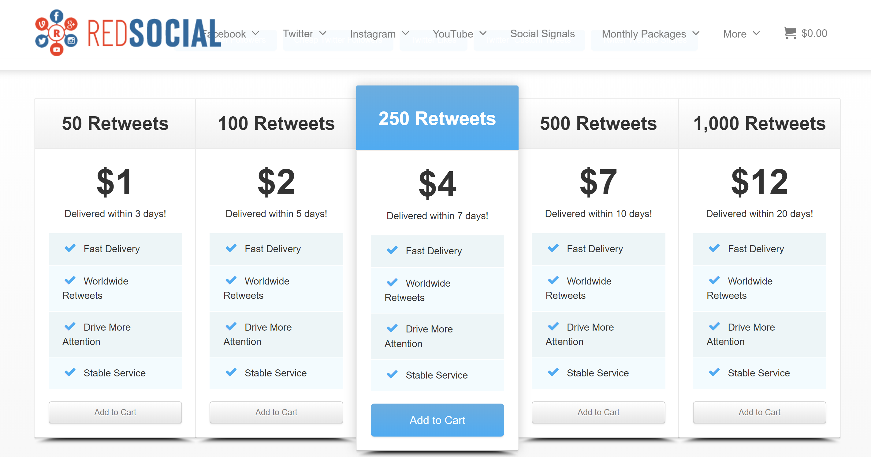
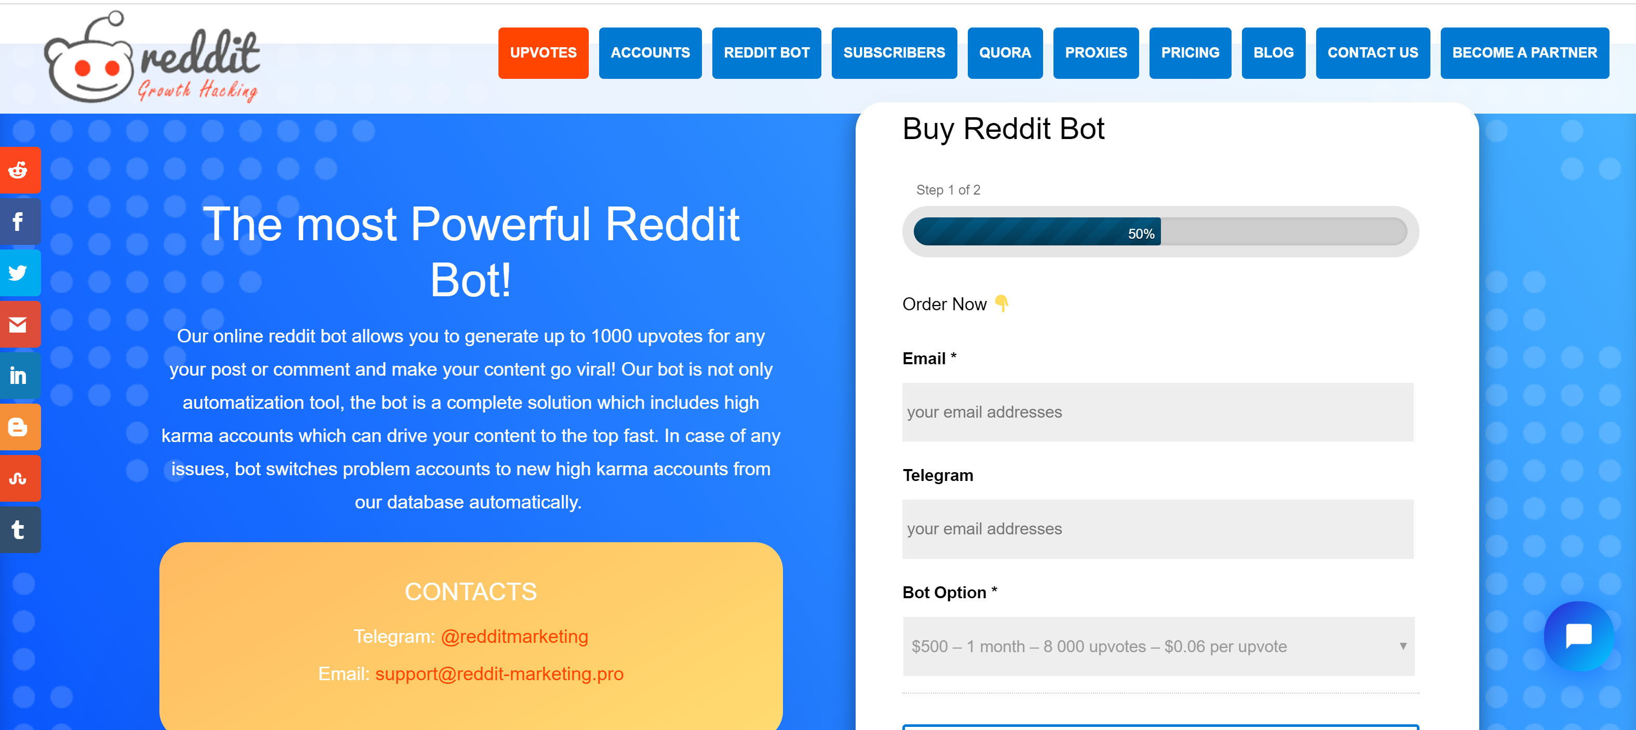
Bot and Automation Vendors
Sold as “Growth Hacking” services, many vendors exist who can amplify a propaganda actor’s message, without creating suspicion around the disinformation account.

Slide 10
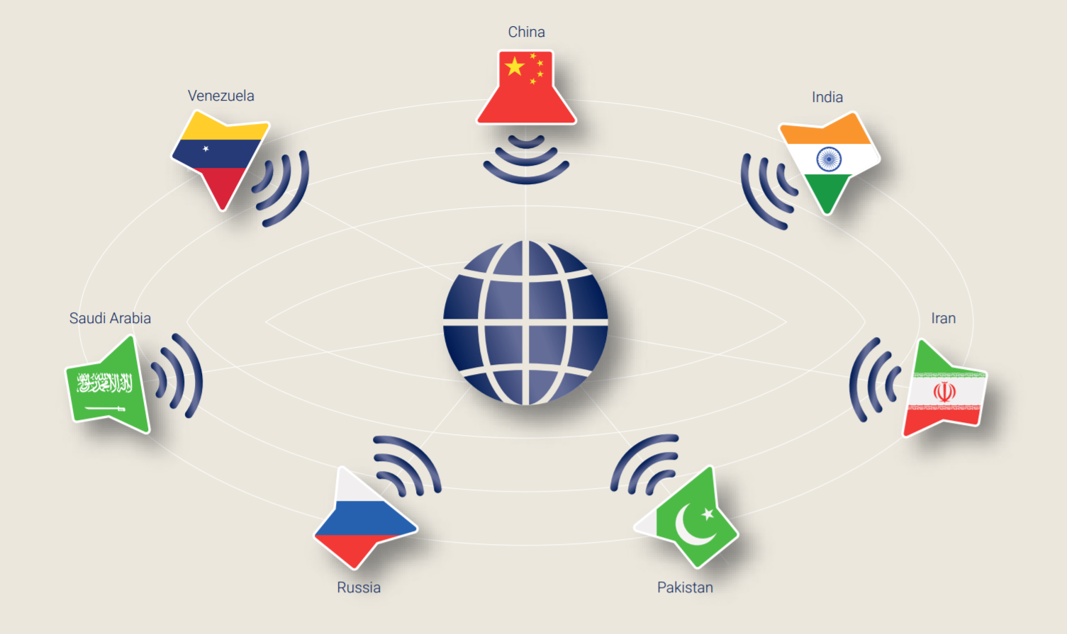
Countries Using Social Media for International Computational Propaganda Campaigns
Russia
Iran
Venezuela
India
China
Saudi Arabia
Pakistan
U.S. (not shown)
https://comprop.oii.ox.ac.uk/wp-content/uploads/sites/93/2019/09/CyberTroop-Report19.pdf
Notes:
Source: Oxford 2019 Computational Propaganda Report: https://comprop.oii.ox.ac.uk/wp-content/uploads/sites/93/2019/09/CyberTroop-Report19.pdf

Slide 11
Authoritarian Regimes Using Social Media for Domestic Computational Propaganda Campaigns
https://comprop.oii.ox.ac.uk/wp-content/uploads/sites/93/2019/09/CyberTroop-Report19.pdf
Notes:
Source: Oxford 2019 Computational Propaganda Report: https://comprop.oii.ox.ac.uk/wp-content/uploads/sites/93/2019/09/CyberTroop-Report19.pdf

Slide 12
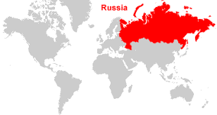
Movement of Computational Propaganda
Computational propaganda moved from successfully executed internal (nation side) campaigns to external (foreign/global) campaigns

Slide 13
Motivations
The three primary goals for computational propaganda orchestrated by cyber troops:
Suppress fundamental human rights
Discredit political opposition
Drown out political dissent
Two primary methods for computational propaganda:
Targeted: Specific and targeted propaganda for binary polarization
Selected targets, meant to pull and push opinions to one side of the argument
Ex: “Yes this is right” or “No this is wrong” – Clear division
Broad: Mass audience-focused
Designed to reach a large audience and disrupt/manipulate views
Pushes towards both/all sides of an argument – Controversial
Notes:
Primary motive – sway public opinion one way or another

Slide 14
Primary Groups
Russian Internet Research Agency (IRA)
State-of-the-art computational propaganda group
Presence on Facebook:
3,393 advertisements purchased (a total 3,519 advertisements total were released after more were identified by the company);
More than 11.4 million American users exposed to those advertisements;
470 IRA-created Facebook pages;
80,000 pieces of organic content created by those pages; and
Exposure of organic content to more than 126 million Americans.

Slide 15
Primary Groups (Cont.)
Presence on Twitter:
More than 36,000 Russian-linked bot accounts tweeted about the U.S. election
Approximately 288 million impressions of Russian bot tweets; and
More than 130,000 tweets by accounts linked to the IRA

Slide 16
Targets
Anyone and everyone
Very similar to APT groups
Manipulate as many people as possible, whether it is one side or the other
OR BOTH
Two primary types of targets:
Selected group
Global Audience

Slide 17
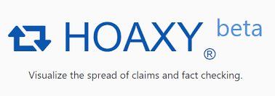
Mitigation of Propaganda
Public awareness
Fact checking
Artifacts:
Tools developed by Indiana University Network Science Institute (IUNI)
Botometer
Hoaxy
Social media bot/post credibility checking is key to identifying propaganda

Slide 18
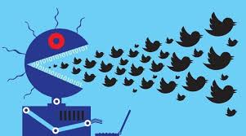
How is this related to Cyber Warfare? (Cont.)
APT 28
Attacking Democratic National Committee
Sabotage 2016 US Presidential Election
Motive: Tip the scale of geopolitical landscape
Twitter Bots
Target the masses → sway opinions about current events
Produce and spread fake news
Notes:
Countries/groups with agendas using technology to influence decisions and disrupt/manipulate democratic processes.

