Slide 1
Predictive Analytics for Data Mining: Regression & Classification
Weifeng Li, Sagar Samtani, and Hsinchun Chen
Spring 2023
Acknowledgements: Cynthia Rudin, Hastie & Tibshirani
Michael Crawford – San Jose State University
Pier Luca Lanzi – Politecnico di Milano
John Whitehead, East Carolina University

Slide 2
Outline
Introduction and Motivation
  Terminology
  Top DM methods and tools
Regression
  Linear Regression, hypothesis testing
  Multiple linear regression
Classification
  Logistic/logit Regression
  Decision Tree
  Random Forest
  Naïve Bayes
  K Nearest Neighbor
  Support Vector Machine
Evaluation metrics
Conclusion and Resources

Slide 3
Introduction and Motivation: Data Mining, Machine Learning, Deep Learning, AI
Data Mining: Data mining is the process of discovering patterns in large data sets involving analytical methods at the intersection of machine learning, statistics, artificial intelligence, and database systems. Data mining is the analysis step of the "knowledge discovery in databases" process or KDD.
Other Common Terminologies:
  Symbolic machine learning (symbolic AI)
  Statistical machine learning (statistics + ML)
  Supervised learning (regression, classification)
  Unsupervised learning (clustering)
  Deep learning, Deep neural networks (connectionist AI)
  Reinforcement learning (agent-based optimization)
  Self-supervised learning, contrastive learning (text/image)
  Adversarial machine learning (RL, Generative Adversarial Network, GAN)
  Transformer, Generative AI, GPT (attention mechanism, foundation models)

Slide 4
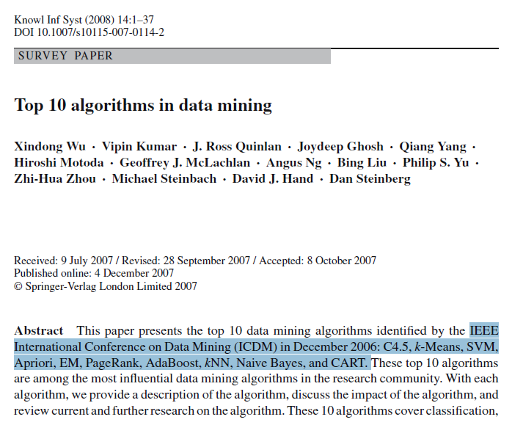
Introduction and Motivation: DM 2008

Slide 5

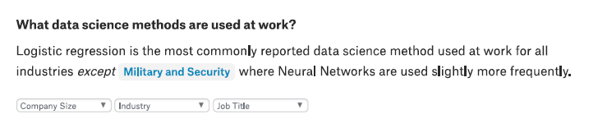
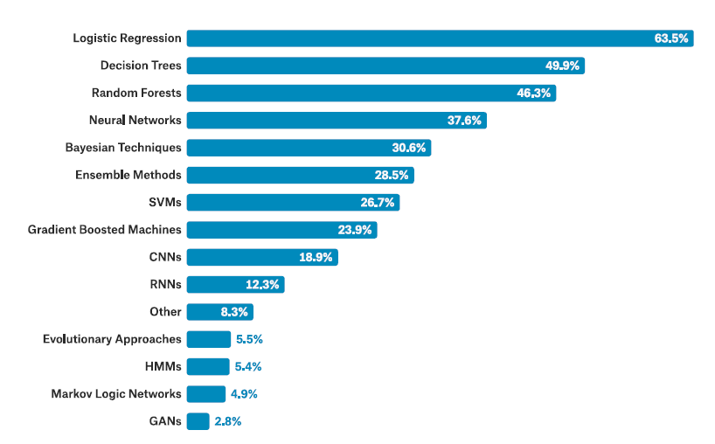
Introduction and Motivation: The State of Data Science 2017

Slide 6
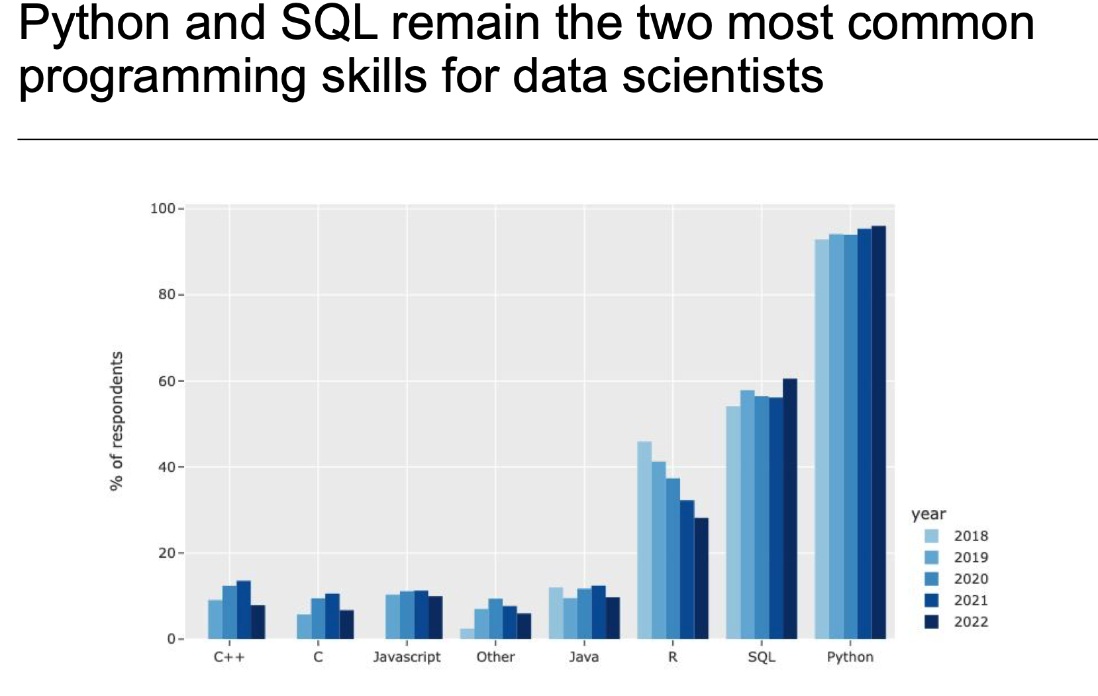
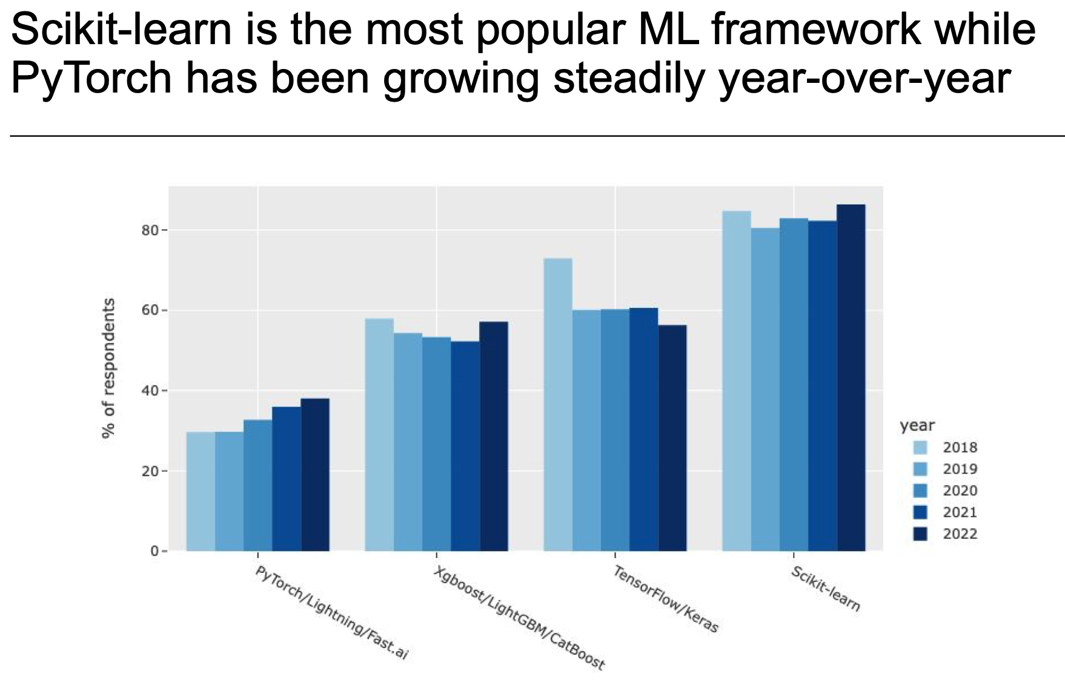
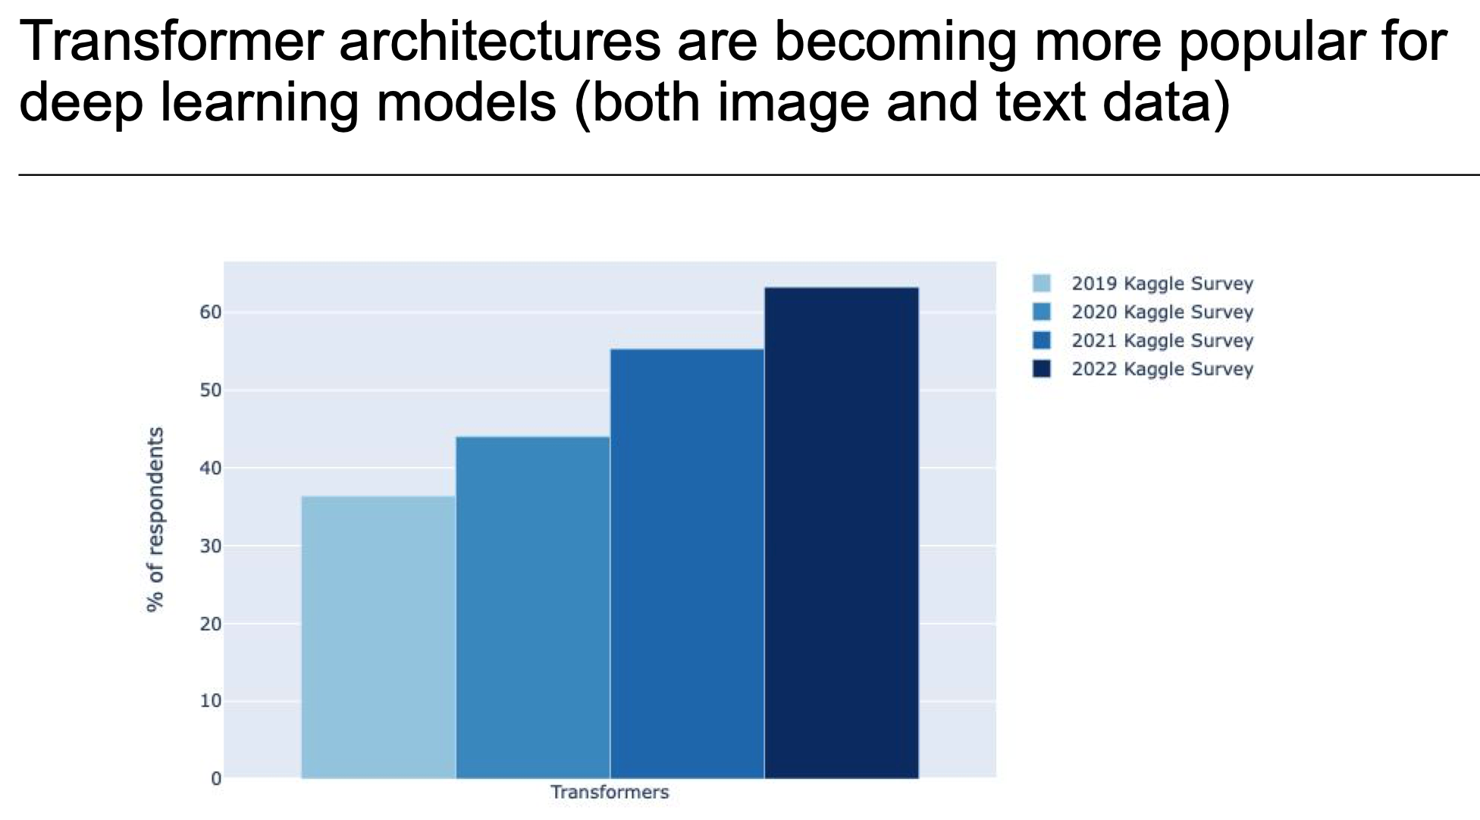
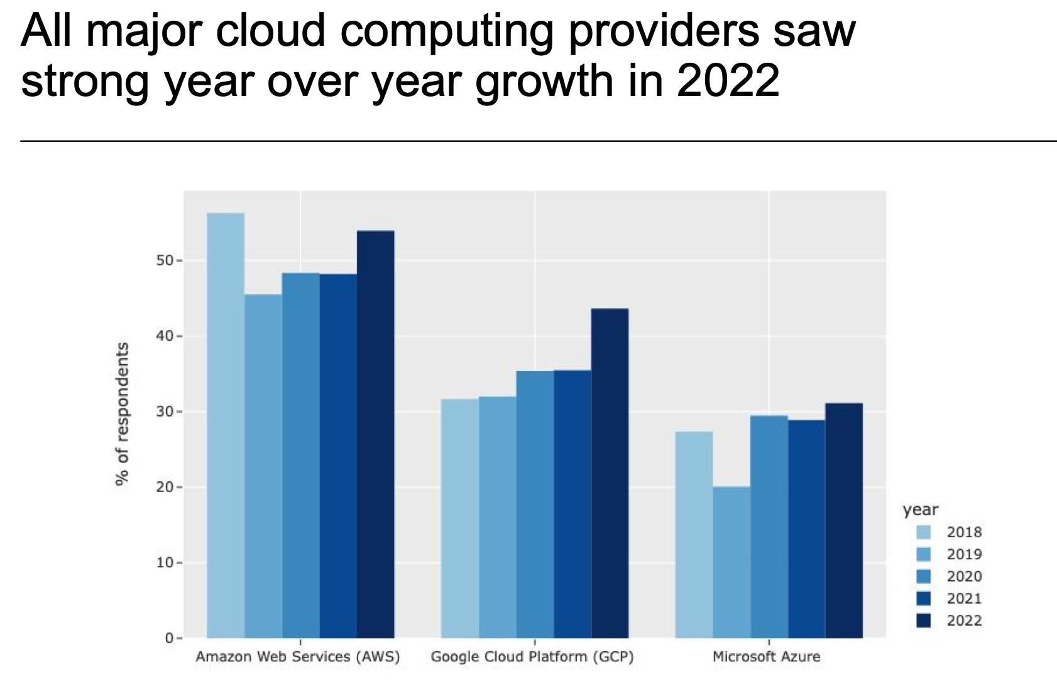
Introduction and Motivation: 2022 Kaggle Data Science and ML Survey

Slide 7
WEKA Main Capabilities and Functionalities
WEKA has tools for various data mining tasks.
Data Mining Task | Description | Examples
Data Pre-Processing | Preparing a dataset for analysis | Discretizing, Nominal to Binary
Classification | Given a labeled set of observations, learn to predict labels for new observations | BayesNet, KNN, Decision Tree, Neural Networks, Perceptron, SVM
Regression | Learn to predict numeric values for observations | Linear Regression, Isotonic Regression
Clustering | Identify groups (i.e., clusters) of similar observations | K-Means
Association rule mining | Discovering relationships between variables | Apriori Algorithm, Predictive Accuracy
Feature Selection | Find attributes of observations important for prediction | Cfs Subset Evaluation, InfoGain
Visualization | Visually represent data mining results | Cluster assignments, ROC curves

Slide 8
WEKA Classification Features
Classifier Type | Classifiers
Bayes | BayesNet, Naïve Bayes, Naïve Bayes Multinomial, Naïve Bayes Multinomial Updatable, Naïve Bayes Updateable
Statistical Functions | Gaussian Processes, Linear Regression, Logistic Regression, Multilayer Perceptron, SGD, SDG Text, Simple Linear Regression, Simple Logistic Regression, SMO/SVM, SMOreg, Voted Perceptron
Lazy | IBk, Kstar, LWL
Meta | AdaBoostM1, Additive Regression, Attribute Selected Classifier, Bagging, Classification via Regression, Cost Sensitive Classifier, CV Parameter Selection, Filtered Classifier, Iterative Classifier Optimizer, Logit Boost, Multiclass Classifier, Multiclass Classifier Updateable, Multischeme, Random Committee, Randomizable Filtered Classifier, Random Subspace, Regression by Discretization, Stacking, Vote, Weighted Instances Handler Wrapper
Misc | Input Mapped Classifier, Serialized Classifier
Rules | Decision Table, Jrip, M5 Rules, OneR, PART, ZeroR
Trees | Decision Stump, Hoeffding Tree, J48, LMT, M5P, Random Forest, Random Tree, REP Tree

Slide 9
Mahout (Hadoop) vs MLlib (Spark):
Major Algorithm Coverage
 | Mahout | MLlib
Regression | N/A | Linear Regression, Isotonic Regression, Survival Analysis
Classification | Logistic Regression, Naïve Bayes, Random Forest, Hidden Markov Models, Multilayer Perceptron | Logistic Regression, Naïve Bayes, linear Support Vector Machine, Decision Tree, Random Forest, Multilayer Perceptron
Clustering | K-Means, Spectral Clustering | K-Means, Spectral Clustering, Gaussian Mixtures
Dimension Reduction | Singular Value Decomposition, Principal Component Analysis, QR Decomposition | Singular Value Decomposition, Principal Component Analysis, QR Decomposition, Elastic Net
Text Mining | Latent Dirichlet Allocation, TF-IDF, Collocations | Latent Dirichlet Allocation, TF-IDF, Word2Vec, Tokenization
Recommendation | Alternating Least Squares | Alternating Least Squares, Association Rule Mining, FP-Growth
Notes:
details and comparison with Mahout and MLlib, including: algorithms coverage, input/output (e.g., disks, files, visualization), other APIs options, strengths/weaknesses (e.g., parallel training, speed up), etc. Please include3 1-2 examples for each.

Slide 10
Introduction and Motivation: Predictive Analytics
In recent years, there has been a growing emphasis for researchers and practitioners alike to be able to “predict” the future based on past data.
These slides present two standard “predictive analytics” approaches:
  Regression – given a set of attributes, predict the value for a record
  Classification – given a set of attributes, predict the label (i.e., class) for the record

Slide 11
Introduction and Motivation
Consider the following:
  The NFL trying to predict the number of Super Bowl viewers
  An insurance company determining how many policy holders will have an accident
Or:
  A bank trying to determine if a customer will default on their loan
  A marketing manager needs to determine whether a customer will purchase or not
Regression
Classification
Notes:
Classification is has a variety of applications, such as:
Determining whether a website is phishing or legit
Categorizing news stories as finance, weather, sports, etc.
Classifying unknown source code into their programming language
Determining whether a tumor cell is benign or malicious

Slide 12
Background – Terminology
  Let’s review some common data mining terms.
  Data mining data is usually represented with a feature matrix.
    Features
      Attributes used for analysis
      Represented by columns in feature matrix
    Instances
      Entity with certain attribute values
      Represented by rows in feature matrix
      An example instance is highlighted in red (also called a feature vector).
    Class Labels
      Indicate category for each instance.
      This example has two classes (C1 and C2).
      Only used for supervised learning.
The Feature Matrix
Features
Attributes used to classify instances
 | F1 | F2 | F3 | F4 | F5
C1 | 41 | 1.2 | 2 | 1 | 3.6
C2 | 63 | 1.5 | 4 | 0 | 3.5
C1 | 109 | 0.4 | 6 | 1 | 2.4
C1 | 34 | 0.2 | 1 | 0 | 3.0
C1 | 33 | 0.9 | 6 | 1 | 5.3
C2 | 565 | 4.3 | 10 | 0 | 3.2
C1 | 21 | 4.3 | 1 | 0 | 1.2
C2 | 35 | 5.6 | 2 | 0 | 9.1
Each instance has a class label
Instances

Slide 13
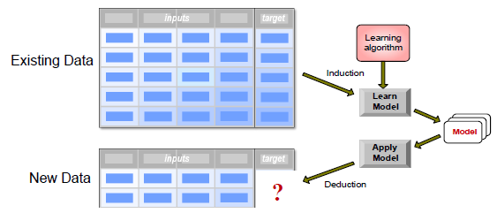
Background – Terminology
In predictive tasks, a set of input instances are mapped into a continuous (using regression) or discrete (using classification) outputs.
Given a collection of records, where each records contains a set of attributes, one of the attributes is the target we are trying to predict.
Training
Testing/Prediction

Slide 14
Outline
Introduction and Motivation
  Terminology
Regression
  Linear Regression, hypothesis testing
  Multiple linear regression
Classification
  Logistic Regression
  Decision Tree
  Random Forest
  Naïve Bayes
  K Nearest Neighbor
  Support Vector Machine
Evaluation metrics
Conclusion and Resources

Slide 15
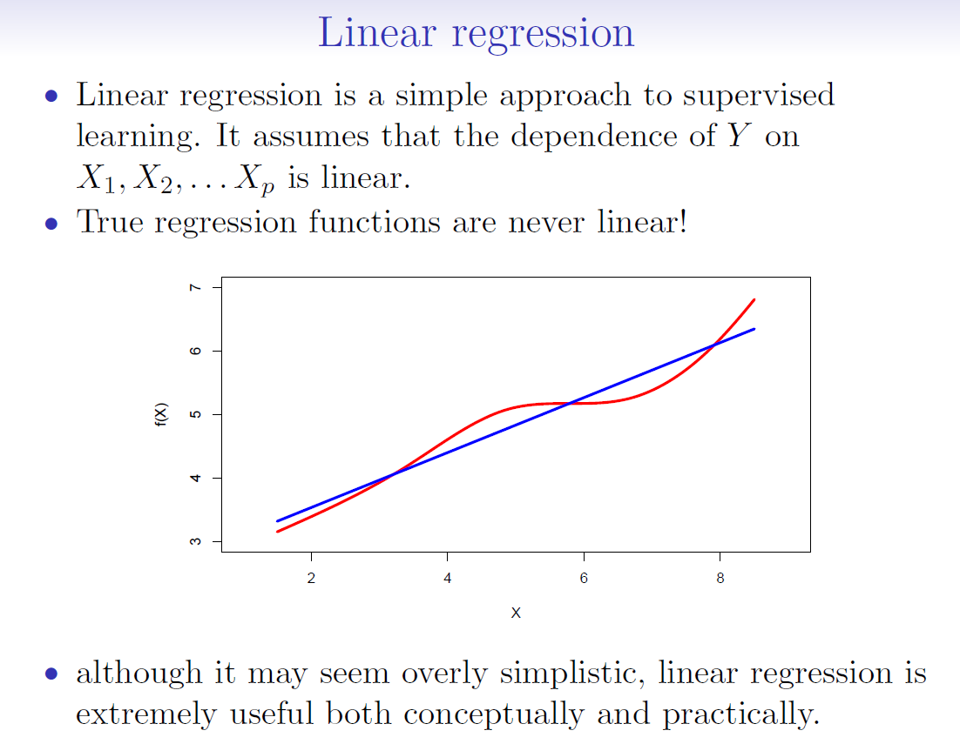
The earliest form of regression using least squares was published by Legendre in 1805.

Slide 16
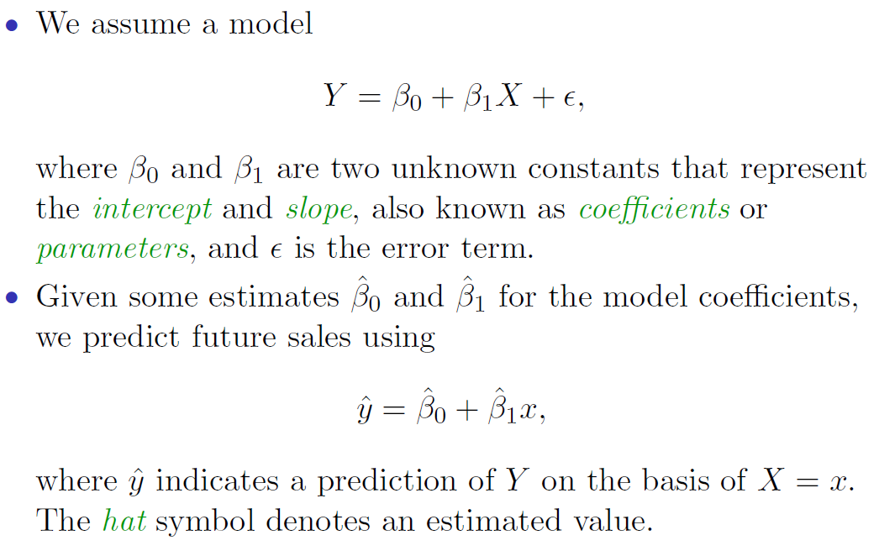
Simple Linear Regression

Slide 17
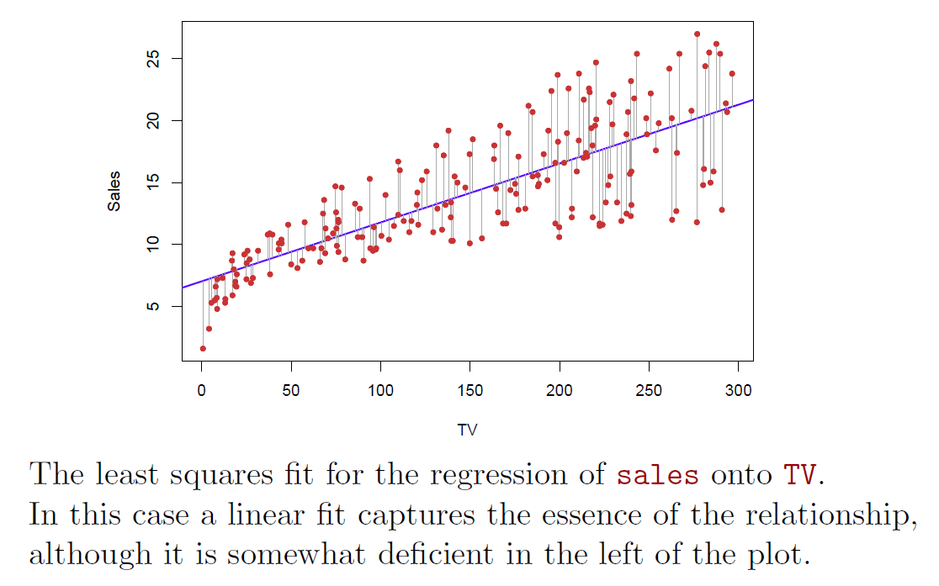
Simple Linear Regression: Example

Slide 18
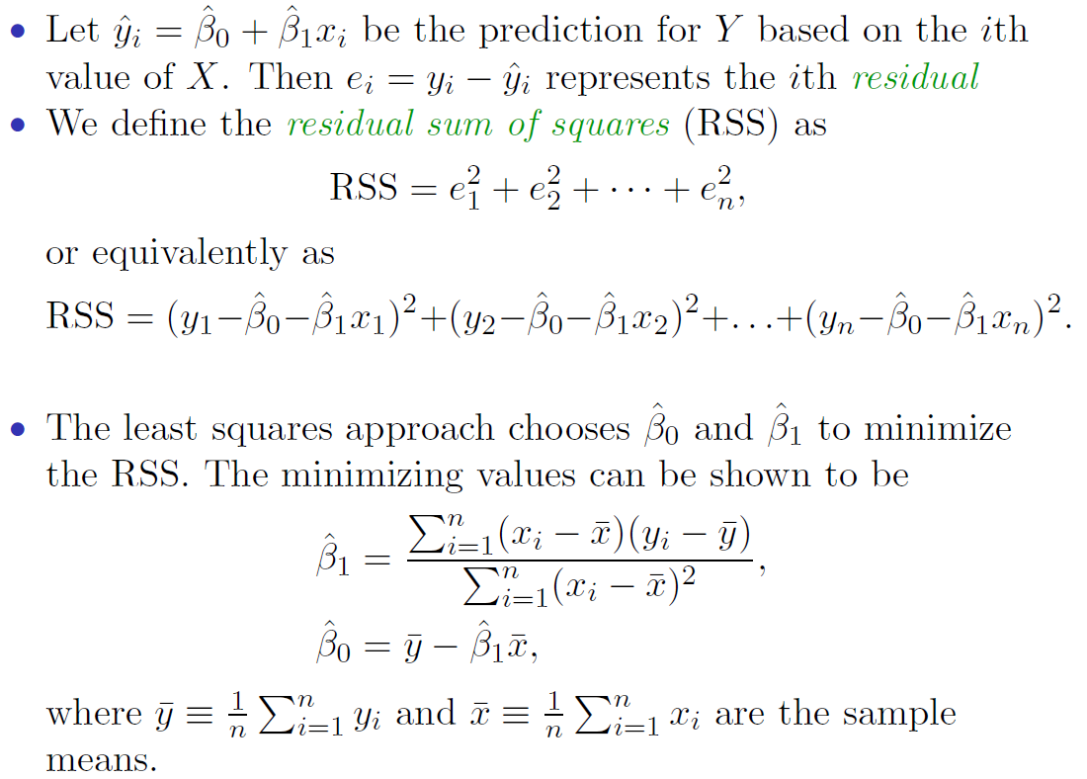
Estimation of the Parameters by Least Squares

Slide 19
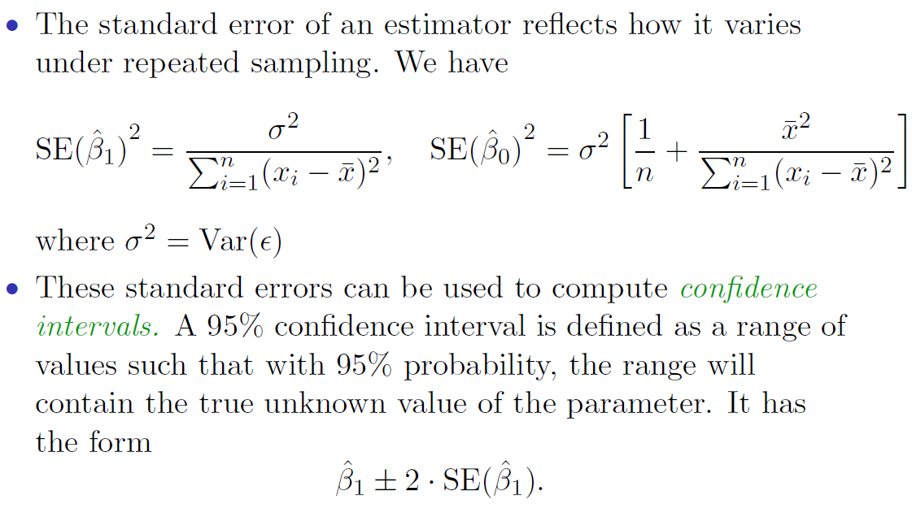
Assessing the Accuracy of the Coefficient Estimates
- Standard error: standard deviation of its sampling distribution
- Var: Variance, measure of dispersion; squared deviation of a random variable from its sample mean

Slide 20
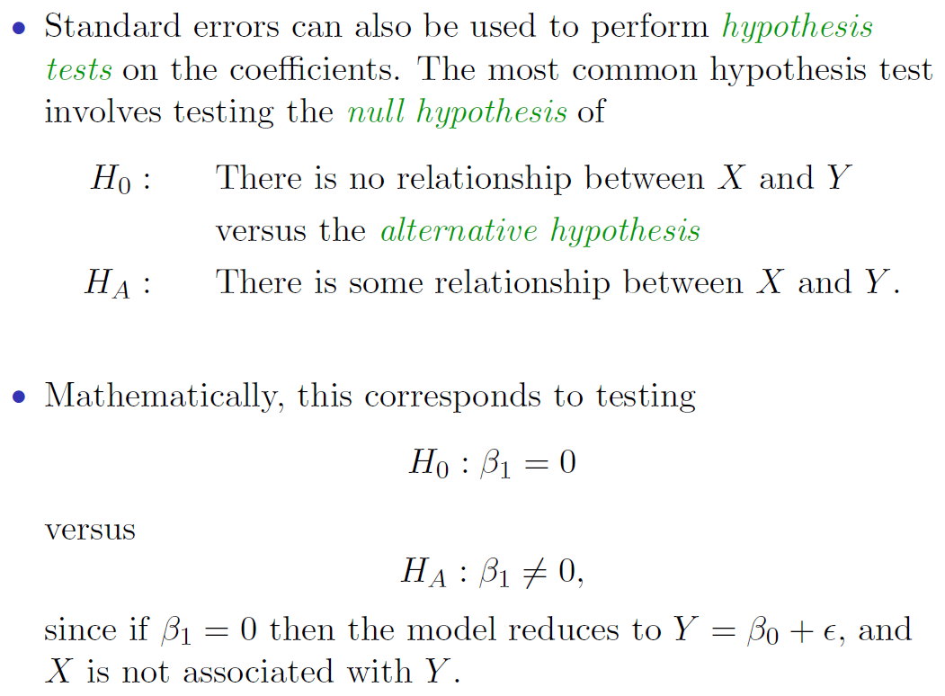
Hypothesis Testing

Slide 21
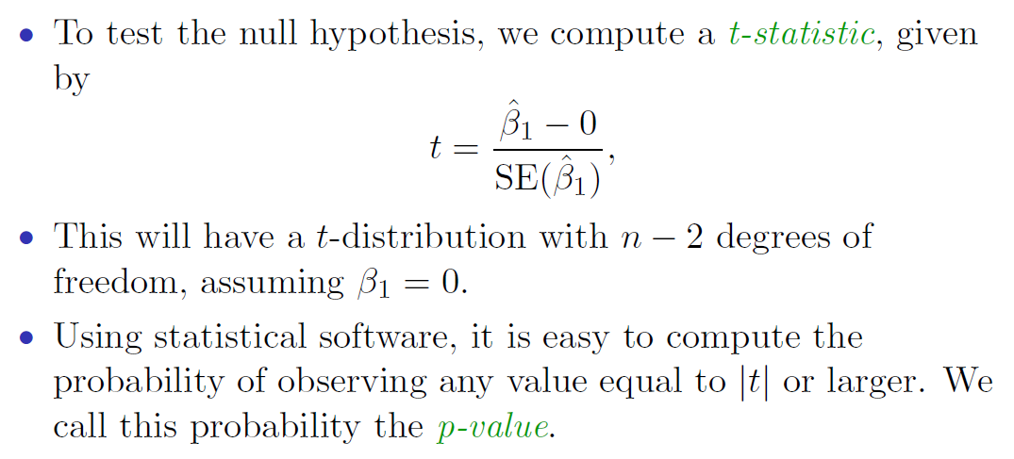
Hypothesis Testing (continued)

Slide 22
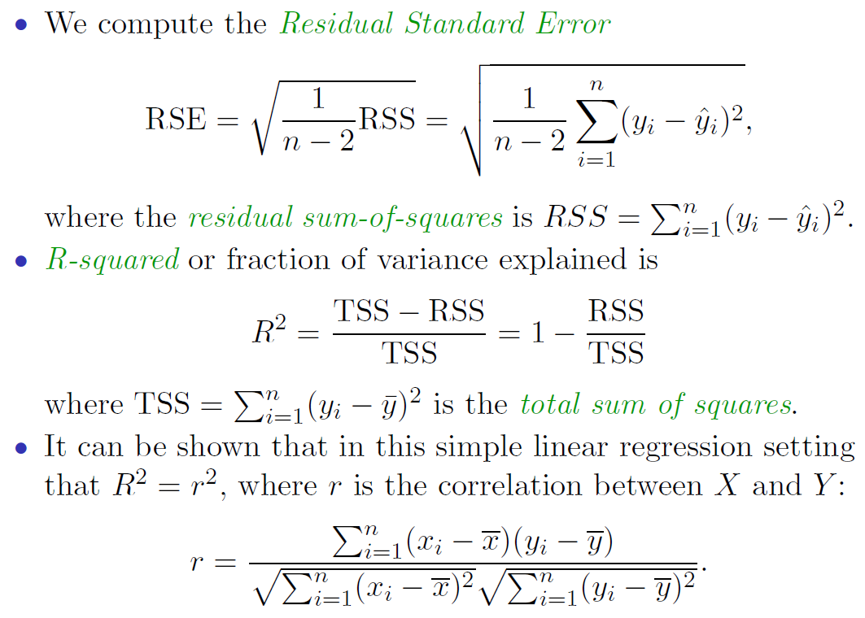
Model Evaluation: Assessing the Overall Accuracy of the Model
Noted: r value [-1..1]; R² value [0..1]

Slide 23


Multiple Linear Regression
Multiple linear regression models the relationship between two or more explanatory variables (i.e., predictors or independent variables) and a response variable (i.e., dependent variable.)
Multiple linear regression models can be used for predicting response variable that has range from $−∞$ to $∞$.
Formally, a multiple regression model can be written as,
$$Y=β_{0}+β_{1}x_{1}+β_{2}x_{2}+…+β_{K}x_{K}+ε$$
where $Y$ is the dependent variable, $β_{0}$ is the intercept, $\{x_{1},x_{2},…,x_{K}\}$ are predictors, $\{β_{1},β_{2},…,β_{K}\}$ are coefficients to be estimated, and $ε$ is the error term, which represents the randomness that the model does not capture.

Slide 24
Outline
Introduction and Motivation
  Terminology
Regression
  Linear regression, hypothesis testing
  Multiple linear regression
Classification
  Logistic/logit Regression
  Decision Tree
  Random Forest
  Naïve Bayes
  K Nearest Neighbor
  Support Vector Machine
Evaluation metrics
Conclusion and Resources

Slide 25
Classification Background
Classification is a two-step process: a model construction (training) phase, and a model usage (testing/prediction) phase.
In model construction, we describe a set of pre-determined classes:
  Each record is assumed to belong to a predefined class based on its features
  The set of records is used for model construction is a training set
The trained model is then applied to unseen data to classify those records into the predefined classes.
Model should fit well to training data and have strong predictive power.
  Do NOT want to overfit a model, as that results in low predictive power.

Slide 26
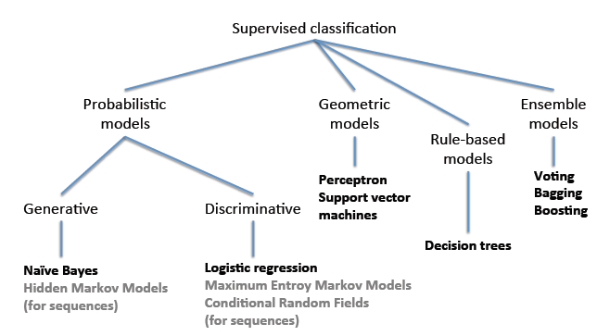
Classification Methods

Slide 27
Classification Methods
There is no “best” method. Methods can be selected based on metrics (accuracy, precision, recall, F-measure), speed, robustness, scalability, and robustness.
We will cover some of the more classic and state-of-the-art techniques in the following slides, including:
  Logistic/logit Regression
  Decision Tree
  Random Forest
  Naïve Bayes
  K-Nearest Neighbor
  Support Vector Machine (SVM)

Slide 28
Logistic/Logit Regression
There are many important research topics for which the dependent variable is "limited."
For example: whether or not a person smokes, or drinks, or skips class, or takes advanced mathematics. For these the outcome is not continuous or distributed normally.
  Example: Are mother’s who have high school education less likely to have children with IEP’s (individualized plans, indicating cognitive or emotional disabilities)
Binary logistic regression is a type of regression analysis where the dependent variable is a dummy variable (or as class): coded 0 (did not smoke) or 1 (did smoke)

Slide 29
Problems with Linear Regression
The linear regression line seems to oversimplify the (binary) relationship;
Value of Y cannot be represented correctly for extreme values of X.
Y
X

Slide 30

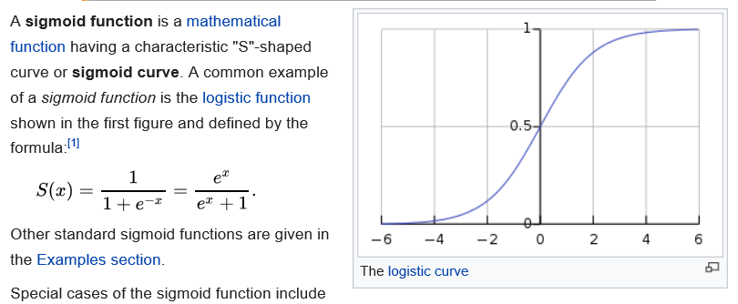
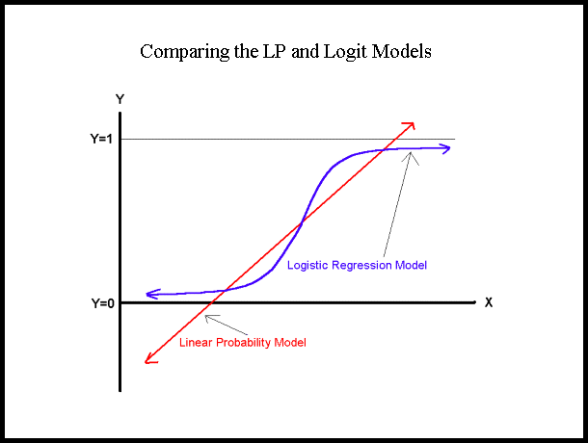
A logistic function or SIGMOID function

Slide 31
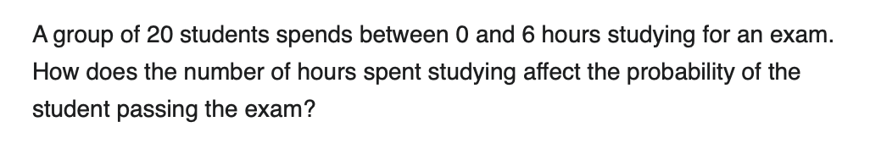
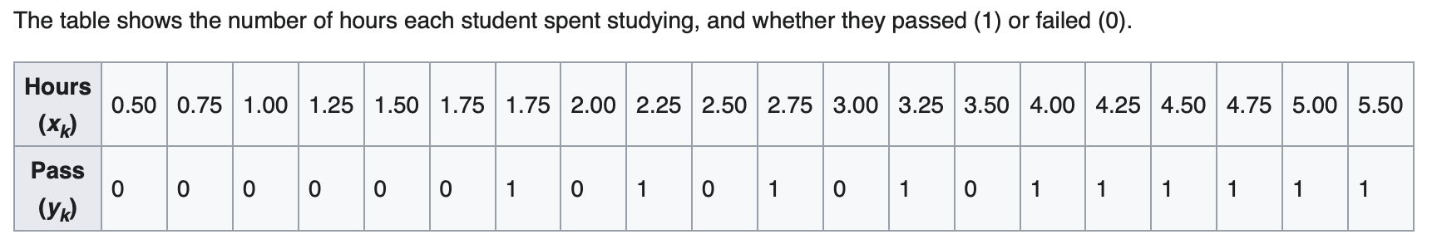
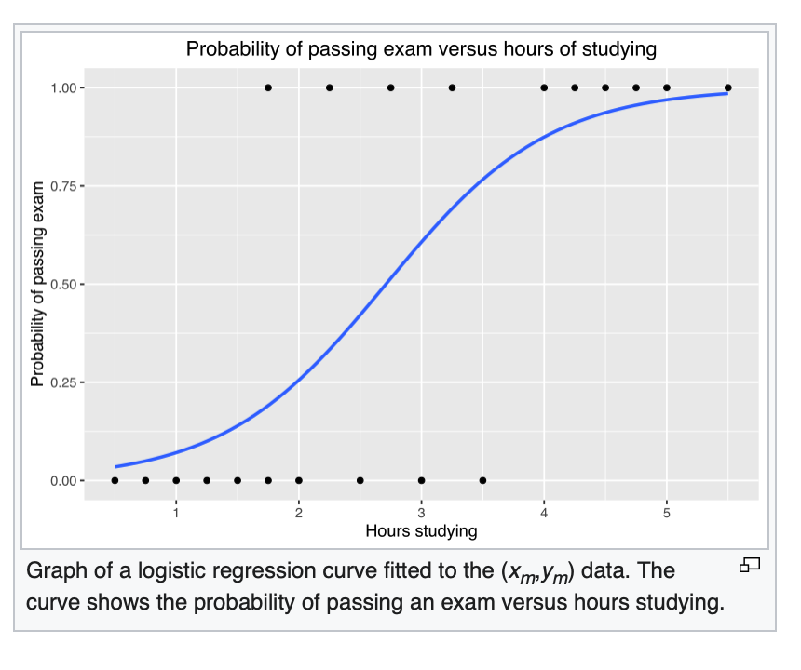
An Example (Wikipedia)
Questions:
For a student who studies 2 hours, what’s his probability of passing?
For a student who studies 3.75 hours, what’s his probability of passing?

Slide 32
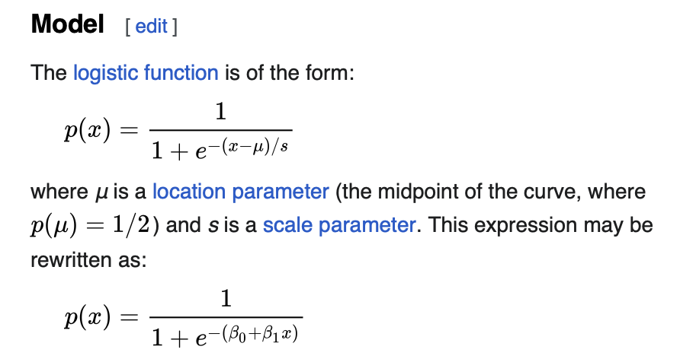
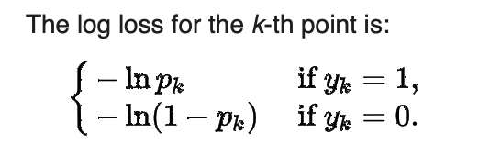
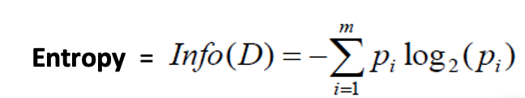
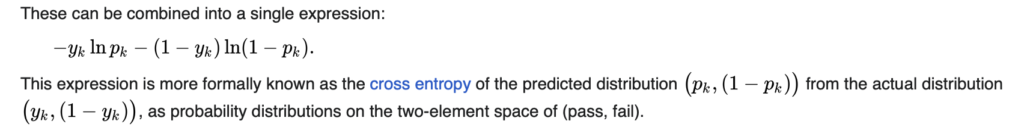
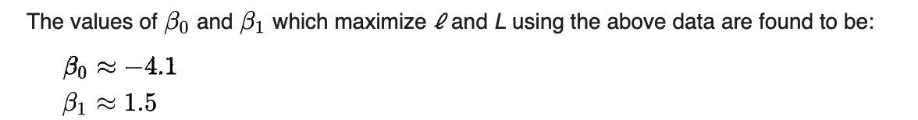
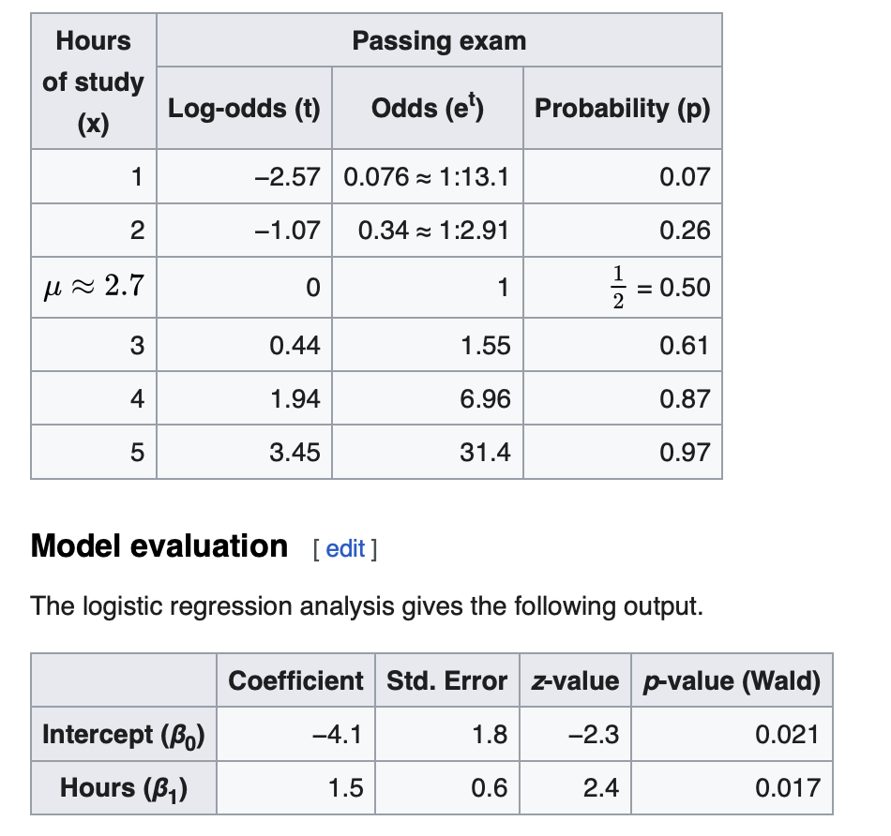
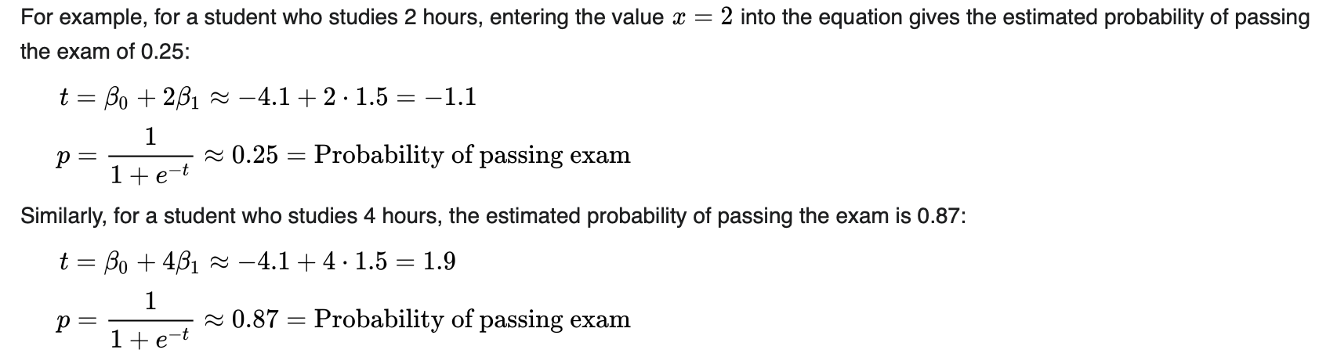
The Model/Solution

Slide 33

The Logistic Regression Model
The "logit" model solves these problems:
ln[p/(1-p)] = β₀ + β₁X
p is the probability that the event Y occurs, p(Y=1)
  [range=0 to 1]
p/(1-p) is the "odds ratio"
  [range=0 to ∞]
ln[p/(1-p)]: log odds ratio, or "logit“ (logistic unit)
  [range=-∞ to +∞]

Slide 34
Interpreting logistic function
The logistic distribution constrains the estimated probabilities to lie between 0 and 1.
The estimated probability is:
p = 1/[1 + e⁻⁽β₀ + β₁X⁾]
if you let β₀ + β₁X = 0, then p = .50
as β₀ + β₁X gets really big, p approaches 1
as β₀ + β₁X gets really small, p approaches 0

Slide 35
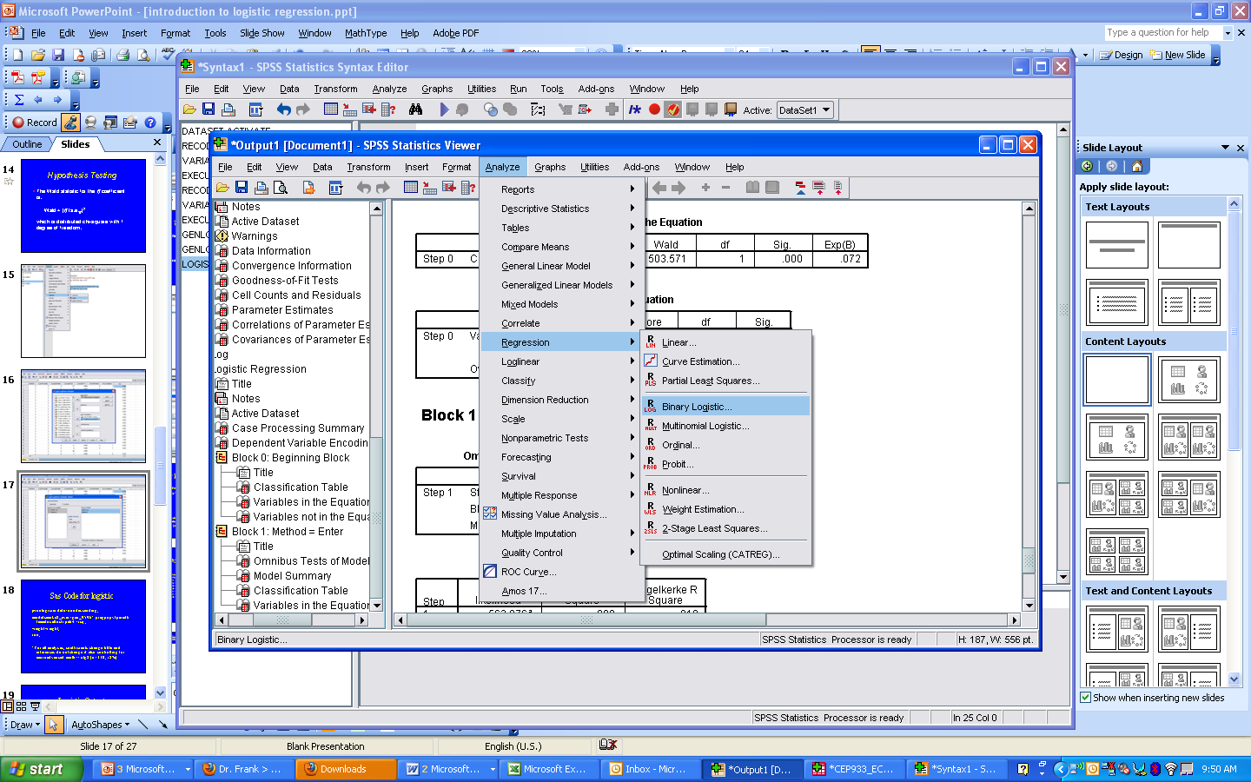
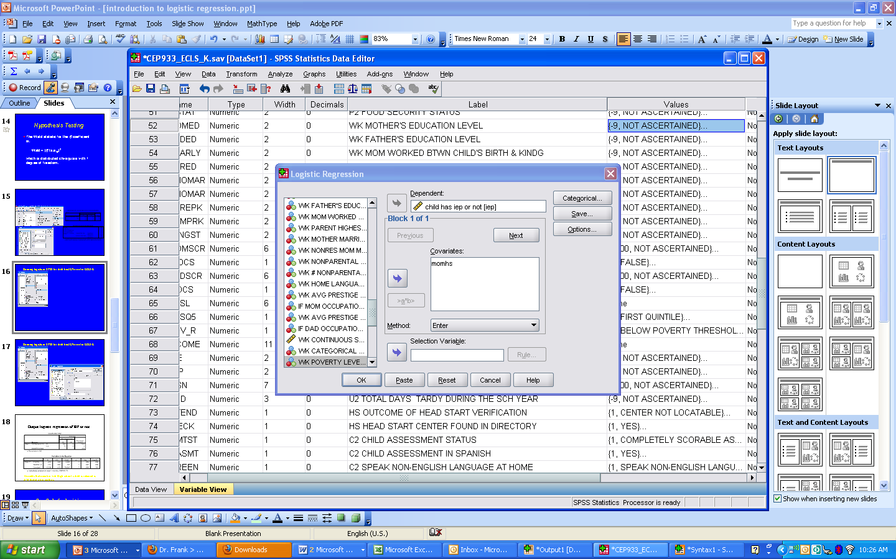
Running Logistic Regression in SPSS

Slide 36
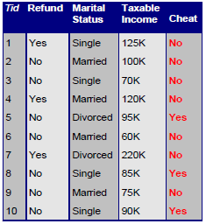
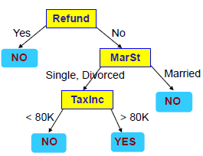

Decision Tree
A decision tree algorithm iteratively creates a tree by selecting the “best” attribute to classify the records.

Slide 37
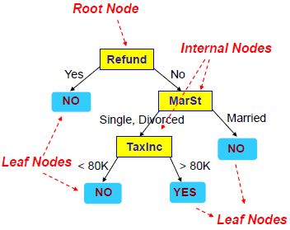
Decision Tree – Example
The top most node in a tree is the root node.
An internal node is a test on an attribute.
A leaf node represents a class label.
A branch represents the outcome of the test.

Slide 38
Building a Decision Tree
There are many algorithms to build a Decision Tree (ID3, C4.5, CART, SLIQ, SPRINT, etc).
Basic algorithm (greedy)
  Tree is constructed in a top-down recursive divide-and-conquer manner
  At start all the training records are at the root
  Splitting attributes (and their split conditions, if needed) are selected on the basis of a heuristic or statistical measure (Attribute Selection Measure)
  Records are partitioned recursively based on splitting attribute and its condition
When to stop partitioning?
  All records for a given node belong to the same class
  There are no remaining attributes for further partitioning
  There are no records left

Slide 39
ID3 Algorithm
1) Establish Classification Attribute (in Table R)
2) Compute Classification Entropy.
3) For each attribute in R, calculate Information Gain using classification attribute.
4) Select Attribute with the highest gain to be the next Node in the tree (starting from the Root node).
5) Remove Node Attribute, creating reduced table R_{S}.
6) Repeat steps 3-5 until all attributes have been used, or the same classification value remains for all rows in the reduced table.

Slide 40
Building a Decision Tree – Splitting Attributes
Selecting the best splitting attribute depends on the attribute type (categorical vs continuous) and number of ways to split (2-way split, multi-way split).
We want to use a purity function (summarized below) that will help us to choose the best splitting attribute.
  WEKA will allow you to choose your desired measure.
Measure | Description | Pros | Cons
Information Gain (ID3/C4.5) | Chooses the attribute with the lowest amount of entropy (i.e., uncertainty) to classify a record | Fast, works well with few multivalued attributes | Biased towards multivalued attributes
Gain Ratio | Modification to Info gain that reduces its bias on high-branch attributes. Takes into account branch sizes. | More robust than Information Gain | Prefers unbalanced splits in which one partition is much smaller than the others
Gini Index | Used in CART, SLIQ | Golden standard in economics Incorporates all data | Biased towards multivalued attributes, has difficulty when # of classes is large

Slide 41


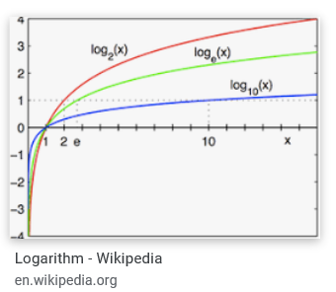
Entropy: a measure for degree of uncertainty (# of outcomes) or value of information
Entropy =
When P_{i} = 1/m,
Entropy
= - m x 1/m x [log₂ 1/m]
= log₂ m
X
X
X
O
O
X
O
Entropy
= log₂ 1
= 0
Entropy
= log₂ 2
= 1
Entropy
= log₂ 2
= 1
X
Entropy
= - [3/5 x log 3/5 + 2/5 x log 2/5]
= 0.971
X
O
X
O

Slide 42
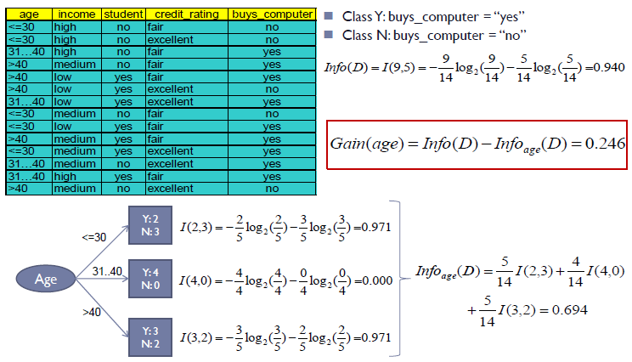
Information Gain Example

Slide 43
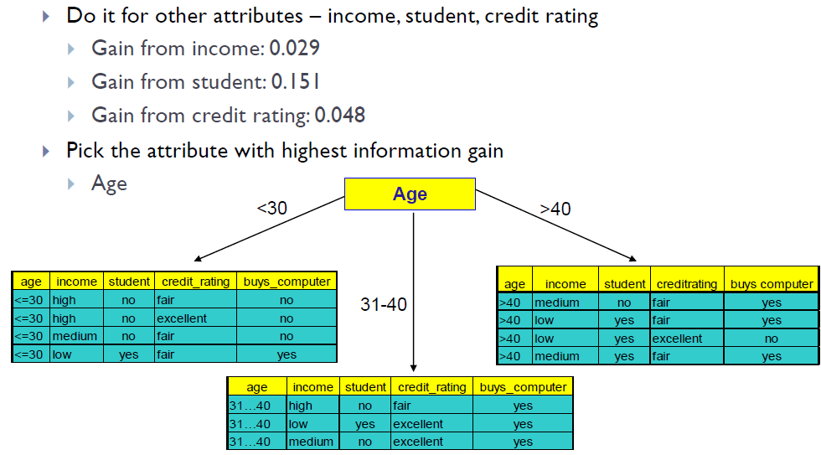
Information Gain Example (continued)

Slide 44
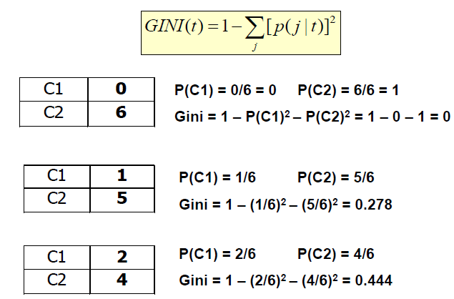
GINI Index Example

Slide 45
C4.5 Algorithm for Continuous Attributes
First sort on the values (v₁ to v_{m}) of the attribute A being considered, e.g., customer spending per month, greyhound’s past 7 races’ finishing time.
There are thus only m – 1 possible split points (midpoints; (v_{i} + v_{i+1} )/2) on A;all of which are examined to compute their respective entropy values.
Choose the “best” (based on information gain) split point for this attribute.
This continuous attribute A is then compared with other (continuous or categorical) attributes to find the “best” overall information gain. The ID3/C4.5 decision tree algorithm then selects this “best” attribute to divide the tree.

Slide 46
Building a Decision Tree - Pruning
A common issue with Decision Tree is overfitting. To address such an issue, we can apply pre and post-pruning rules.
  WEKA will give you these options.
Pre-pruning – stop the algorithm before it becomes a full tree. Typical stopping conditions for a node include:
  Stop if all records for a given node belong to the same class
  Stop if there are no remaining attributes for further partitioning
  Stop if there are no records left
Post-pruning – grow the tree to its entirety.
  Trim the nodes of the tree in a bottom-up fashion
  If error improves after trimming, replace sub-tree by a leaf node
  Class label of leaf is determined from majority class of records in sub-tree

Slide 47
Random Forest – Bagging
Before Random Forest, we must first understand “bagging.”
Bagging is the idea wherein a classifier is made up of many individual classifiers from the same family.
  They are combined through majority rule (unweighted)
Each classifier is trained on a bootstrapped sample with replacement from the training data.
  Each of classifiers in the bag is a “weak” classifier

Slide 48
Random Forest
Random Forest is based off of decision tree and bagging.
The weak classifier in Random Forest is a decision tree.
Each decision tree in the bag is using only a subset of features.
Only two hyper-parameters to tune:
  How many trees to build
  What percentage of features to use in each tree
Performs very well and can be implemented in WEKA!

Slide 49
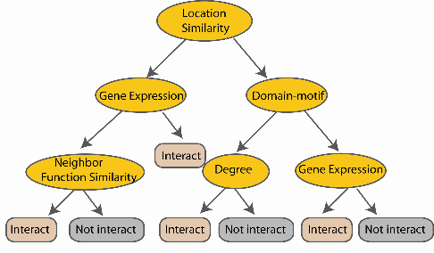
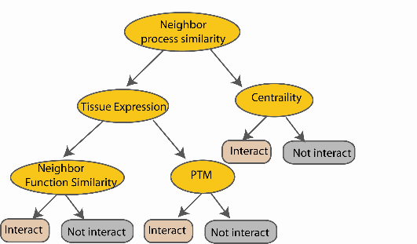
Random Forest
Create decision tree
from each
bootstrap sample
Create bootstrap samples
from the training data
M features
Take the majority vote
N examples
....…
....…

Slide 50
Naïve Bayes
Naïve Bayes is a probabilistic classifier applying Bayes’ theorem.
Assumes that the value of features are independent of other features and that features have equal importance.
  Hence “Naive”
Scales and performs well in text categorization tasks.
  E.g., spam or legitimate email, sports or politics, etc.
Also has extensions such as Gaussian Naïve Bayes, Multinomial Naïve Bayes, and Bernoulli Naïve Bayes.
  Naïve Bayes and Multinomial Naïve Bayes are part of WEKA

Slide 51
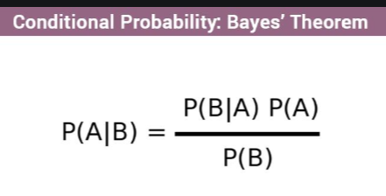



Naïve Bayes – Bayes Theorem
Naïve Bayes is based off of Bayes theorem, where a posterior is calculated based on prior events, likelihood, and evidence.
In Medical diagnosis: P(Disease|Symptom) = P(D) x P(S|D)/P(S)
Example – If a patient has Stiff Neck, what is the probability he/she has Meningitis (P(M|S)) given that:
  A doctor knows that meningitis causes stiff neck (P(S|M)) 50% of the time
  Prior probability of any patient having meningitis (P(M)) is 1/50,000
  Prior probability of any patient having stiff neck (P(S)) is 1/20
In English

Slide 52




Naïve Bayes – Approach to Classification
“If a 60-year old patient returned from Beijing, China to Tucson yesterday and has fever, nagging cough, and shortness of breadth, what is the probability that he has COVID-19?”
  Compute the posterior probability P(C | A₁ , A₂ , … , A_{n}) (with multiple evidence) for all values of C (i.e., class) using Bayes’ theorem.
  After computing the posteriors for all values, choose the value of C that maximizes:
  This is equivalent to choosing value of C that maximizes:
  The following equation equates to the first equation. It also illustrates the “naive” assumption that all attributes (A_{i}) are independent from each other.

Slide 53
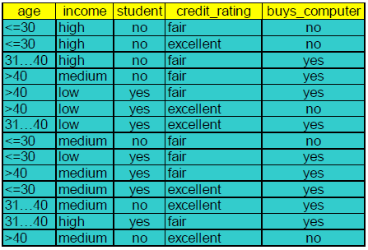



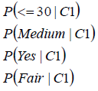
Naïve Bayes – Example

Slide 54
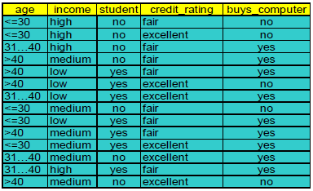
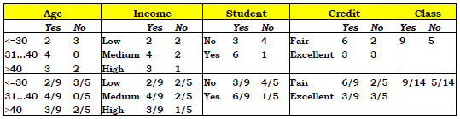
Naïve Bayes – Example

Slide 55
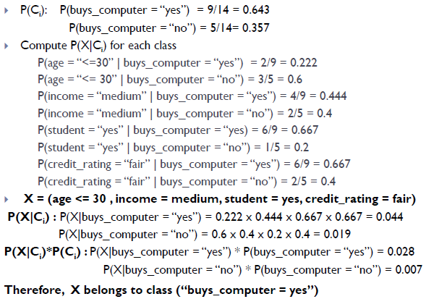
Naïve Bayes – Example

Slide 56
K-Nearest Neighbors
All instances correspond to points in an n-dimensional Euclidean space.
Classification is delayed till a new instance arrives.
Classification done by comparing feature vectors of the different points.
Target function may be discrete or real-valued

Slide 57
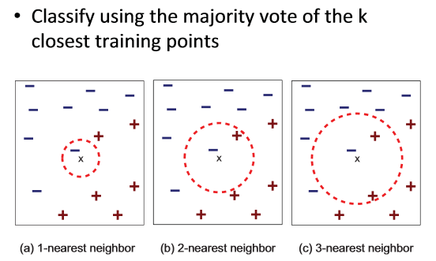
K-Nearest Neighbors

Slide 58
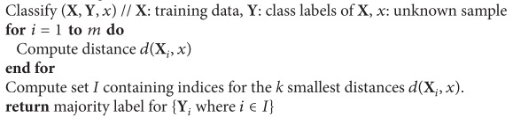
K-Nearest Neighbors Pseudocode

Slide 59
Support Vector Machine
SVM is a geometric model that views the input data as two sets of vectors in an n-dimensional space. It is very useful for textual data.
It constructs a separating hyperplane in that space, one which maximizes the margin between the two data sets.
To calculate the margin, two parallel hyperplanes are constructed, one on each side of the separating hyperplane.
A good separation is achieved by the hyperplane that has the largest distance to the neighboring data points of both classes.
The vectors (points) that constrain the width of the margin are the support vectors.

Slide 60

Support Vector Machine
Solution 1
Solution 2
An SVM analysis finds the line (or, in general, hyperplane) that is oriented so that the margin between the support vectors is maximized. In the figure above, Solution 2 is superior to Solution 1 because it has a larger margin.

Slide 61

Support Vector Machine – Kernel Functions
What if a straight line or a flat plane does not fit?
The simplest way to divide two groups is with a straight line, flat plane or an N-dimensional hyperplane. But what if the points are separated by a nonlinear region?
Rather than fitting nonlinear curves to the data, SVM handles this by using a kernel function to map the data into a different space where a hyperplane can be used to do the separation.
Nonlinear, not flat

Slide 62

Support Vector Machine – Kernel Functions
Kernel function Φ: map data into a different space to enable linear separation.
Kernel functions are very powerful. They allow SVM models to perform separations even with very complex boundaries.
  Some popular kernel functions are linear, polynomial, and radial basis.
  For data in a structured representation, convolution kernels (e.g., string, tree, etc.) are frequently used.
  While you can construct your own kernel functions according to the data structure, WEKA provides a variety of in-built kernels.

Slide 63


Support Vector Machine – Kernel Examples

Slide 64
Summary of Classification Methods
Classifier | Pros | Cons | WEKA Support?
Naïve Bayes | -Easy to implement -Less model complexity | -No variable dependency -Over simplification | Yes
Decision Tree | -Fast -Easily interpretable -Generally performs well | -Tend to overfit -Little training data for lower nodes | Yes
Random Forest | -Strong performance -Simple to implement | -Few hyper-parameters to tune -A little harder to interpret than decision trees | Yes
K-Nearest Neighbors | -Simple and powerful -No training involved | -Slow and expensive | Yes
Support Vector Machine | -Tend to have better performance than other methods -Works well on text classification -Works well with large feature set | -Can be computationally intensive -Choice of kernel may not be obvious | Yes

Slide 65
Outline
Introduction and Motivation
  Terminology
Regression
  Linear regression, hypothesis testing
  Multiple linear regression
Classification
  Decision Tree
  Random Forest
  Naïve Bayes
  K Nearest Neighbor
  Support Vector Machine
Evaluation metrics
Conclusion and Resources

Slide 66
Evaluation – Model Training
While the parameters of each model may differ, there are several methods to train a model.
  We want to avoid overfitting a model and maximize its predictive power.
There are two standard methods for training a model:
  Hold-out – reserve 2/3 of data for training and 1/3 for testing
  Cross-Validation – partition data into k disjoint subsets, train on k-1 partitions, test on remaining & run k times to get average, e.g., 10-fold validation is commonly used.
Many software (e.g., WEKA, RapidMiner) will do these methods automatically for you.

Slide 67
Evaluation
There are several questions we should ask after model training:
  How predictive is the model we learned?
  How reliable and accurate are the predicted results?
  Which model performs better?
We want our model to perform well on our training set but also have strong predictive power.
Fortunately, various metrics applied on the testing set can help us choose the “best” model for our application.

Slide 68

Metrics for Performance Evaluation
A Confusion Matrix provides measures to compute a models’ accuracy:
  True Positives (TP) – # of positive examples correctly predicted by the model
  False Negative (FN) – # of positive examples wrongly predicted as negative by the model
  False Positive (FP) - # of negative examples wrongly predicted as positive by the model
  True Negative (TN) - # of negative examples correctly predicted by the model

Slide 69

Metrics for Performance Evaluation
However, accuracy can be skewed due to a class imbalance.
Other measures are better indicators for model performance, e.g., recall, precision, F)
Statistical tests (t test, F test) cam be used to measure effect (significance levels of 1%, 5%, 10%)
Metric | Description | Calculation
Precision | Exactness – % of tuples the classifier labeled as positive are actually positive | $$= \frac{TP}{TP+FP}$$
Recall | Completeness – % of positive tuples the classifier actually labeled as positive | $$= \frac{TP}{TP+FN}$$
F-Measure | Harmonic mean of precision and recall | $$= \frac{2∗Recall∗Precision}{Recall+ Precision}$$

Slide 70


Metrics for Performance Evaluation
Models can also be compared visually using a Receiver Operating Characteristic (ROC) curve.
An ROC curve characterizes the trade-off between TP and FP rates.
  TP rate is plotted on the y-axis against FP rate on the x-axis
  Stronger models will generally have more Area Under the ROC curve (AUC).
TP
FP

Slide 71
Outline
Introduction and Motivation
  Terminology
Regression
  Linear regression, hypothesis testing
  Multiple linear regression
Classification
  Decision Tree
  Random Forest
  Naïve Bayes
  K Nearest Neighbor
  Support Vector Machine
Evaluation metrics
Conclusion and Resources

Slide 72
Conclusion
Regression and classification techniques can provide powerful predictive analytics techniques in Data Mining.
Linear and multiple regression provide mechanisms to predict specific data values.
Classification allows for predicting specific classes of output.
Many existing tools today can implement these techniques directly.
  SAS, SPSS
  WEKA, Rapidminer
  Mahout (Hadoop), Spark (MLlib)

Slide 73
References
Data Mining: Concepts and Techniques, 3rd Edition. JiaweiHan, Micheline Kamberand Jian Pei. Morgan Kaufmann
Introduction to Data Mining. Pang-Ning Tan, Michael Steinbach and Vipin Kumar. Addison-Wesley
Tay, B., Hyun, J. K., & Oh, S. (2014). A machine learning approach for specification of spinal cord injuries using fractional anisotropy values obtained from diffusion tensor images. Computational and mathematical methods in medicine, 2014.

Slide 74



Appendix: A Research Example (Chen et al., IEEE Expert, 1994)
Identifying important features
Identifying greyhound racing data

Slide 75


Appendix: A Research Example
Developing an ID3 decision tree
Developing a 3-layber backpropagation NN

Slide 76


Appendix: A Research Example
Testing prediction accuracy and payoffs
Performing statistical test, ANOVA (P = 8.3%)

