Slide 1

An Introduction to Transformers: Overview, Applications, and Implementations
Benjamin Ampel & Hsinchun Chen
Updated April 2023

Slide 2
Outline
Introduction
Baseline Transformer
  Overview
  Architecture
  Applications
    Implementation resources
    Transformer in the context of Cybersecurity research
Pre-Trained Language Models
  Overview
  BERT
    Implementation resources
  GPT-1/2/3
  DALL-E

Slide 3
Introduction
Prior to 2017, recurrent neural network (RNN) architectures (Long short-term memory, gated recurrent unit) had seen state-of-the-art performance for various natural language processing (NLP) tasks.
However, researchers noted a critical limitation of RNNs: Sequential computation became infeasible for long sequences and massive datasets.
  Reading inputs sequentially prevents parallelization in training.
  Reading inputs sequentially leads to “forgotten” past information (vanishing gradients).
In 2017, the Google Brain research team noted the success of attention mechanisms and built a new model known as the Transformer.
  This model has no convolutions or recurrence.
  The Transformer implements attention mechanisms to achieve state-of-the-art NLP performance.

Slide 4
Baseline Transformer - Overview
The baseline transformer is known as a sequence-to-sequence model.
  These models contain an encoder and decoder that are each a separate deep learning model that learn the latent representation of an input.
The encoder is composed of a multi-head attention block and a feed-forward layer.
  This block can attend to multiple positions of the input simultaneously, allowing for long-range dependency modeling.
The decoder is composed of a masked multi-head attention block and a multi-head attention block that needs to process both the decoder input and the encoder output (shown on the following slide).

Slide 5
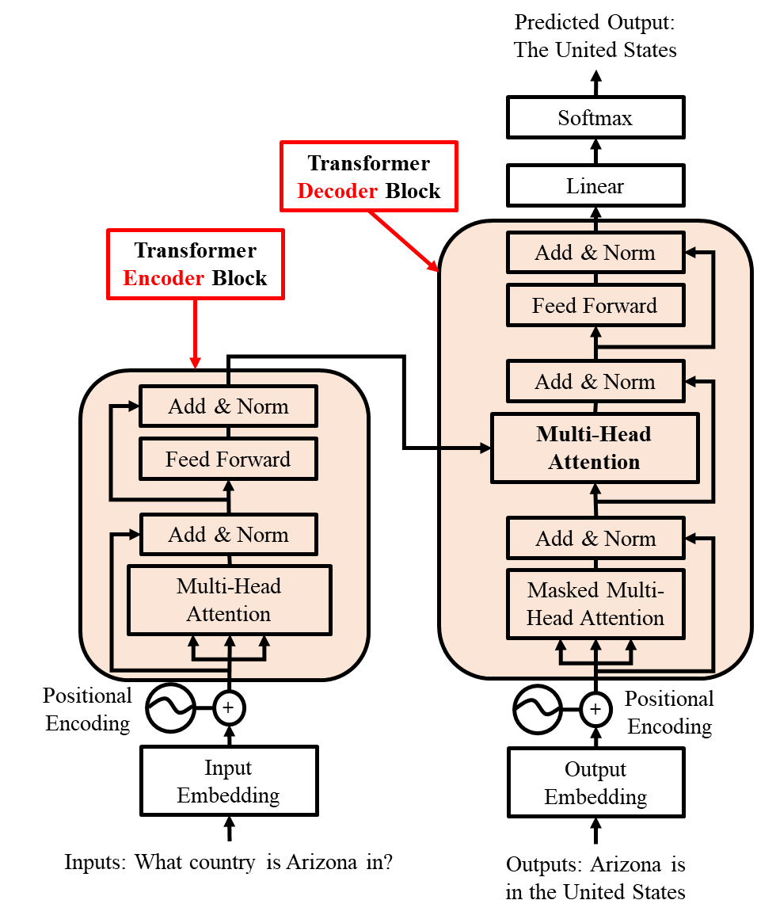
Baseline Transformer - Architecture
The encoder of the transformer is shown on the left side of Figure 1.
Each word (token) in the input is turned into a 512-length vector with encoded positional information.
The multi-head attention (MHA) layer processes the vectors and passes them to the MHA in the decoder.
The decoder is shown on the right side of Figure 1.
The decoder takes the output text as an input and processes like the encoder.
The masked multi-head attention processes the embedding, and the output is compared to the encoder output vectors.
The model learns what inputs correspond to what outputs.
Figure 1. Transformer Architecture

Slide 6
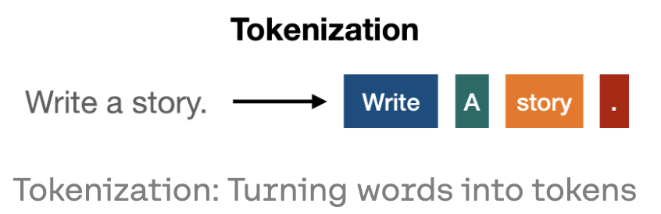
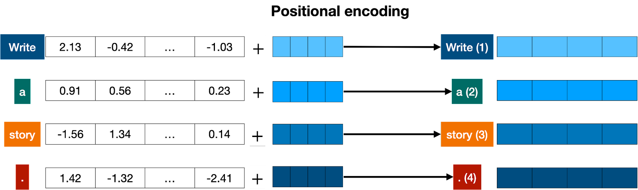
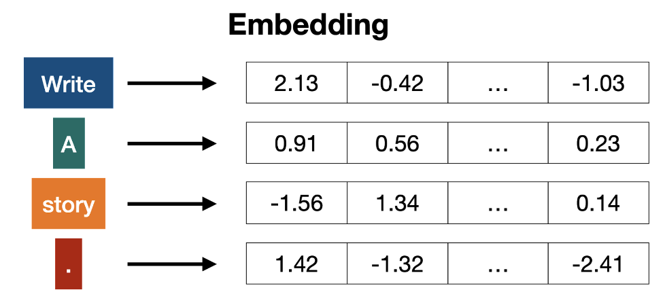
Baseline Transformer – Embedding and Encoding
1.
3.
Textual inputs are first tokenized, transforming sentences into individual tokens.
The position of each token in the sentence is added to the vector, such that sentences with the same words in a different order will have different vectors.
2.
The vectors with added positional encoding are considered a word embedding and are input into the Transformer model.
Tokens are transformed into vectors based on co-occurrence statistics (e.g., Word2Vec).

Slide 7
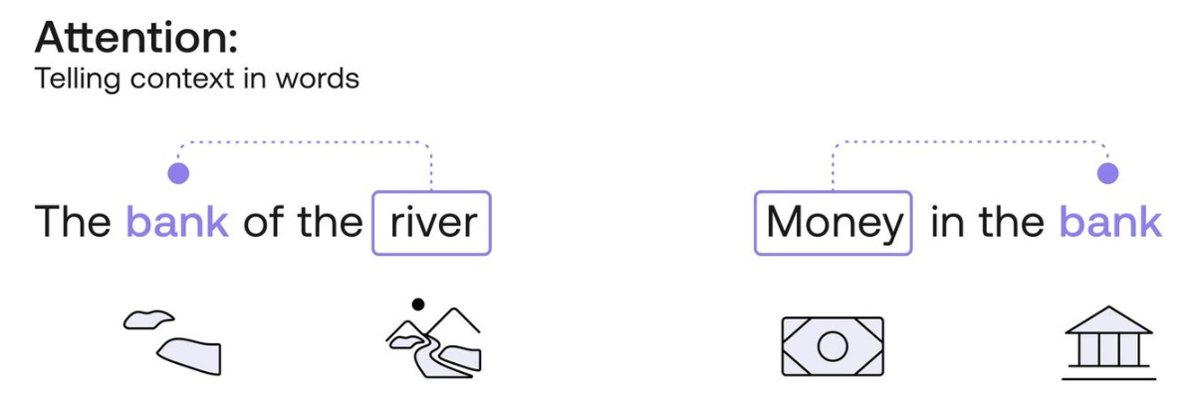
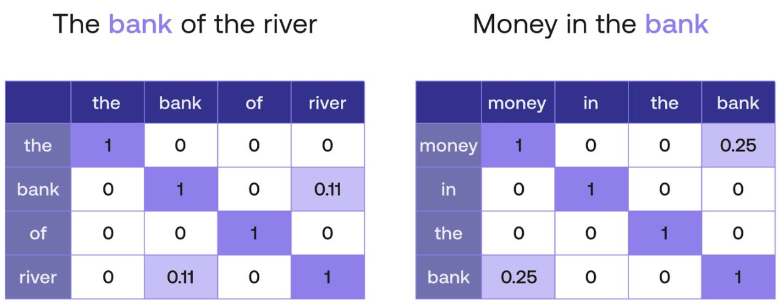
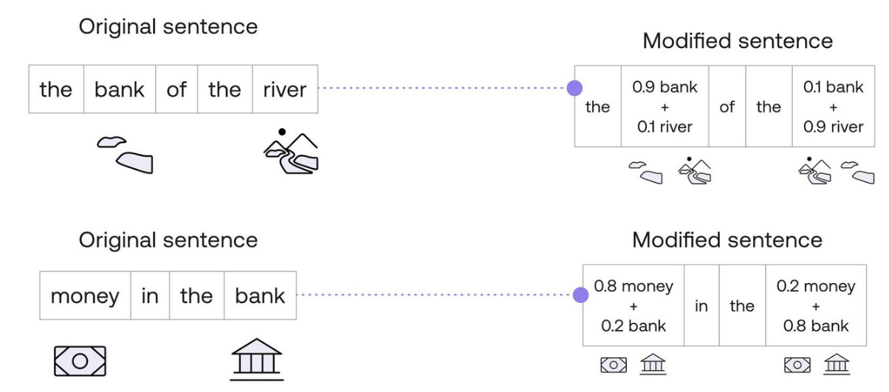
Baseline Transformer – Self-Attention
1.
In a transformer, the self-attention mechanism learns context.
  The word “bank” has numerous meaning depending on the context it is used.
  Self-attention can learn language context through repetition over billions of sentences.
2.
The self-attention mechanism uses the learned word embedding to calculate similarities in each sentence.
The self-attention mechanism will then used query, key, and value vectors to learn shared contexts (i.e., weights) between words.
3.
7

Slide 8
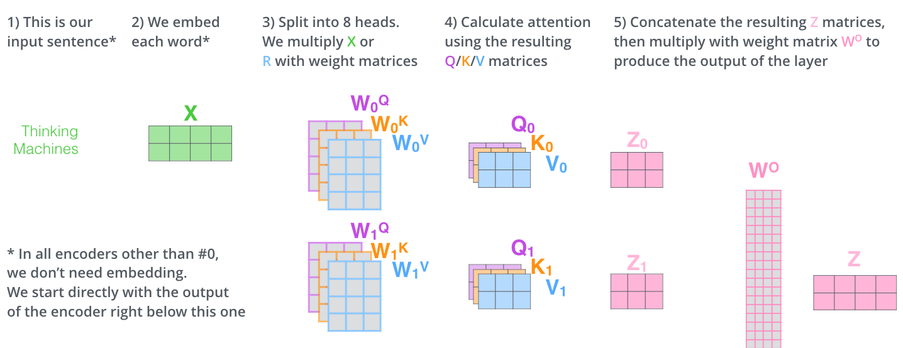
Baseline Transformer – Self-Attention
The input embedding is multiplied by a Query, Key, and Value matrix, which are learned weights.
The query is a feature vector that describes what token we are calculating for.
For each input token, there is a key, represented as a feature vector. The key describes how important the token is and can be considered the answer to the query.
For each input token, we also have a value feature vector.
To calculate attention weights, the query is compared to all keys with a score function (i.e., dot product). The value is generated by averaging the dot product of all sentence tokens to generate an output.

Slide 9
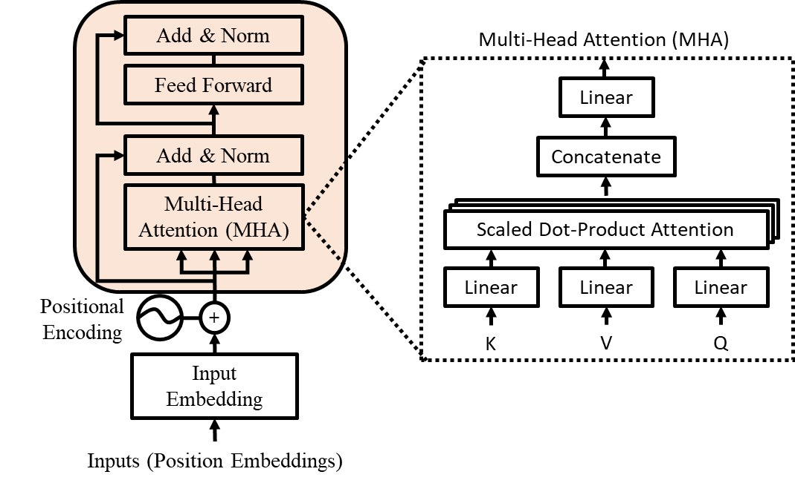
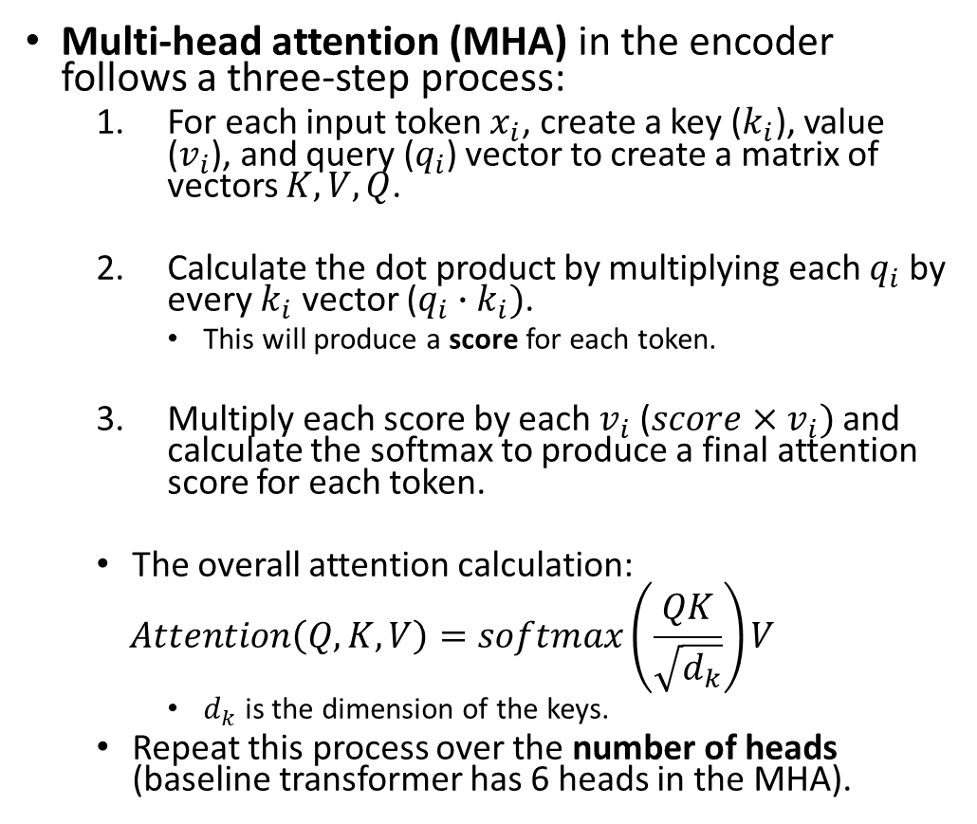
Baseline Transformer – Multi-head Attention
Multi-head attention (MHA) in the encoder follows a three-step process:
  For each input token $x_{i}$, create a key ($k_{i}$), value ($v_{i}$), and query ($q_{i}$) vector to create a matrix of vectors $K, V, Q$.
  Calculate the dot product by multiplying each $q_{i}$ by every $k_{i}$ vector ($q_{i}∙k_{i})$.
    This will produce a score for each token.
  Multiply each score by each $v_{i}$ ($score×v_{i})$ and calculate the softmax to produce a final attention score for each token.
  The overall attention calculation:
  $$Attention\left(Q, K, V\right)=softmax\left(\frac{QK}{\sqrt{d_{k}}}\right)V$$
    $d_{k}$ is the dimension of the keys.
  Repeat this process over the number of heads (baseline transformer has 6 heads in the MHA).
Figure 2. Transformer Encoder Architecture

Slide 10
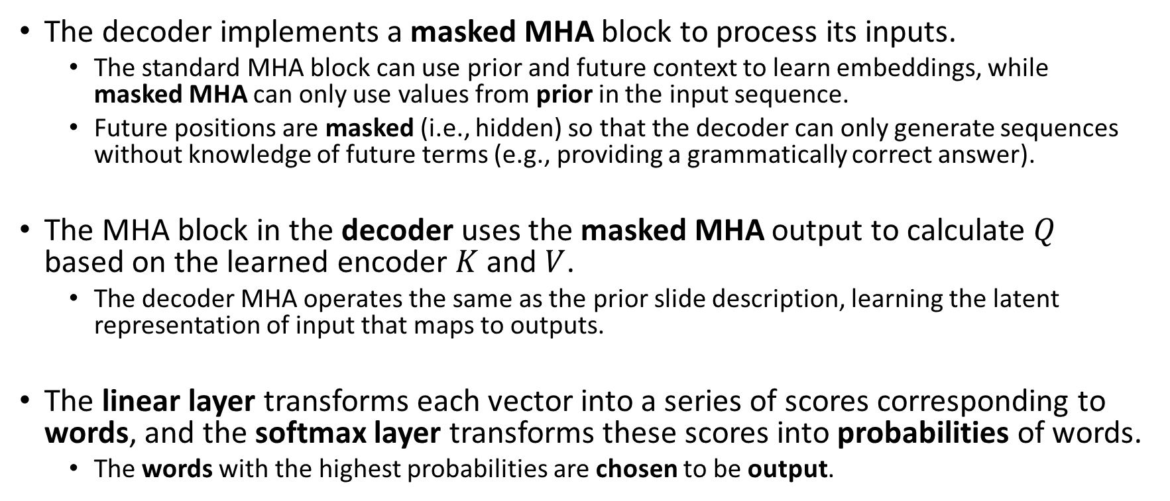
Baseline Transformer – Decoder Architecture
The decoder implements a masked MHA block to process its inputs.
  The standard MHA block can use prior and future context to learn embeddings, while masked MHA can only use values from prior in the input sequence.
  Future positions are masked (i.e., hidden) so that the decoder can only generate sequences without knowledge of future terms (e.g., providing a grammatically correct answer).
The MHA block in the decoder uses the masked MHA output to calculate $Q$ based on the learned encoder $K$ and $V$.
  The decoder MHA operates the same as the prior slide description, learning the latent representation of input that maps to outputs.
The linear layer transforms each vector into a series of scores corresponding to words, and the softmax layer transforms these scores into probabilities of words.
  The words with the highest probabilities are chosen to be output.

Slide 11
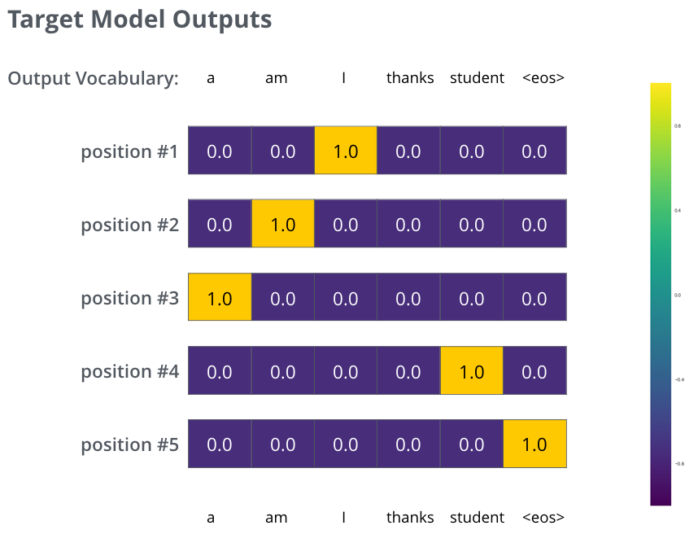
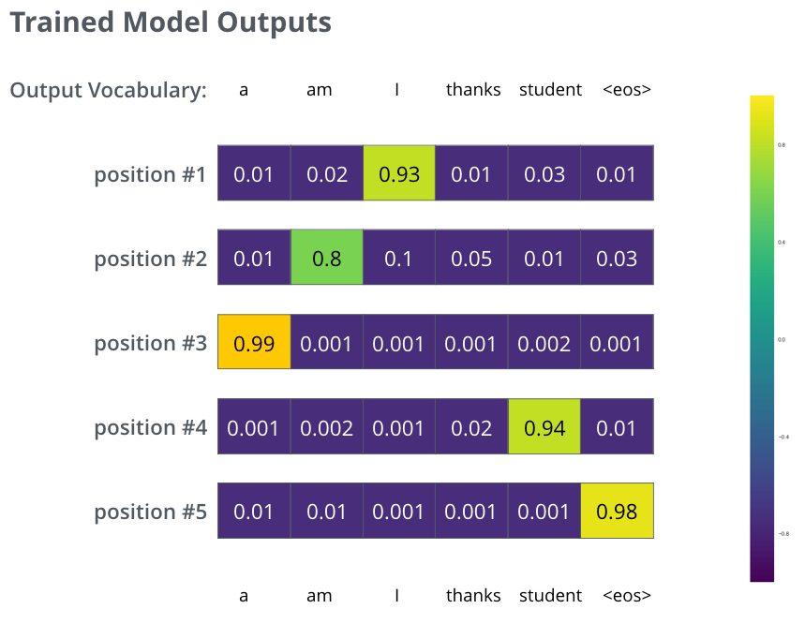
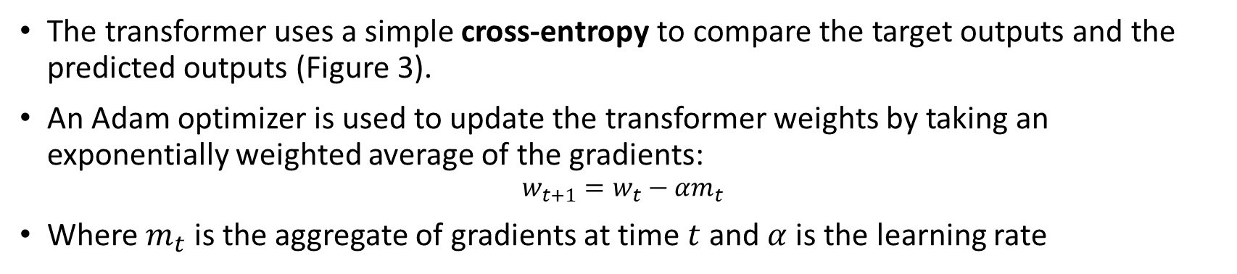
Baseline Transformer – Loss Function
The transformer uses a simple cross-entropy to compare the target outputs and the predicted outputs (Figure 3).
An Adam optimizer is used to update the transformer weights by taking an exponentially weighted average of the gradients:
$$w_{t+1}=w_{t}−{αm}_{t}$$
Where $m_{t}$ is the aggregate of gradients at time $t$ and $α$ is the learning rate
Figure 3. Transformer Output Example (from https://jalammar.github.io/illustrated-transformer/)

Slide 12
Baseline Transformer – Applications
Upon release, the Transformer model achieved state-of-the-art performance in:
  Machine Translation: Translating an English input into French or German.
  Question Answering: Given an input question, output a relevant answer.
  Text Summarization: Given an input paragraph, produce a high-quality summary sentence.

Slide 13
Baseline Transformer – Keras Implementation
The Keras (seminal Python deep learning package) team has created tutorial code to build a transformer model for text classification in a Google CoLab Notebook.
  That code can be found here.
The Keras team has created tutorial code to build a transformer model for time-series analysis in a Google CoLab Notebook.
  That code can be found here.

Slide 14
Baseline Transformer – Research Outputs
The following slides provide an example of how the transformer can be adapted and updated for research outputs.
  For this work, the transformer encoder was adapted for a multi-label classification task.
Paste sites are valuable sources for proactive cyber threat intelligence as they hold pertinent information regarding future threats and prior breaches.
  Although cybersecurity risk management frameworks (CRMFs) and CTI are individually valuable for cybersecurity, no prior research has investigated how utilizing a CRMF (e.g., MITRE ATT&CK) along with paste site data can fuse CTI.
Automatically mapping exploit code from paste sites to ATT&CK Techniques can fuse adversary threat intelligence which may be used for prevention and detection abilities across organizations.

Slide 15
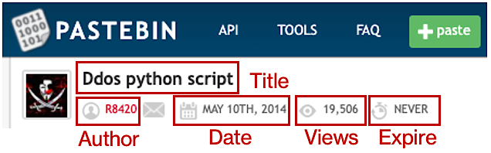

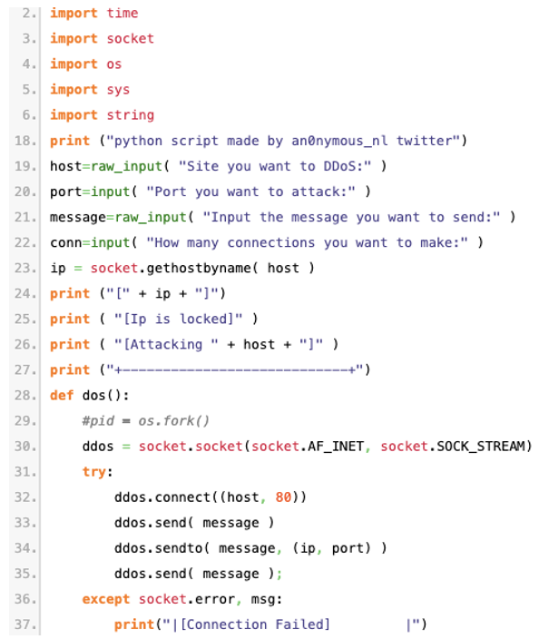



Baseline Transformer – Research Outputs
Tactics
Resource Development
Impact
Defense Evasion
Acquire Infrastructure
Sys. Shutdown
BITS Job
Compromise Accounts
Data Destruction
Build Image on Host
Compromise Infras.
Data Encrypted
Deploy Container
Develop Capabilities
Data Manipulation
Hide Artifacts
Establish Accounts
Defacement
Execution Guardrails
Techniques
Obtain Capabilities
Disk Wipe
Modify Registry
Stage Capabilities
Service Stop
Service Stop
Network DoS
Masquerading
Endpoint DoS
Pre-OS Boot
Process Injection
Impair Defenses
Figure 4. Mapping a Sample Distributed Denial of Service (DDoS) exploit code from Pastebin to multiple MITRE ATT&CK Techniques under Separate Tactics.
Labeling paste site source code to multiple techniques can help organizations identify gaps in their current security posture as well as understand the technical aspects of an adversary's attack lifecycle.
Our objective in this study is to develop a novel multi-label classification (MLC) method that automatically maps lengthy source code from paste sites to the ATT&CK CRMF to aid proactive CTI.

Slide 16


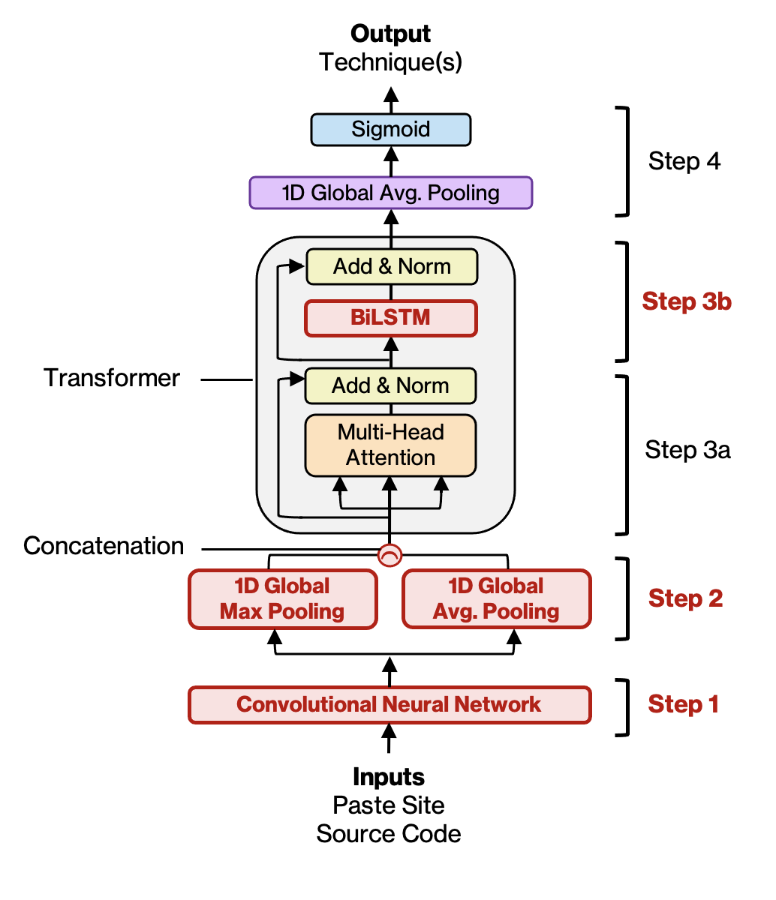







Baseline Transformer – Research Outputs
To complete the objective, we propose a research framework with three major components, as presented in Figure 5.
Data Collection & Pre-processing
Proposed CBT Model
Experiments & Case Study
Experiments 1 & 2:
Benchmark ML and DL Models
Public Repos
Gold-Standard
(Public Repos)
Experiment 3:
Benchmark Ablation Analysis
Classify
Source
Code
Preprocess:
remove stop words, URLs, special characters, and stem
Unlabeled Pastes
(Paste Sites)
Case Study
Identify Adversarial Trends and
Behaviors on Paste Sites
Proposed CBT* Model
Figure 5. Proposed Research Design
Note: CBT= Convolutional Bidirectional Long Short-Term Memory Transformer, DL = Deep Learning, ML = Machine Learning

Slide 17
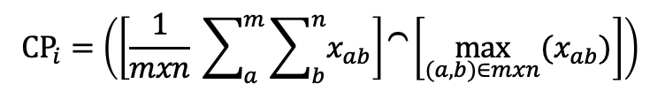
Baseline Transformer – Research Outputs
Step 1 CNN: Pass input data to a Convolutional Neural Network (CNN) layer.
  The CNN layer comes before the Transformer block and collects low and high-level features as encoded representations without using positional encodings.
  The transformer learns from CNN’s local feature representation which offers relative positional information required for discovering long-range relationships between local concepts.
Step 2 Concatenated Pooling (CP): Pass the CNN output to a Global Max Pooling (GMP) and Global Average Pooling (GAP) for concatenation.
  Multiple pooling’s reduce the sequence of feature vectors and extract context from both inconclusive and fine details of data.
  Our CP is calculated as:
  where (a, b) is a pixel index, x is an index of the channels, m is the number of rows, and n is the number of columns.
Step 3 Transformer: Pass concatenated pooling to a transformer block.
  3a. Goes through multi-head attention and normalization layers.
  3b. Next, we pass the output to a fully connected BiLSTM layer, replacing the FF layer in the standard transformer model.
    Replacing FF with a BiLSTM layer will help induce internal memory and capture word orders via a feedback loop from input to output.
Step 4 Output: Sigmoid activation function produces multi-label outputs.
Figure 6. Proposed Convolutional BiLSTM Transformer (CBT) Model

Slide 18
Baseline Transformer – Research Outputs
Our CBT model significantly outperformed RF, the highest performing ML model, in F1-Score (79.54% to 52.21%) and Hamming Loss (1.59% to 3.36%).
  Non-DL-based models are incapable of generalizing long sequential dependencies, resulting in information loss and a higher rate of error.
Our CBT model also outperformed CNN, the highest performing DL model, in Accuracy (78.57% to 76.29%), Recall (70.62% to 65.04%), F1-Score (79.54% to 73.97%), and Hamming Loss (1.59% to 1.72%), and underperformed in Precision by 4.9%.
  Since CNN does not include multiple architectural components, it concentrates on the relevant pixel properties, which boosts model stability and overall precision compared to our CBT model.
  The results suggest our CBT model’s use of a convolutional layer with multiple pooling’s helps discover locality and latent features of the source code over the CNN model, resulting in lower hamming loss.
Type | Model | Accuracy | Precision | Recall | F1-Score | HL*
Experiment 1: Machine Learning Models | LR | 4.06% | 43.32% | 46.81% | 37.42% | 13.48%
 | SVM | 1.00% | 41.85% | 20.17% | 24.91% | 3.72%
 | KNN | 10.36% | 68.01% | 34.09% | 40.75% | 3.56%
 | LightGBM | 8.63% | 70.59% | 44.97% | 49.37% | 3.50%
 | DT | 13.42% | 65.58% | 42.02% | 46.64% | 3.41%
 | RF | 13.92% | 73.82% | 45.87% | 52.21% | 3.36%
Experiment 2: Deep Learning Models | RNN | 42.32% | 49.34% | 20.36% | 28.65% | 3.82%
 | GRU | 57.24% | 64.07% | 49.19% | 55.11% | 2.98%
 | LSTM | 58.93% | 66.82% | 48.78% | 56.16% | 2.87%
 | BiLSTM | 59.41% | 68.48% | 51.90% | 58.90% | 2.73%
 | BiLSTM w/ Attention | 66.19% | 73.94% | 52.13% | 61.28% | 2.52%
 | Transformer | 69.27% | 73.32% | 65.04% | 68.96% | 2.23%
 | CNN | 76.29% | 86.39% | 65.04% | 73.97% | 1.72%
Experiment 3: Ablation Analysis | Transformer w/ BiLSTM | 69.54% | 74.21% | 64.82% | 69.22% | 2.19%
 | CNN + Transformer w/ BiLSTM | 72.10% | 75.42% | 61.84% | 76.88% | 2.01%
 | CBT (Ours) | 78.57% | 81.49% | 70.62% | 79.54% | 1.59%
Table 1. Summary of Experiment 1, 2, and 3 Results
*Note: BiLSTM = Bidirectional Long-Short Term Memory, CNN = Convolutional Neural Network, DT = Decision Tree, GRU = Gated Recurrent Unit, KNN = K-Nearest Neighbor, LightGBM = Light Gradient Boosting Machine, LR = Logistic Regression, LSTM = Long Short-Term Memory, RF = Random Forest, RNN = Recurrent Neural Network, SVM = Support Vector Machines.

Slide 19
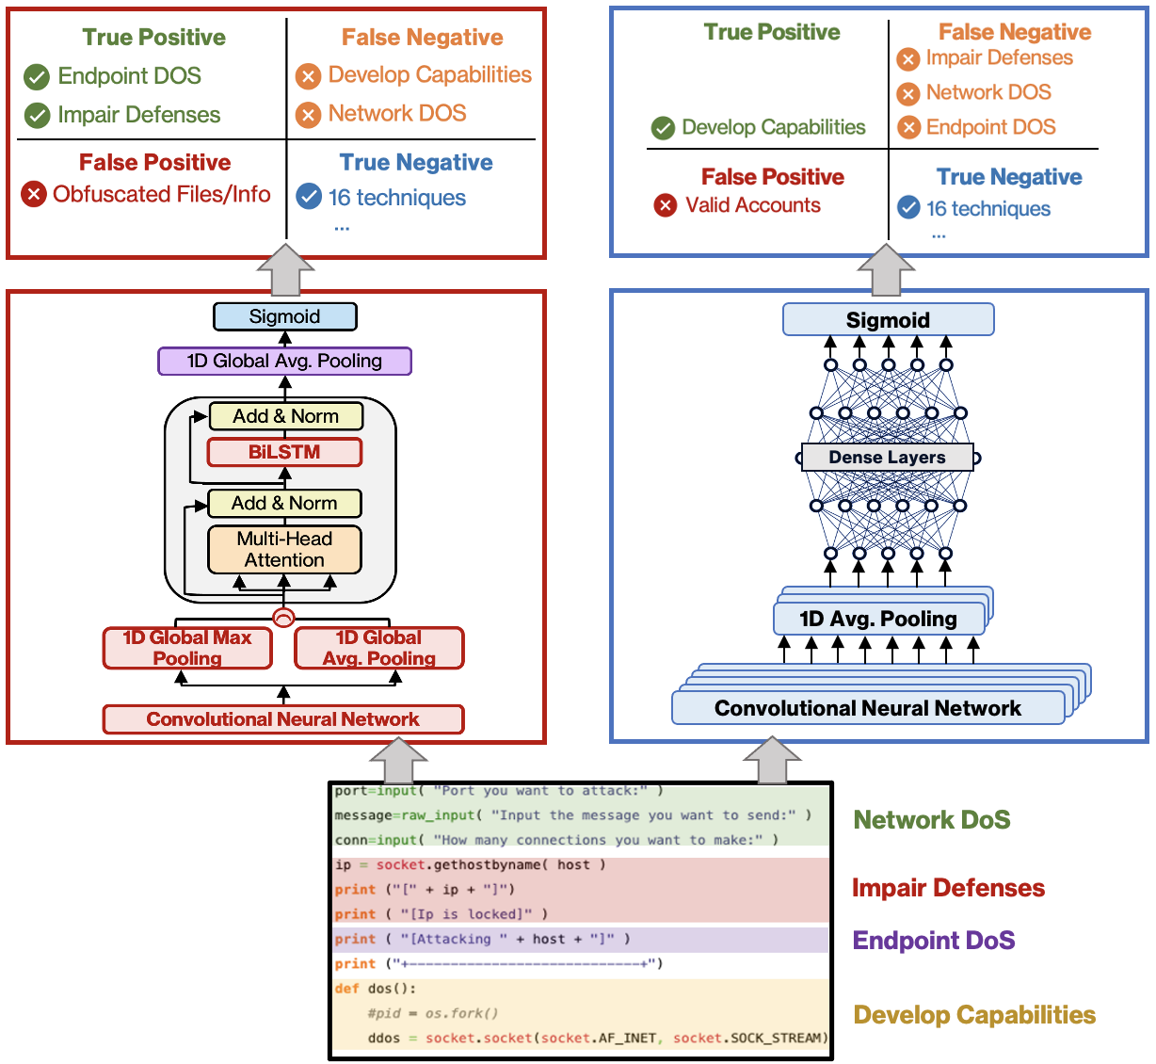
Baseline Transformer – Research Outputs
Our CBT Model
CNN Model
Figure 7 illustrates an end-to-end comparison between our CBT model and CNN, the next best performing DL model.
Our CBT model correctly mapped the DDoS paste to the Endpoint DoS and Impair Defenses techniques; however, it incorrectly mapped the paste to Obfuscated Files/Information.
The CNN model, on the other hand, correctly mapped the DDoS paste to the Develop Capabilities technique and incorrectly mapped it to the Valid Accounts technique.
In comparison to the CNN model, our model's coupling of a convolutional layer with multiple pooling’s and a BiLSTM pair-wise function resulted in less than 1.6% of error due to its focus on long-term dependencies of source code.
Figure 7. Illustration of Our CBT Model (On the Left in Red) and CNN, The Next
Best Performing Model (On Right In Blue) Processing a Pastebin DDoS Script.

Slide 20
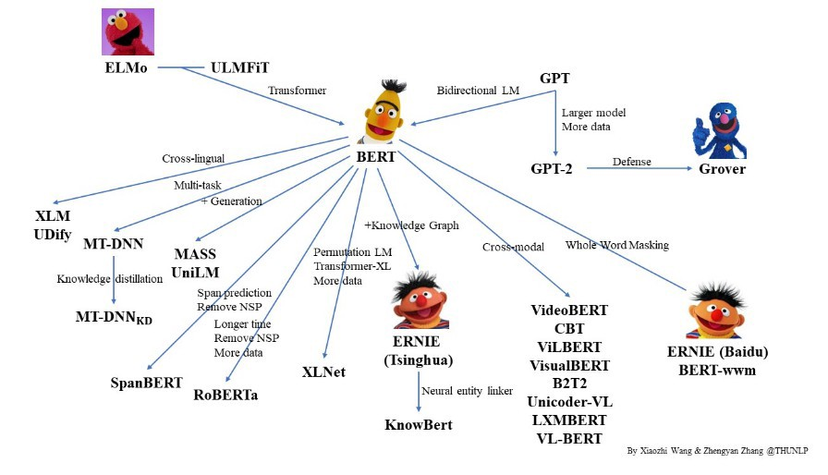
Pre-Trained Language Models
Figure 8. Different Types of Pre-Trained Models

Slide 21
Pre-Trained Language Models - Overview
Historically, NLP models often required labeled datasets and large computational power to train.
  Labeled datasets require tremendous resources to create, restricting the scalability of NLP models.
  Additionally, these trained NLP models could only be used for task they were trained on, restricting their generalizability.
The field of deep transfer learning (DTL) helped alleviated some of these concerns.
  NLP models were trained on some task (e.g., sentiment analysis), and then the model parameters were transferred to a different model for a similar task (e.g., multi-class text classification).
  However, DTL could not alone alleviate the scalability and generalizability concerns of NLP research.

Slide 22
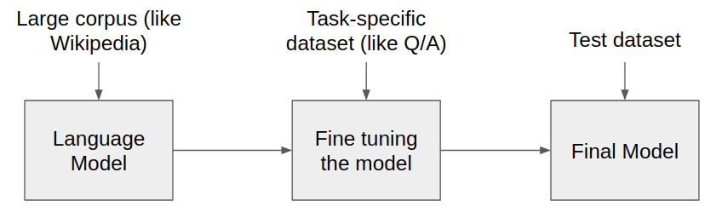
Pre-Trained Language Models - Overview
Two key research outputs led to the creation of massive pre-trained language models (PTLMs), which are often language task agnostic:
  Transformers read the entire input sequence simultaneously, making them more efficient to train on massive datasets than RNN.
  Researchers discovered you could teach a model generalized language information by pre-training on a self-supervised multi-million record corpus, and then fine-tuning the model with task specific data (Figure 9).
Figure 9. General Pre-Trained Language Model Architecture

Slide 23
Pre-Trained Language Models - BERT
The Bidirectional Encoder Representations from Transformers (BERT) model was released in 2018 by Google’s AI Research team.
  BERT uses the encoder of Vaswani’s architecture with 24 transformer blocks, 16 attention heads, and 340 million parameters to pre-train a large language model.
  BERT is pre-trained on the BooksCorpus (74 million sentences from 11,038 books) and English Wikipedia (2.5 billion words).
  BERT jointly conditions on the left and right context of an input (like a bidirectional LSTM).

Slide 24
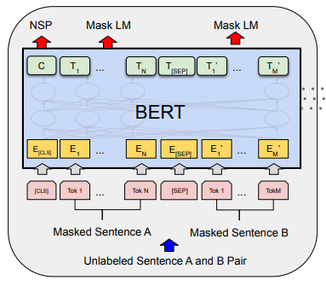
Pre-Trained Language Models - BERT
BERT uses two simultaneous pre-training strategies (Figure 10):
  Masked Language Modeling (Mask LM)
    A random word in a sentence is masked (i.e., hidden) from the model.
    A classification layer is placed on top of the encoder output.
    The model is trained to predict the masked word in the sequence.
  Next Sentence Prediction (NSP)
    The training dataset is split into two-sentence pairs; half the data are sentences that sequentially follow each other in the corpus, the other half is sentences that are unrelated.
    A classification layer is placed on top of the encoder output.
    The model is trained to predict if the second sentence follows the first.
Figure 10. BERT Training Strategies (from Devlin et al., 2018)

Slide 25
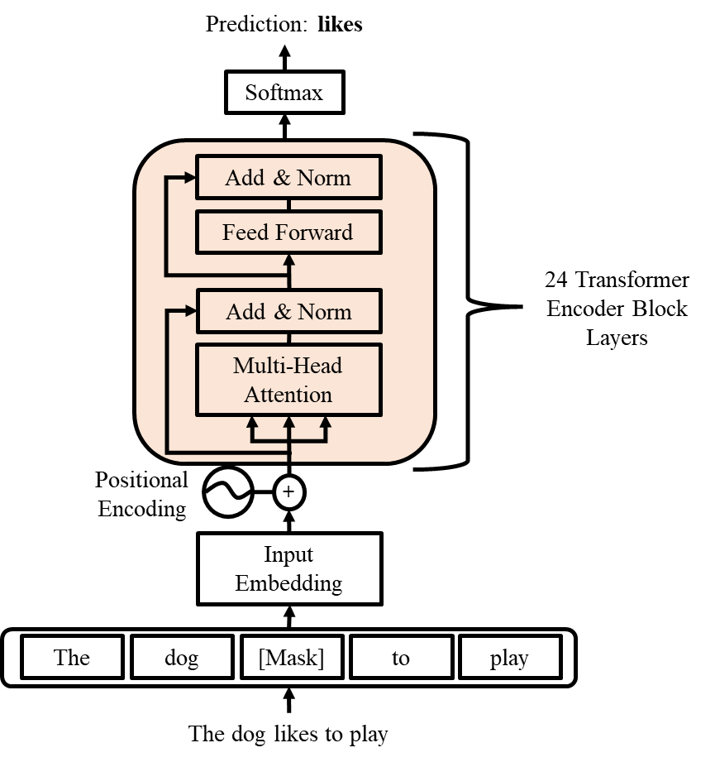
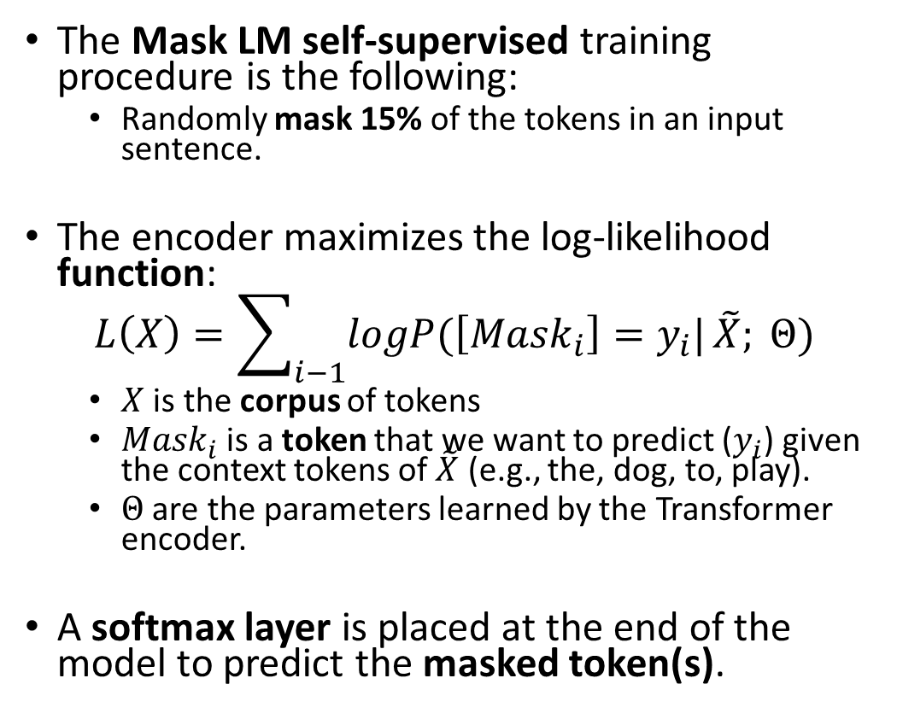
BERT – Masked Language Modeling
The Mask LM self-supervised training procedure is the following:
  Randomly mask 15% of the tokens in an input sentence.
The encoder maximizes the log-likelihood function:
$$L\left(X\right)=\sum_{i−1}{logP(\left[{Mask}_{i}\right]=y_{i}|}\tilde{X}; Θ)$$
  $X$ is the corpus of tokens
  ${Mask}_{i}$ is a token that we want to predict ($y_{i}$) given the context tokens of $\tilde{X}$ (e.g., the, dog, to, play).
  $Θ$ are the parameters learned by the Transformer encoder.
A softmax layer is placed at the end of the model to predict the masked token(s).
Figure 11. Mask LM Training Example

Slide 26
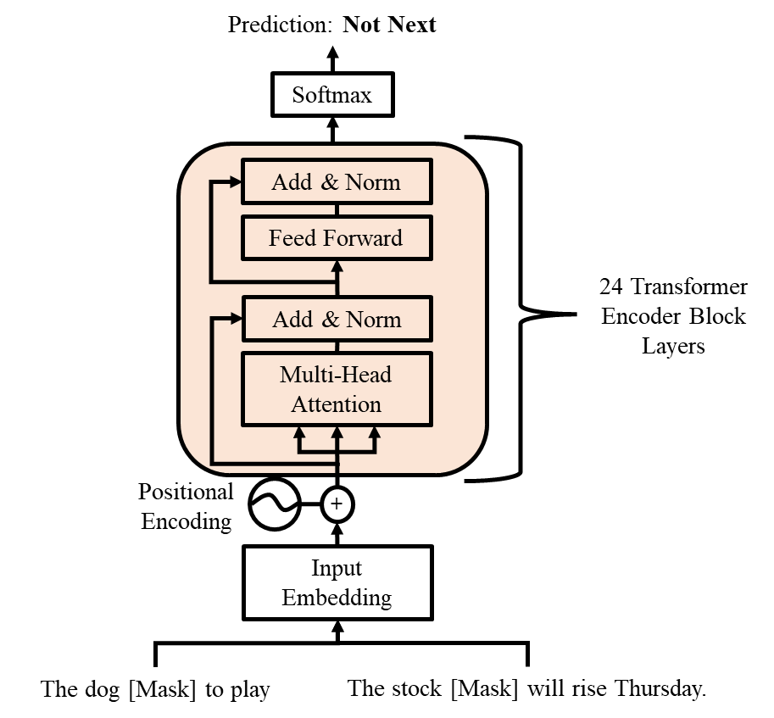
BERT – Next Sentence Prediction
Many language tasks require an understanding of the relationship between two sequences (e.g., question answering).
To discover this relationship, the authors use a self-supervised training procedure.
  The dataset is randomly split into sentence pairs that follow each other in the corpus and pairs that do not.
The task becomes simple binary classification (i.e., does the second sentence follow the first sentence? Yes/No).
Figure 12. NSP Training Example

Slide 27
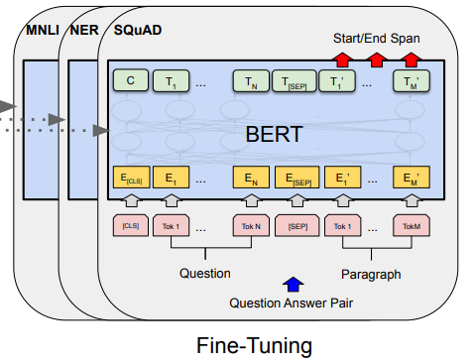
BERT – Fine-Tuning
Fine-tuning BERT (or any pre-trained language model) is the same process as training a normal model.
BERT is provided a set of inputs/output (e.g., Questions/Answers).
  Instead of training from scratch like a standard NLP model, BERT updates it’s known parameters.
The generalized knowledge that BERT learned in pre-training provided a large performance boost in 11 downstream seminal NLP tasks over models trained from scratch.
Figure 13: Fine-Tuning BERT
(from Devlin et al., 2018)

Slide 28
BERT – Huggingface Implementation
While we do not have the computational resources of Google to create our own BERT, we can still use the model for our research.
The Huggingface library makes fine-tuning BERT (and hundreds of other pre-trained language models) easy.
Dozens of CoLab tutorials on fine-tuning BERT for Text Classification, Question Answering, Summarization, and more can be found here.

Slide 29
Pre-Trained Language Models – GPT
The Generative Pre-Trained Transformer (GPT) model was released in 2018 by the OpenAI Research team.
  GPT uses the decoder of Vaswani’s architecture with 12 transformer blocks, 12 self-attention heads, and 117 million parameters to pre-train a large language model.
  GPT is pre-trained on the BooksCorpus (74 million sentences from 11,038 books).
  GPT uses an autoregressive (predicts future values based on past values) training strategy.
    The goal of GPT is to maximize the conditional probabilities of each token given prior tokens as context.

Slide 30
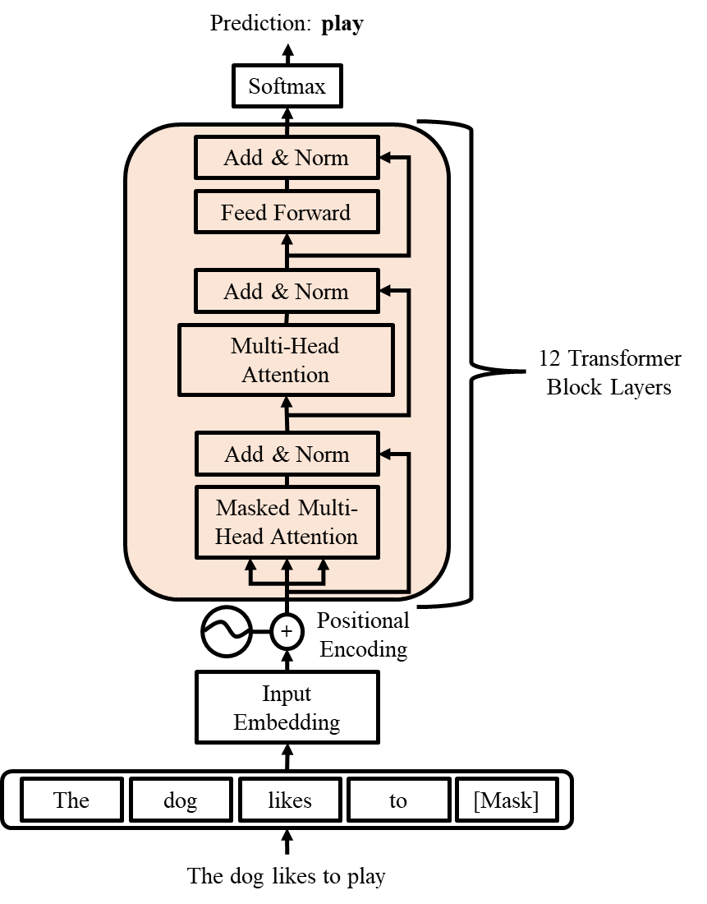
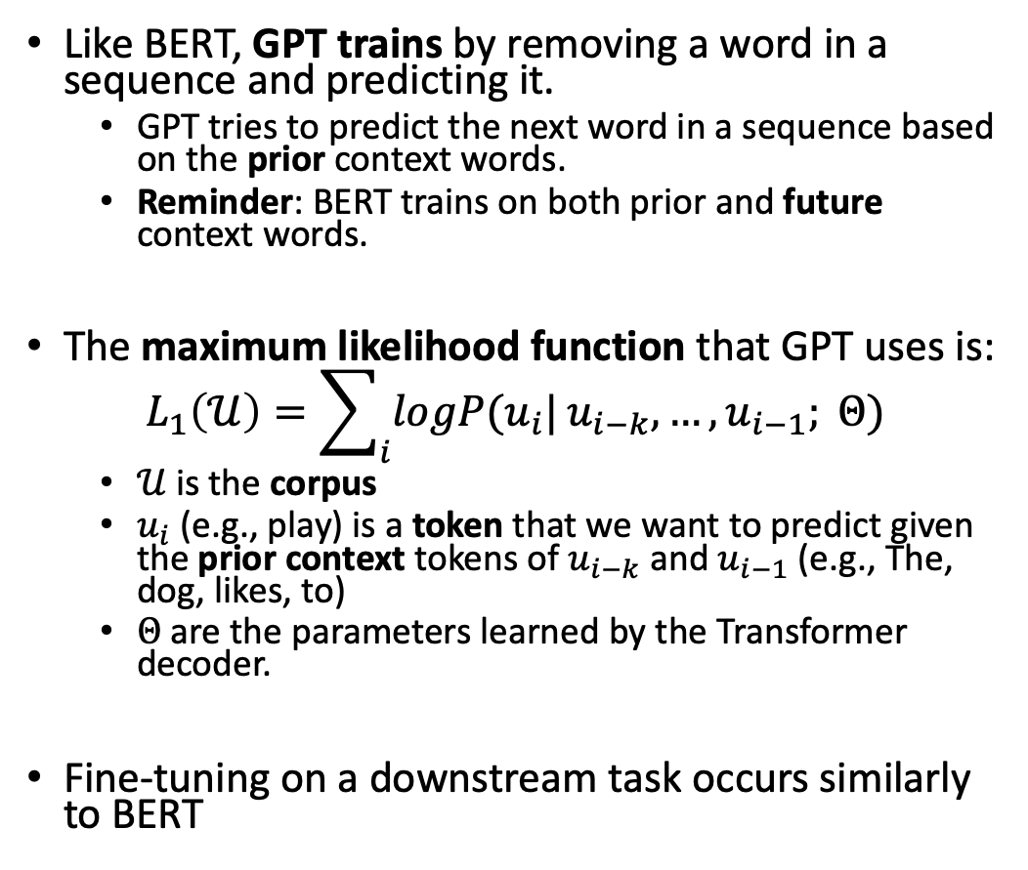
GPT - Architecture
Like BERT, GPT trains by removing a word in a sequence and predicting it.
  GPT tries to predict the next word in a sequence based on the prior context words.
  Reminder: BERT trains on both prior and future context words.
The maximum likelihood function that GPT uses is:
$$L_{1}\left(𝒰\right)=\sum_{i}{logP(u_{i}|}u_{i−k},…,u_{i−1}; Θ)$$
  $𝒰$ is the corpus
  $u_{i}$ (e.g., play) is a token that we want to predict given the prior context tokens of $u_{i−k}$ and $u_{i−1}$ (e.g., The, dog, likes, to)
  $Θ$ are the parameters learned by the Transformer decoder.
Fine-tuning on a downstream task occurs similarly to BERT
Figure 14. GPT Training Example

Slide 31
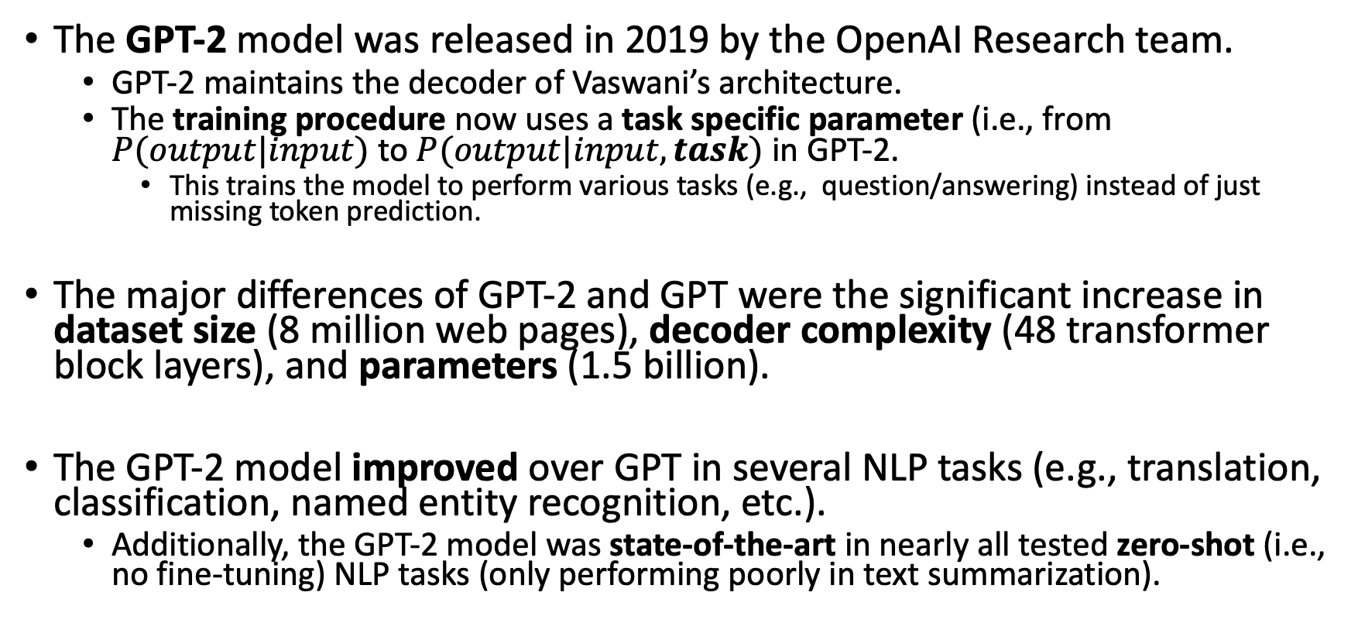
Pre-Trained Language Models – GPT-2
The GPT-2 model was released in 2019 by the OpenAI Research team.
  GPT-2 maintains the decoder of Vaswani’s architecture.
  The training procedure now uses a task specific parameter (i.e., from $P(output|input)$ to $P(output|input, task)$ in GPT-2.
    This trains the model to perform various tasks (e.g., question/answering) instead of just missing token prediction.
The major differences of GPT-2 and GPT were the significant increase in dataset size (8 million web pages), decoder complexity (48 transformer block layers), and parameters (1.5 billion).
The GPT-2 model improved over GPT in several NLP tasks (e.g., translation, classification, named entity recognition, etc.).
  Additionally, the GPT-2 model was state-of-the-art in nearly all tested zero-shot (i.e., no fine-tuning) NLP tasks (only performing poorly in text summarization).

Slide 32
Pre-Trained Language Models – GPT-3
The GPT-3 model was released in 2020 by the OpenAI Research team.
  GPT-3 once again maintains the decoder of Vaswani’s architecture with the same training procedure as GPT-2.
  GPT-3 massively scaled up the dataset size and diversity (500 billion words), decoder complexity (96 transformer block layers), and parameters (175 billion, 116 times bigger than GPT-2).
  At the time, GPT-3 was by far the largest language model (now GPT-4 is with over 1 trillion parameters).
Built upon GPT-3, OpenAI released ChatGPT in 2022. ChatGPT is trained with a three-step process known as Reinforcement Learning from Human Feedback (RLHF):
  Supervised Fine-Tuning (SFT): GPT-3 is fine-tuned on human queries answered by contracted human labelers to learn a model that generates outputs from a list of prompts.
  Reward Model Training: Humans rank the SFT model outputs, creating a new dataset of comparisons. A reward model is trained on this dataset to determine optimal outputs.
  Proximal Policy Optimization (PPO): The reward model is used to further fine-tune and improve the SFT model.

Slide 33
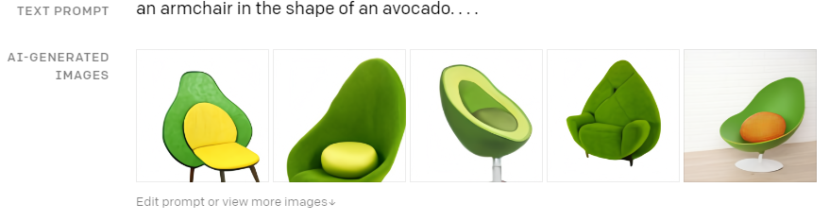
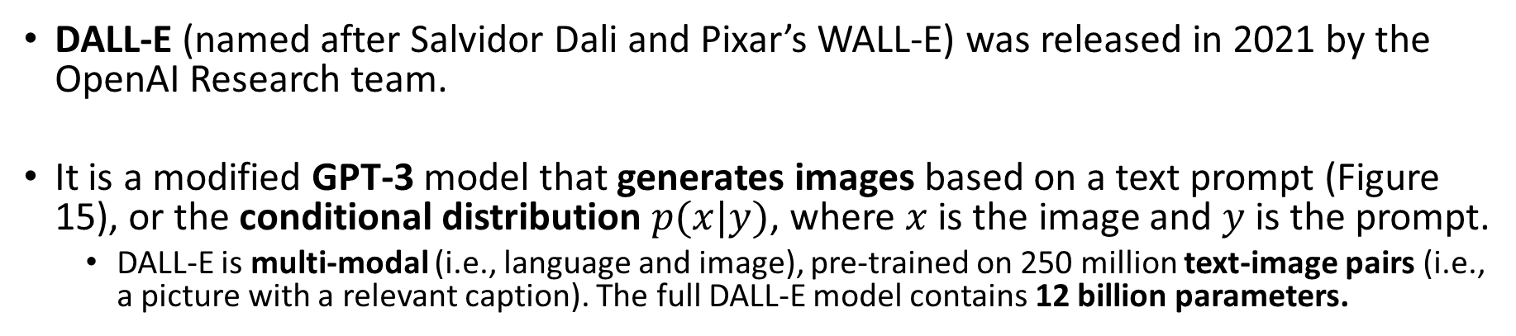
Pre-Trained Language Models – DALL-E
DALL-E (named after Salvidor Dali and Pixar’s WALL-E) was released in 2021 by the OpenAI Research team.
It is a modified GPT-3 model that generates images based on a text prompt (Figure 15), or the conditional distribution $p(x|y)$, where $x$ is the image and $y$ is the prompt.
  DALL-E is multi-modal (i.e., language and image), pre-trained on 250 million text-image pairs (i.e., a picture with a relevant caption). The full DALL-E model contains 12 billion parameters.
Figure 15: A Popular DALL-E Example (from https://openai.com/blog/dall-e/)

Slide 34
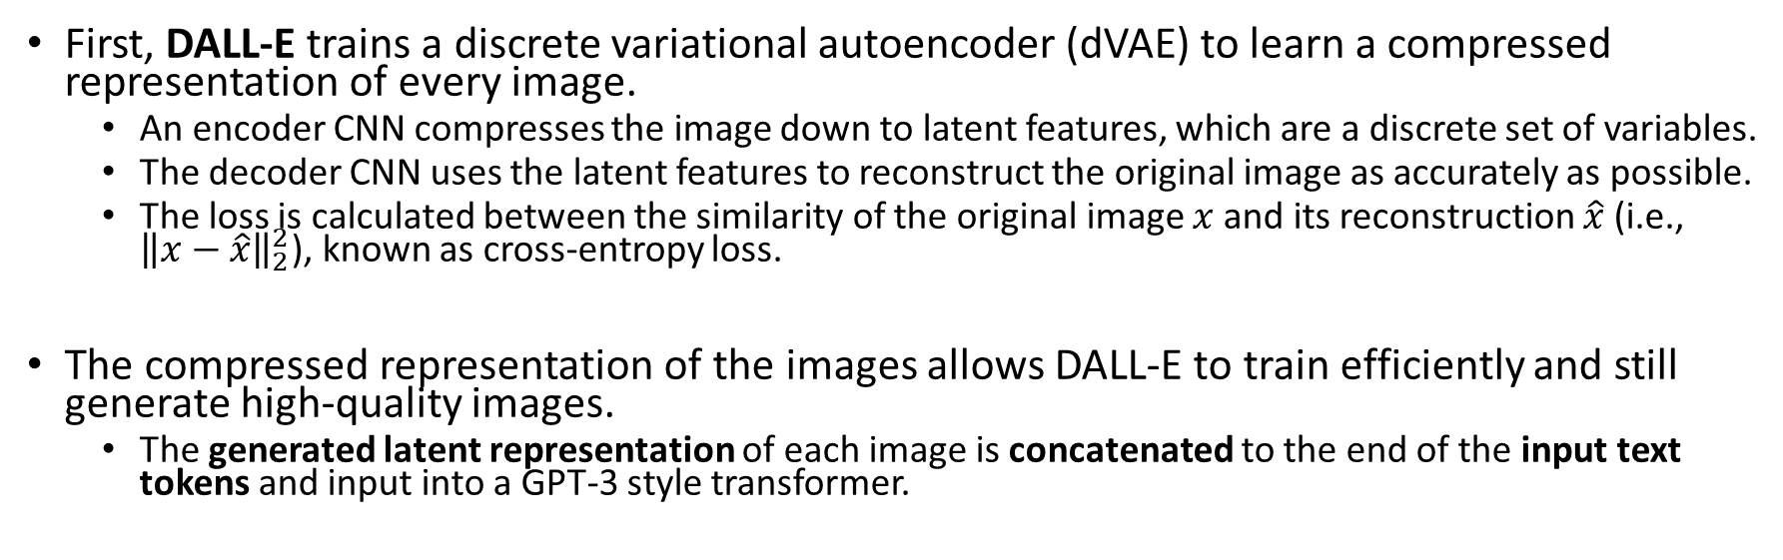

DALL-E - Architecture
256x256 Image
Latent Features
256x256 Image
Encoder CNN
Decoder CNN
32x32 Image Latents
Figure 16: dVAE Architecture
First, DALL-E trains a discrete variational autoencoder (dVAE) to learn a compressed representation of every image.
  An encoder CNN compresses the image down to latent features, which are a discrete set of variables.
  The decoder CNN uses the latent features to reconstruct the original image as accurately as possible.
  The loss is calculated between the similarity of the original image $x$ and its reconstruction $\hat{x}$ (i.e., ${\left\|x−\hat{x}\right\|}_{2}^{2}$), known as cross-entropy loss.
The compressed representation of the images allows DALL-E to train efficiently and still generate high-quality images.
  The generated latent representation of each image is concatenated to the end of the input text tokens and input into a GPT-3 style transformer.

Slide 35
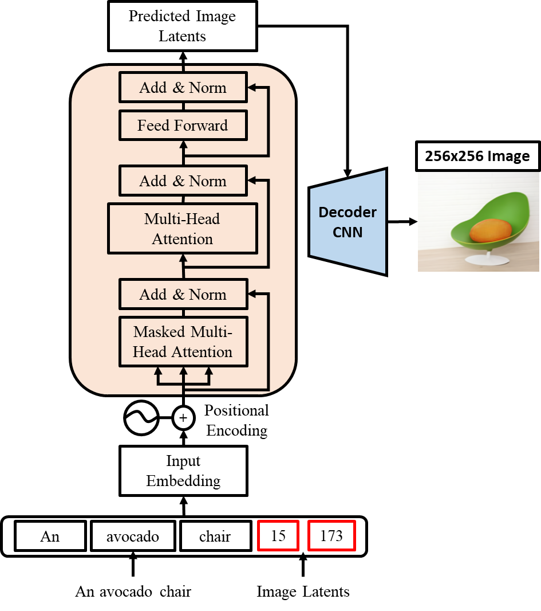
DALL-E - Architecture
The training process for predicting the image latents is similar as GPT-2 and 3.
  The future image latents are masked from the transformer.
  The transformer attempts to predict the image latents based on the prior latents and input text.
A cross-entropy loss updates the transformer decoder using the Adam optimization function.
Figure 17: DALL-E Architecture

Slide 36
Summary
The Transformer architecture has ushered in a new age of deep learning, and its limits have not yet been reached.
Pre-trained language models are almost exclusively built using an adapted Transformer encoder or decoder.
  These models achieve state-of-the-art performance in a wide array of NLP tasks (e.g., text classification, summarization, question/answering, etc.).
Transformers are also capable of generating highly realistic images based on a simple text caption.

Slide 37
References
Many of the images, results, and materials can be found within:
  Vaswani, A., Shazeer, N., Parmar, N., Uszkoreit, J., Jones, L., Gomez, A. N., & Polosukhin, I. (2017). Attention is All You Need. Advances in Neural Information Processing Systems, 30, 1-11.
  Devlin, J., Chang, M. W., Lee, K., & Toutanova, K. (2018). BERT: Pre-training of Deep Bidirectional Transformers for Language Understanding. arXiv preprint arXiv:1810.04805.
  Brown, T., Mann, B., Ryder, N., Subbiah, M., Kaplan, J. D., Dhariwal, P., & Amodei, D. (2020). Language Models are Few-shot Learners. Advances in Neural Information Processing Systems, 33, 1877-1901.
  Ramesh, A., Pavlov, M., Goh, G., Gray, S., Voss, C., Radford, A., & Sutskever, I. (2021). Zero-shot Text-to-image Generation. International Conference on Machine Learning, 8821-8831.
  Radford, A., Narasimhan, K., Salimans, T., & Sutskever, I. (2018). Improving Language Understanding by Generative Pre-Training. OpenAI Blog.
  Radford, A., Wu, J., Child, R., Luan, D., Amodei, D., & Sutskever, I. (2019). Language Models are Unsupervised Multitask Learners. OpenAI Blog.

