Slide 1
Visualizing Data: Frameworks and Examples
Hongyi Zhu, Sagar Samtani, Hsinchun Chen
AI Lab, U of Arizona, Spring 2019
Acknowledgements:
Katy Börner, School of Informatics and Computing, Indiana University
Robert Putnam, Research Computing, IS&T, Boston University
Ben Schneiderman, U of Maryland

Slide 2
Outline
Overview & History
Visualization Frameworks
UA AI Lab Examples
Evaluation Research of Information Visualization
Promising Trends
Tools Overview
Resources

Slide 3
Overview
Definition of Visualization
A Brief History of Visualization
Visualization Classification
Value of Information Visualization
Goals of Information Visualization

Slide 4
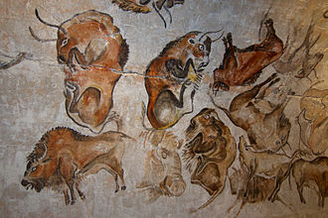
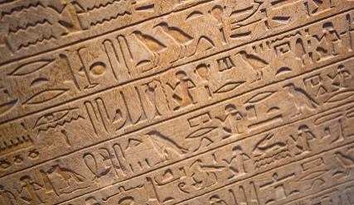
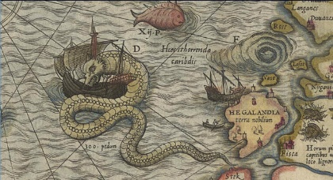
What is Visualization?
Visualization is any technique for creating images, diagrams, or animations to communicate a message.
Visualization through visual imagery has been an effective way to communicate both abstract and concrete ideas since the dawn of man.
Cave paintings
Hieroglyphs
Maps
…

Slide 5
Brief History
First known map: 12th century (Tegarden 1999)
First presentation graphics: William Playfair (1786)
Multidimensional representations appeared in 19th century (Tufte 1983)
Examples:
William Playfair (1821) – Chart showing at one view the price of the quarter of wheat, & wages of labor by the week, from the year 1565 to 1821
John Snow (1854) – Cholera Map in London
Charles Joseph Minard (1861) – Napoleon and The Russian Campaign of 1812

Slide 6
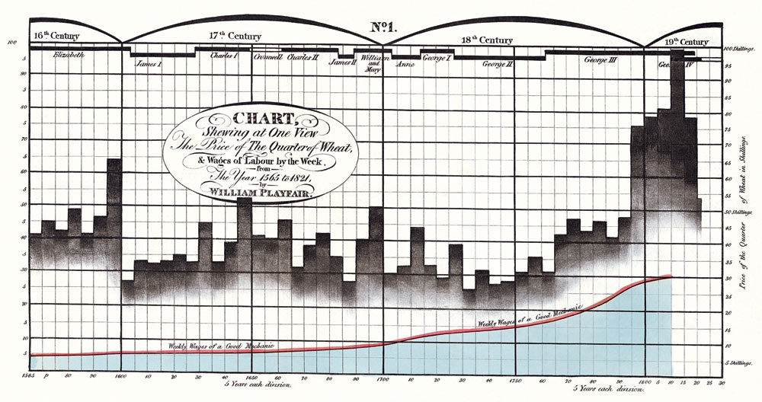
Brief History
Time-series comparison, aimed to show wheat price declined regarding the increase of wages
Integration of bar charts and line graph
William Playfair (1821)

Slide 7
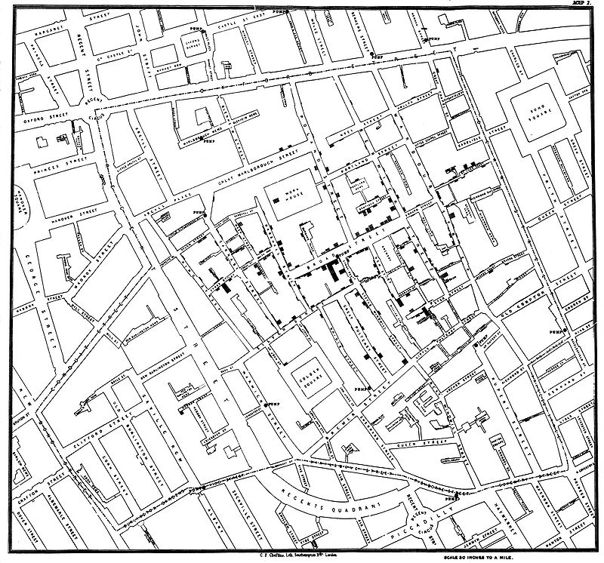
Brief History
John Snow mapped the cholera cases on the map. The cases were clustered around the pump in Broad street.
Each death case is a bar
“Spot map” – Geo-spatial based mapping
John Snow (1854)

Slide 8
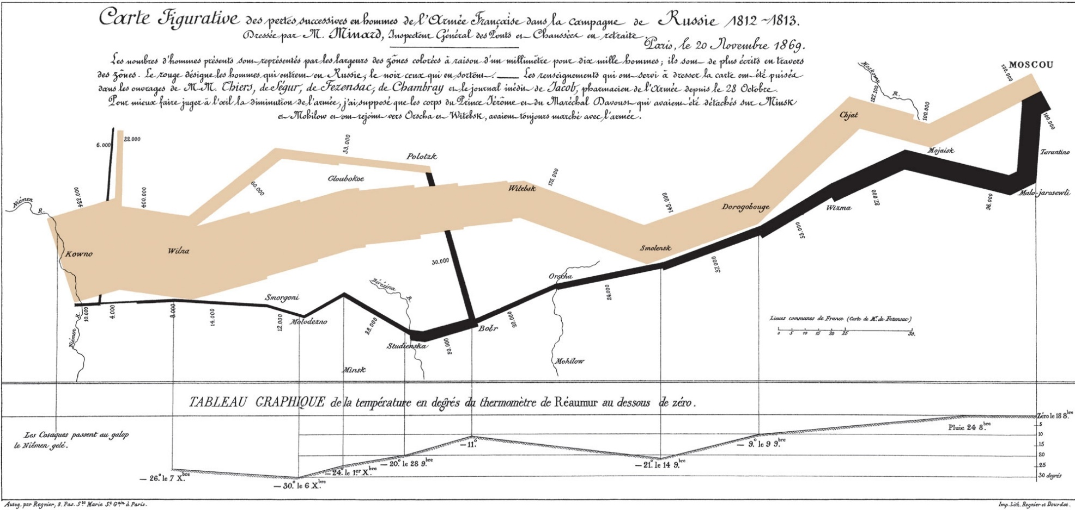
Brief History
In this visualization, Minard visualized:
Napoleon’s marching and retreat routes
Army Size
Temperature during retreat
Charles Joseph Minard (1861)

Slide 9
A Brief History
Modern Visualization
1985: NSF Workshop on Scientific Visualization
1987: Special issue of Computer Graphics on Visualization in Scientific Computing
1990: IEEE 1st visualization conference
2000s: Public media started to integrate infographics into TV news, newspaper/ magazine publication
2004: Pak Chung Wong and J. Thomas (2004). “Visual Analytics.” IEEE Computer Graphics and Applications, Volume 24, Issue 5, Sept.-Oct. 2004 Page(s): 20–21.
Visualizations become popular on social networks
Techniques such as HTML5, CSS3 enabled interactive visualizations on mobile devices

Slide 10
Visualization Types (Purposes)
Visualization can be classified as software, scientific, and information visualization.
Software Visualization
Helps people understand and use computer software effectively (Stasko et al. 1998)
Emphasize source code architecture or software runtime behavior, e.g., visualizing sorting algorithms
Scientific Visualization
Visualizing three-dimensional phenomena (architectural, meteorological, medical, biological, etc.)
Emphasize realistic renderings of volumes, surfaces, illumination sources, and so forth (Friendly 2008)

Slide 11
Visualization Classification
Information Visualization
“... (Visualization) is the two-way and interactive interface between humans and their information resources. Visualization technologies meld the human’s capacity with the computational capacity for analytical computing…” (P1000 Report)
Visual representation of abstract data using computer-supported tools
Numerical and non-numerical data (e.g., text, geographic information)
Reinforce human cognition

Slide 12
Value of Information Visualization
Exploring information collections becomes increasingly difficult as the volume grows.
With minimal effort, the human visual system can process a large amount of information in a parallel manner.
The occurrence of advanced graphical software and hardware enables the large-scale visualization and the direct manipulation of interfaces.

Slide 13
Goals for Information Visualization
Provide insight
Explore large data sets for better understanding
Explain data to solve specific problems
Support analytical tasks, showing correlation (or causality)
Relieve cognitive overload
Conveying abstract information in intuitive ways

Slide 14
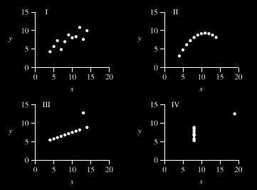
P1000: A Picture is Worth 1000 Words (if done right)
An example of scatter plot: Same regression result, Y=a+bX; different meanings

Slide 15
Visualization Frameworks
How to organize/categorize information visualizations?

Slide 16
How to Organize Visualizations?
User task type?
User insight need?
Data to be visualized?
Data transformation?
Visualization techniques?
Visual mapping transformation?
Interaction techniques?
…?
Our focus
Types of questions
When
Where
What
With Whom
Levels of analysis
Macro
Messo
Micro

Slide 17
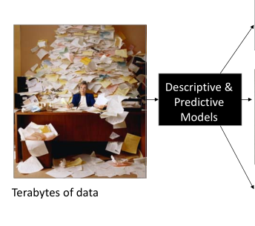
Different Question Types

Slide 18
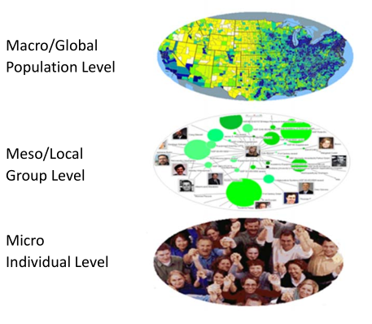
Different Levels of Analysis

Slide 19
Framework by Börner (2014)
Examples in Atlas of Knowledge | Micro/Individual (1-100 records) | Meso/Local (101-10,000 records) | Macro/Global (10,000+ records)
Statistical Analysis/Profiling | Individual person and their expertise profiles | Larger labs, centers, universities, research domains, or states | All of NSF, all of USA, all of science
Temporal Analysis (When) | Funding portfolio of one individual | Mapping topic bursts in 20 years of PNAS | 113 years of physics research
Geospatial Analysis (Where) | Career trajectory of one individual | Mapping a state’s intellectual landscape | PNAS publications
Topical Analysis (What) | Base knowledge from which one grant draws | Knowledge flows in chemistry research | VxOrd/Topic maps of NIH funding
Network Analysis (With Whom) | NSF Co‐PI network of one individual | Co‐author network | NIH’s core competency
Börner, K. (2015). Atlas of Knowledge. The MIT Press. Available online through UA Library.
Notes:
Describe various visualization techniques (what they are, why they are useful, various applications, pros and cons, tips for each one):
Line, bar, scatter plots charts (2-3 slides)
Dashboards (2-3 slides)
Networks (2-3 slides)
Map based visualizations (2-3 slides)
Temporal visualizations (2-3 slides)
…
Also provide a taxonomy succinctly summarizing each of these visualizations strengths, weaknesses, and the type of data that should be used for the visualization (e.g., graph data for network visualizations)

Slide 20
Two Visualization Workflows
Börner (2014) – Visual Insights
Read data
Analyze data
Visualize
Select vis. types
Overlay data
Visually encode data
Deploy
Fry (2007) – Visualizing Data
Acquire
Parse
Filter
Mine
Represent
Refine
Interact

Slide 21
Needs‐Driven Workflow
Börner (2014)

Slide 22
Visualization Types
Shneiderman’s Framework (1996) includes seven types of representation methods:
1-D
Represent information as one-dimensional visual objects in a linear or a circular manner
Textual documents, source codes, name lists, and etc.
2-D
Represent information as two-dimensional visual objects
Geographic maps, floor plans, newspaper layouts and etc.
3-D
Represent information as three-dimensional visual objects
Molecules, human bodies, buildings, etc.
Multi-dimensional
Represent information as multidimensional objects and projects them into a three-dimensional or a two-dimensional space
Temporal
Represent information based on temporal order
Medical records, project management, historical presentations, etc.
Tree
Represent hierarchical relationship
Network
Represent complex relationships that a simple tree structure cannot capture

Slide 23
Visualization Types
Börner (2014) emphasized five major types:
Charts
No reference system (e.g., word cloud, pie charts)
Tables
Categorical axes that can be selected, reordered.
Cells can be color coded and might contain proportional symbols.
Graphs
Quantitative or qualitative (categorical) axes
Timelines, bar graphs, scatter plots, etc.
Geospatial maps
Latitude and longitude reference system (e.g., city map)
Network graphs
Node position might depends on node attributes or node similarity.
Tree graphs: hierarchies, taxonomies, genealogies
Networks: social networks, migration flows

Slide 24
Visualization Type Selection
Select visualization type based on visualization framework:
Temporal Analysis (When)
Geospatial Analysis (Where)
Topical Analysis (What)
Network Analysis (With Whom)

Slide 25
Temporal Visualization (WHEN)
Temporal data analysis and visualization answer “WHEN” questions to
Understand the temporal distribution of datasets
Identify growth rates, latency to peak times, or decay rates
See patterns in time-series data, such as trends, seasonality, or bursts.

Slide 26
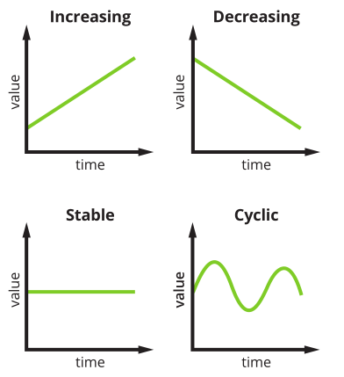
Temporal Visualization
Temporal trends
Increasing
Decreasing
Stable
Cyclic
Visualization Types
Line graph
Stacked graph
Stream graph
Temporal bar graph
Histograms
Heatmap
Small multiples
Polar area diagram
Must include a time axis in the reference system

Slide 27
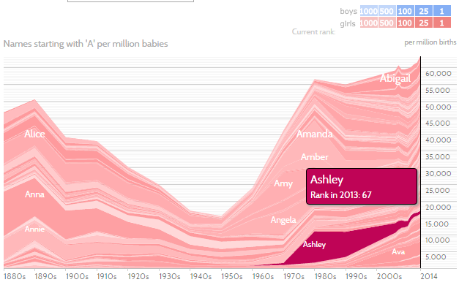
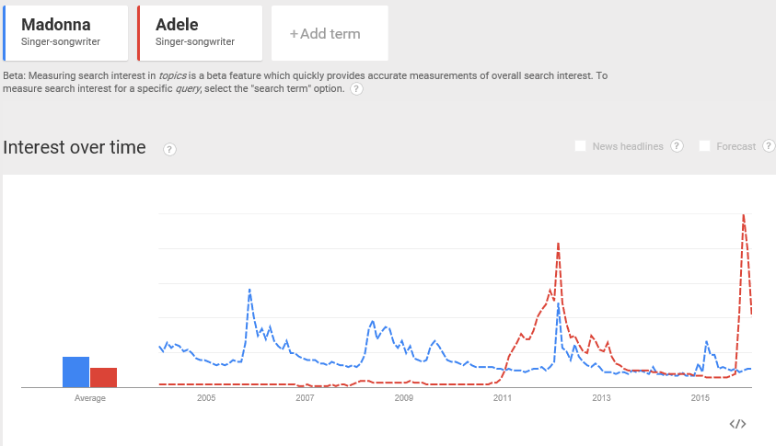
Temporal Visualization: Examples
Line graph shows the trends over time.
Stacked graph illustrates individual and total trends.

Slide 28
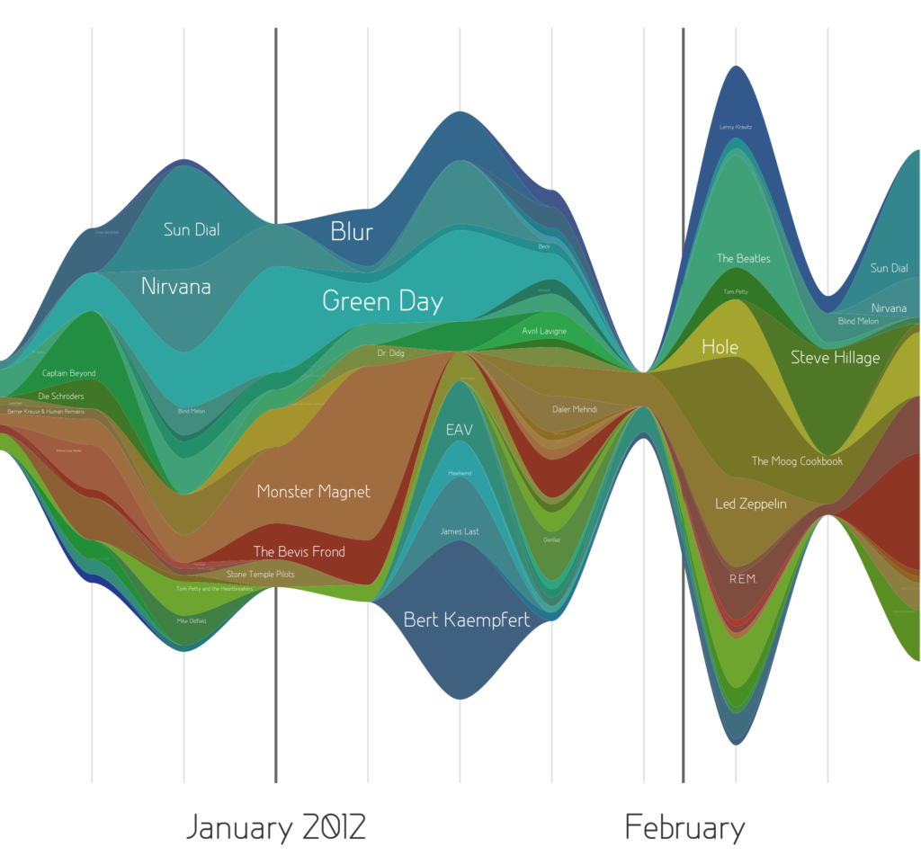
Temporal Visualization: Examples
Stream Graph is a stacked area graph that displaced around a central horizontal axis. It looks like flowing liquid.
Last.fm music-listening habits over time

Slide 29
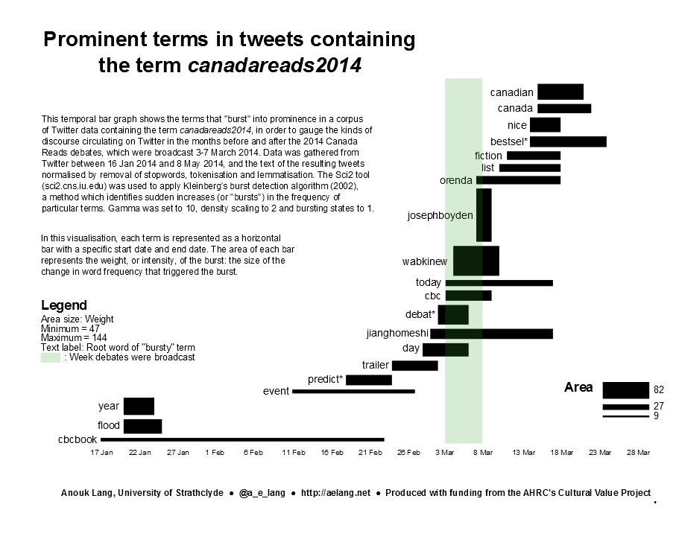
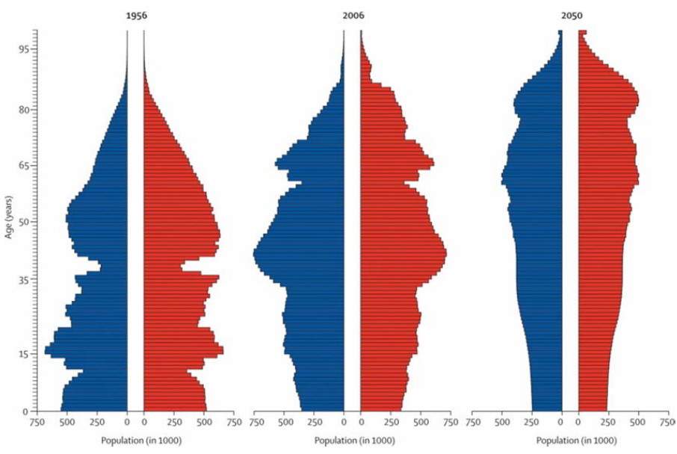
Temporal Visualization: Examples
Temporal bar graph (Gantt Chart) shows the start, end, and properties of events.
Histogram represents the number of occurrences of a certain value.
Christensen, Kaare, Gabriele Doblhammer, Roland Rau, and James W. Vaupel. “Ageing Populations: The Challenges Ahead.” The Lancet 374 (9696): 1196-1208.

Slide 30
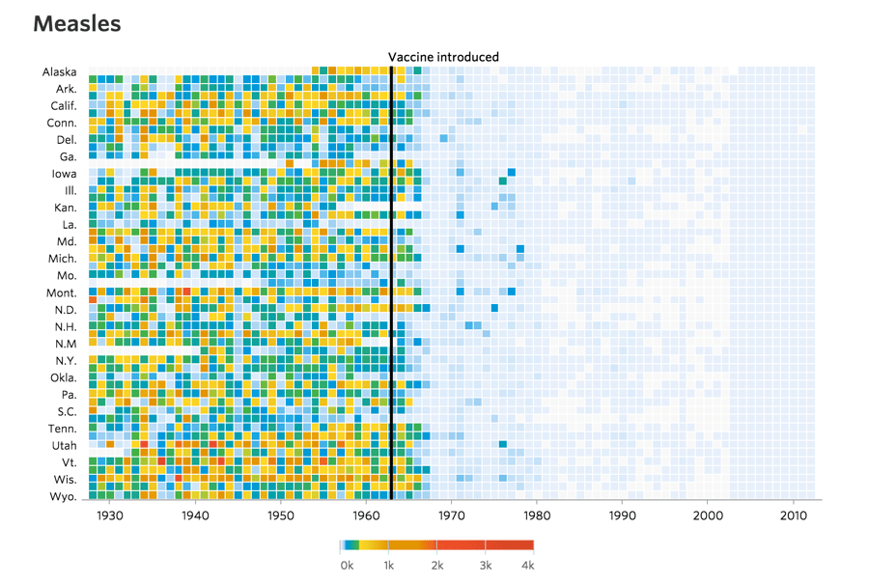
Temporal Visualization: Examples
Heatmap visualizes time series data in a tabular format.
Numeric data is color-coded
Compact design, good for comparison
Infectious diseases and vaccines
(WSJ 2015)

Slide 31
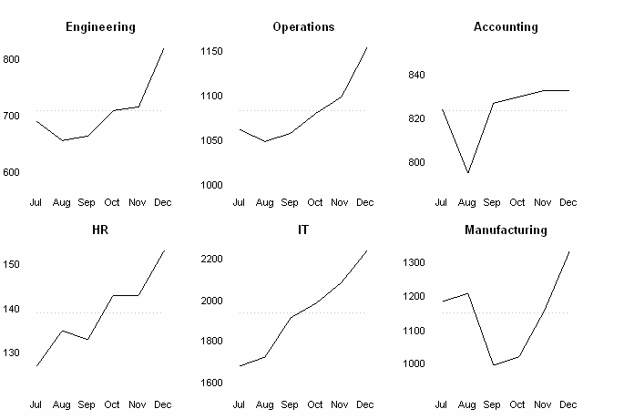
Temporal Visualizations: Examples
A small multiple is a series of similar graphs or charts using the same scale & axes, allowing them to be easily compared (Tufte 1983).
Sometimes called trellis chart, lattice chart, grid chart, or panel chart

Slide 32
Geospatial Visualization (WHERE)
Geospatial data analysis and visualization answer “WHERE” questions with location information to:
Examine spatial distribution
Identify movement patterns over geographic space
Originated in geography and cartography
Increasingly used in statistics, information visualization, and other scientific areas

Slide 33
Geospatial Visualization: Maps
General Maps
General reference maps
Names, roads, coastlines, etc.
Topographic maps
Contour lines and other details
Thematic maps: Emphasize the spatial distribution of one or more geographic variables
Physio-geographical
Natural features of the earth's surface
Socio-economic
Political boundaries, population density, or voting behavior
Technical
Navigation routes

Slide 34
Geospatial Visualization: Examples
Map Type Examples
Proportional symbol map
Choropleth map
Heat (isopleth) map
Cartograms
Flow maps
Space-time cubes
Must include a spatial reference system

Slide 35
Geospatial Visualization: Examples
Proportional symbol map represents data variables by symbols that are sized, colored, etc. according to their amount. Data is (or can be) aggregated at points within areas.
Choropleth map represents data variables such as densities, ratios, or rates by proportionally colored or patterned areas.

Slide 36
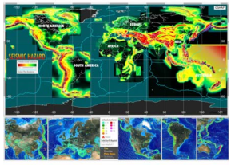
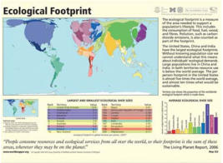
Geospatial Visualization: Examples
Heat (isopleth) map represents continuous data variable values by colors. Heat maps might show color-based contour lines that connect points of equal value or value-by-area maps.
Cartogram is not drawn to scale. Geographical areas are distorted in proportion to data values. Familiarity with region is necessary. Mostly used for world, continental, and country maps.

Slide 37
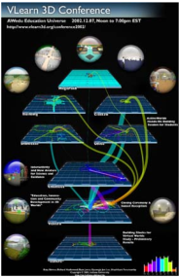
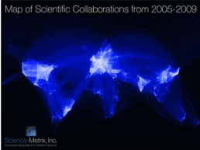
Geospatial Visualization: Examples
Flow map shows the paths that (in)tangible object take to get from one geospatial place to another. Variables such as capacity or maximum speed are encoded proportionally by line width or color.
Space-time cube (3D) displays entities, locations, and events over time.

Slide 38
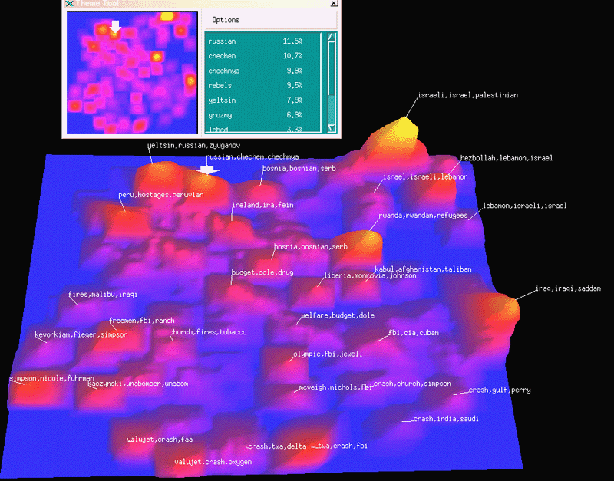
Textual Visualization by Maps (2D, 3D): MDS, PCA
SPIRE system (Wise et al., 1995)

Slide 39
Topical Visualization (WHAT)
To answer “WHAT” question, we use text to identify major topics, their interrelations, and their evolution over time at different levels of analysis – micro to macro.
To generate visualization from text, text processing or natural language processing is needed to generate qualitative or quantitative features of the text.

Slide 40
Topical Visualization: Text Mining
Most of the time, an entire text corpus is analyzed instead of a piece of texts. Various NLP and statistical analysis techniques can be applied to text.
Bag of Words and N-grams are language models used to construct computational representation for a corpus.
Please visit the resource page for a comprehensive review on text mining techniques and tools.
https://ai.arizona.edu/class-resources-page
Text Mining: Techniques, Ontologies and Tools

Slide 41
Topical Visualization: Examples
Representations of Topical (Texual) Data
Charts: word cloud, text overlay
Tables: GRIDL, Periodic table
Graphs: circular visualization, crossmaps, glyphs
Geospatial maps: self-organizing map (SOM)
Network graphs: word co-occurrence networks, concept maps, science map overlays, tree visualizations

Slide 42
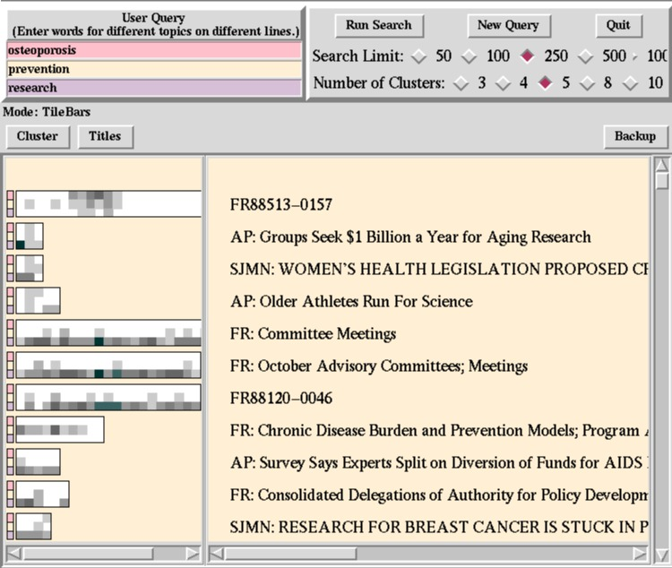
Topical Visualization: Examples
TileBars/Textile
(Hearst, 1995),
Xerox PARC

Slide 43
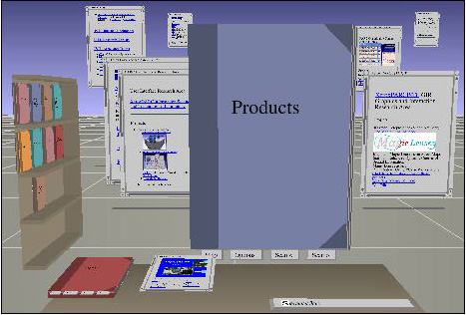
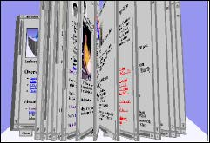
Topical Visualization: Examples
WebBook and WebForager System (Card et al., 1996), Xerox PARC

Slide 44
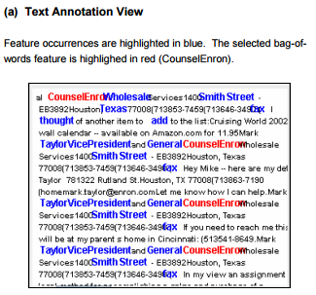
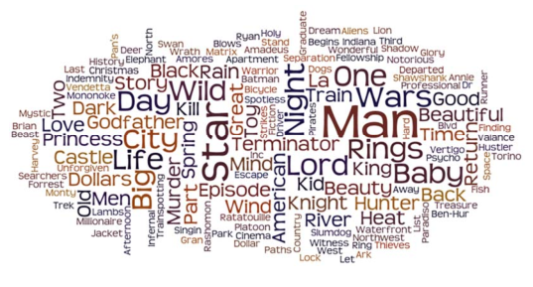
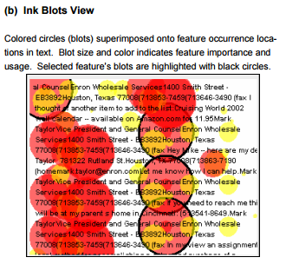
Topical Visualization: Examples
Word cloud visualizes the frequency of the words.
IMDB movie titles word cloud created with Wordle.
Text Overlay (Abbassi and Chen 2008)

Slide 45
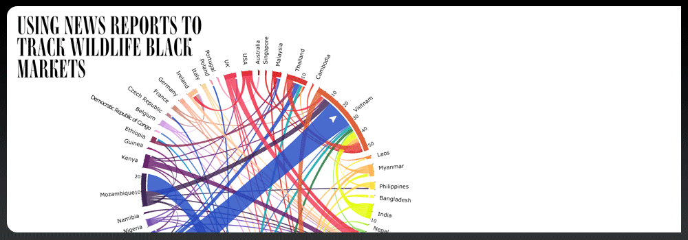
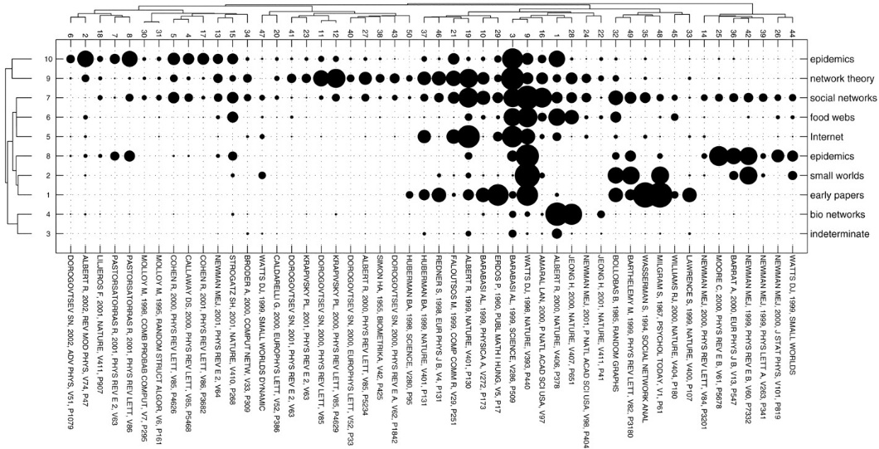
Topical Visualization: Examples
Circular Visualization shows the relationships between entities using arcs.
Crossmap visualizes multiple overlapping relations among entity types.
The example encodes selected journal articles’ topics, types, and relationships.

Slide 46
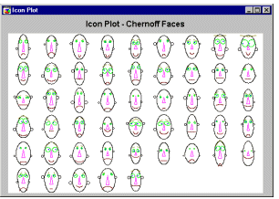
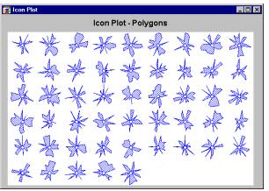
Topical Visualization: Glyphs/Icons (multi-dimensional)

Slide 47
Communication Garden- Content Summary: Topic Flow
(Chen et al., 2001)

Slide 48
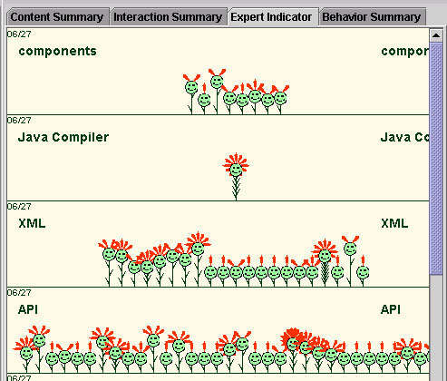
Communication Garden- Interaction Summary: Threads and Senders (Chen at al. 2001)

Slide 49
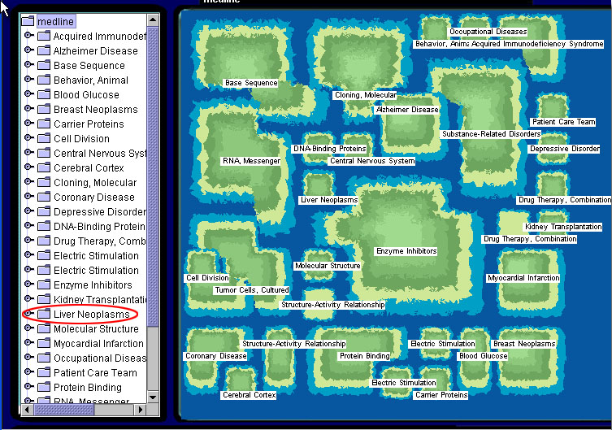
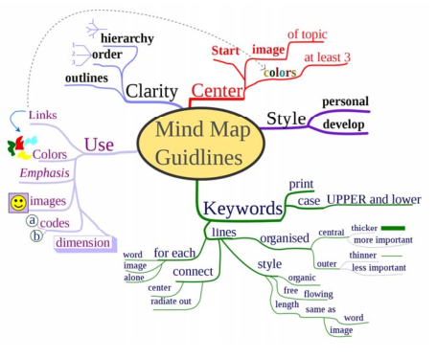
Topical Visualization: Examples
SOM Map uses geospatial metaphors to create abstract 2-D space and map topics onto the space with neural networks – size, proximity, and layer (automatically created).
Concept map is a network graph that shows the relationships among concepts (manually created).

Slide 50
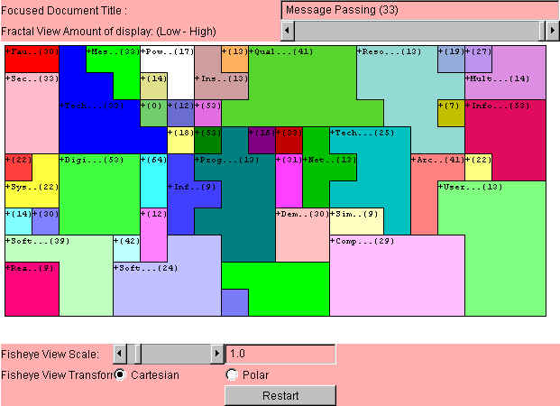
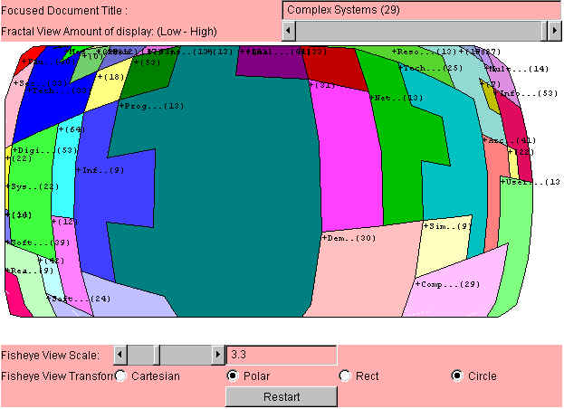
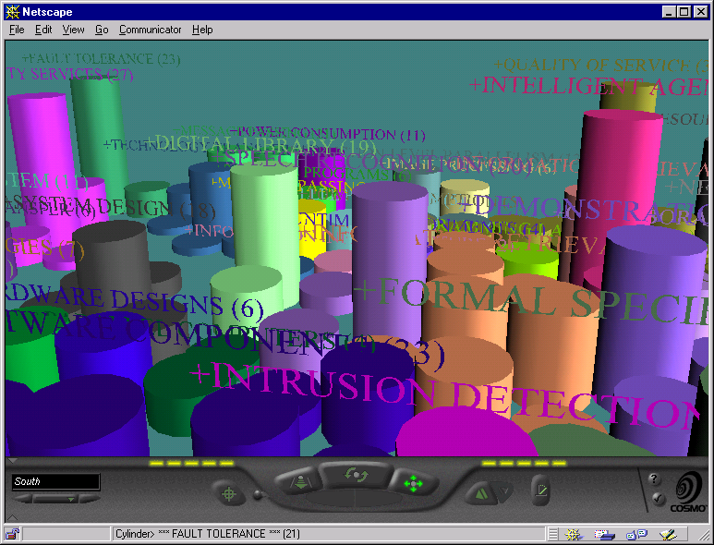
Visualization Research in AI Lab: 2D, 3D and Fisheye
2D SOM
Fisheye View
3D SOM

Slide 51
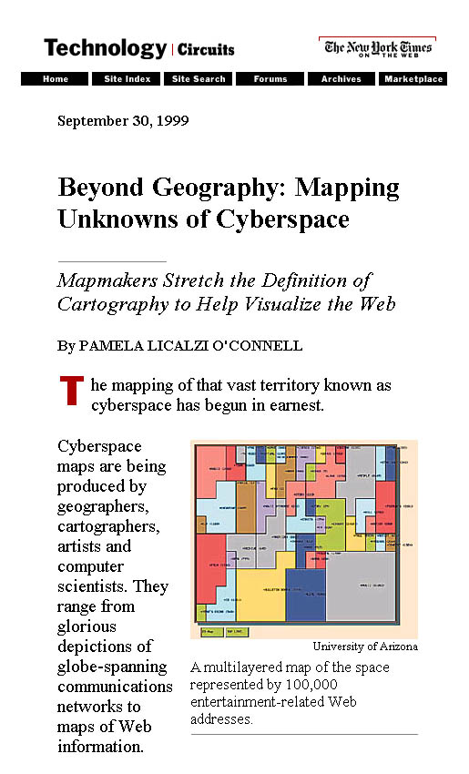
Visualization Research in AI Lab: SOM for Text (Chen et al., 1999)

Slide 52
Visualization Research in AI Lab
From YAHOO! To OOHAY?
Y
A
H
O
O
!
Y
A
H
O
O
Y
A
H
O
O
Y
A
H
O
O
Object
Oriented
Hierarchical
Automatic
Yellowpage
A
Y
H
O
O
O
O
H
A
Y
O
O
H
A
Y
O
O
H
A
Y
?
O
O
H
A
Y

Slide 53
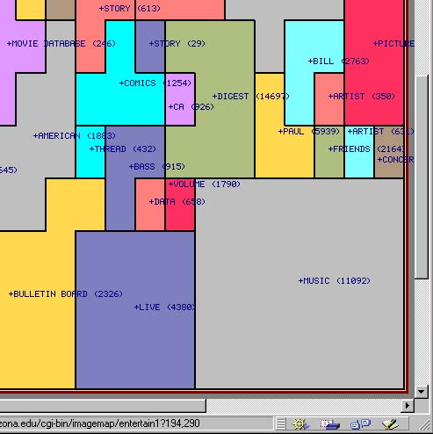
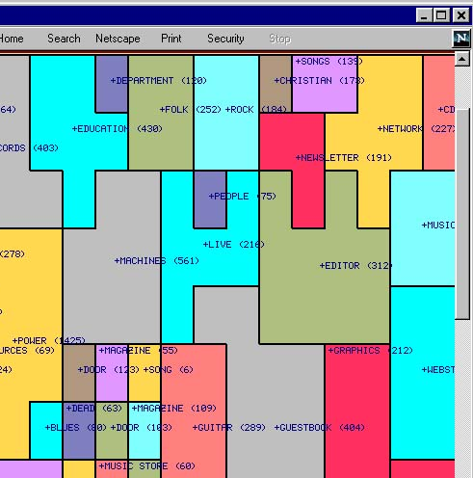
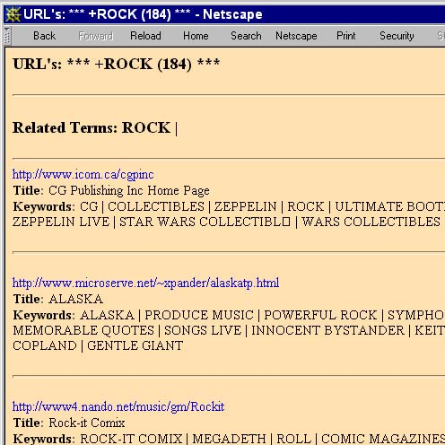
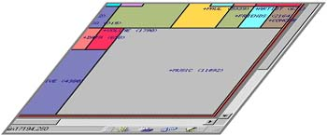
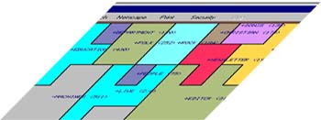
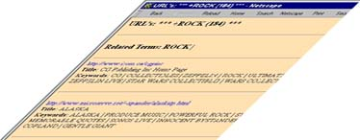
Visualization Research in AI Lab
OOHAY: Visualizing the Web
ROCK
MUSIC
… 50
6

Slide 54
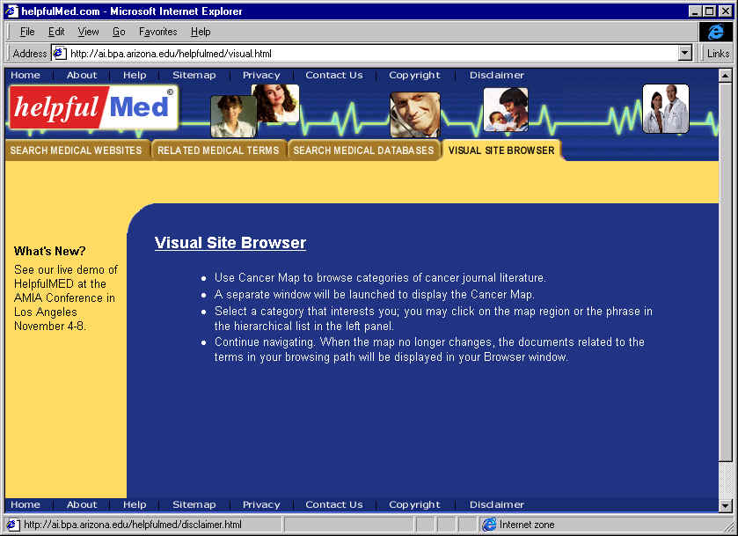
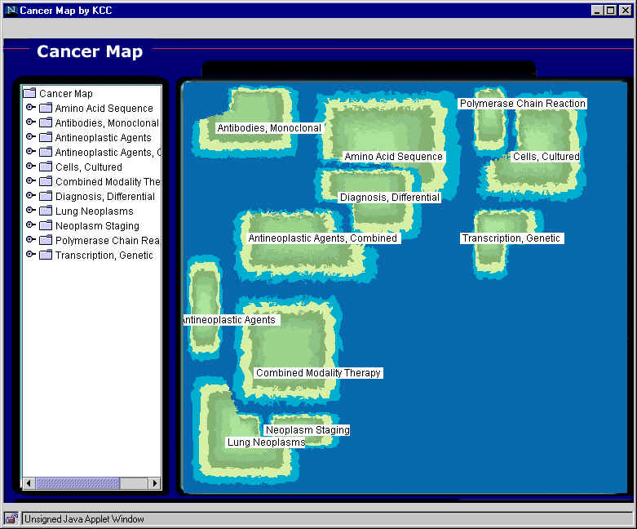
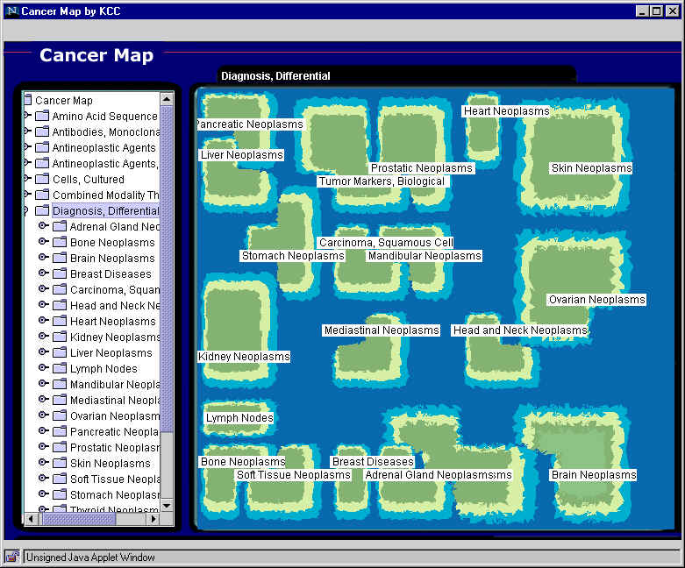
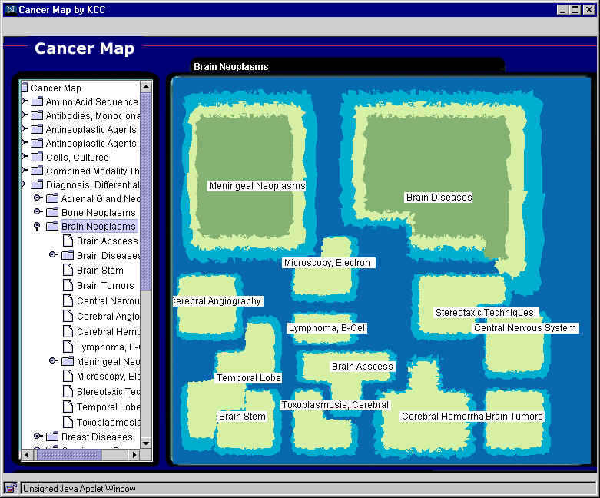
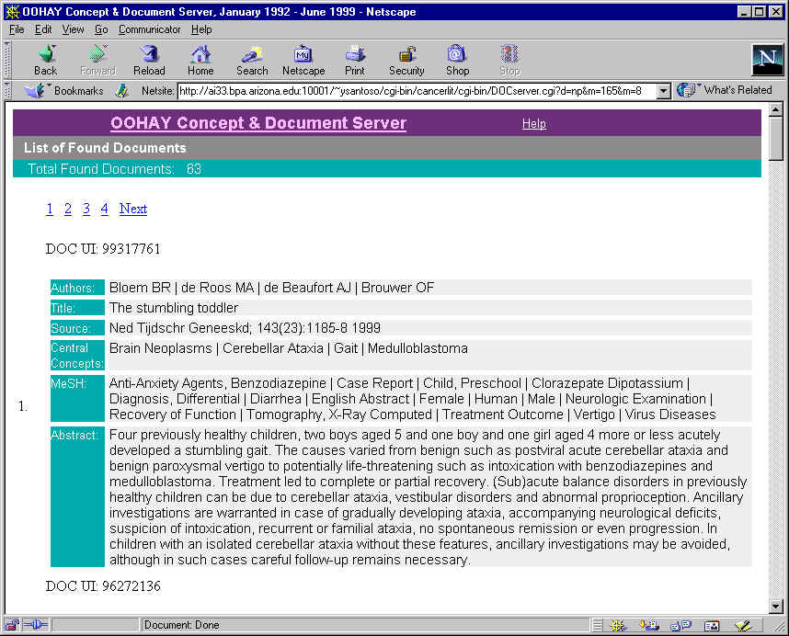
Cancer Map: 2M CancerLit articles, 1500 maps (OOHAY, DLI)
1
Visual Site Browser
2
Top level map
3
Diagnosis, Differential
4
Brain Neoplasms
5
Brain Tumors

Slide 55
Taiwan Health Topic Map: 500K news articles

Slide 56
Writeprints (Abbasi & Chen, 2008)
Author Writeprints
Anonymous Messages
Author A
10 messages
Author B
10 messages

Slide 57
Text Overlay: Ink Blots (Abbasi & Chen, 2008)
After Scandal Text

Slide 58
Tree & Network Visualization (WITH WHOM)
The “WITH WHOM” question can be answered by tree and network visualization.
Tree visualization utilizes structural, hierarchical data.
Radial Tree Map, Hierarchical Edge Bundling
Treemap
Network visualization use different layouts to deal with more complex relationships between nodes.
Random layout
Circular layout
Force directed layout
Bipartite layout
Subway map layout
Network overlays on geospatial maps

Slide 59
Tree Visualization: Examples
Radial Tree Map is a method of displaying a tree structure in a way that expands outwards, radially.
Hierarchical Edge Bundles builds on Radial Tree Map.
Edges shows relationship between leaves, following the tree hierarchy.
Adjacent edges are bundled to reduce visual clutters.

Slide 60
Tree Visualization: Examples
Two-dimensional antigenic dendrogram and phylogenetic tree.

Slide 61
Tree Visualization: Examples
Treemap is a space-constrained visualization of hierarchical structure (Ben Shneiderman 1992).
Car Model Sales

Slide 62
Network Visualization: Layouts
Random layout
Fast
Impression of size and density
Circular layout
Fast
Can provide sequential information

Slide 63
Network Visualization: Layouts
Force directed layout
Utilizes similarity or distance relationships among nodes, e.g., Springer Embedder
Bipartite layout
Renders networks with two node types as two lists

Slide 64
Network Visualization: Layouts
Subway map layout
Aim for evenly distributed nodes, uniform edge lengths, and orthogonal drawings
E.g. Ph.D. Thesis map (2004)
Network overlays on geospatial maps
Use a geospatial reference system to place nodes
E.g., airport traffic

Slide 65
Interactive Visualization
Previous sections demonstrate the workflow to create a static visualization.
In order to present more information and make visualization dynamic, we can show multiple static images side by side or as an animation.
Another way to make dynamic visualization is to introduce interaction into the design process.

Slide 66
Shneiderman's Framework
User-Interface Interaction
Immediate interaction not only allows direct manipulation of the visual objects displayed but also allows users to select what to be displayed (Card et al. 1999)
Shneiderman (1996) summarized six types of interface functionality
Overview
Zoom
Filtering
Details on demand
Relate
History
“Overview first, zoom and filter, then details-on-demand.”

Slide 67
Two Interaction Approaches
Overview + Detail
First overview provides overall patterns to users; then details about the part of interest to the use can be displayed (Card et al. 1999).
Spatial zooming & semantic zooming are usually used

Slide 68
Two Interaction Approaches
Focus + Context
Details (focus) and overview (context) dynamically on the same view. Users could change the region of focus dynamically.
Information Landscape (Andrews 1995)
Cone Tree (Robertson et al. 1991)
Fish-eye (Furnas 1986)

Slide 69
Textual Visualization
Hyperbolic Trees (Lamping et al., 1995)

Slide 70
Interactive Vis. Example: Gapminder World (viz over time)
http://www.gapminder.org/world/
https://www.youtube.com/watch?v=BPt8ElTQMIg (Hans Rosling telling story)

Slide 71
AI Lab Visualization Systems/Examples

Slide 72
COPLINK for Crime Information Sharing & Data Mining (Chen et al. 2002)

Slide 73
CyberGate for CMC (Abbasi, Chen et al., 2008)

Slide 74
BioPortal for Infectious Disease Tracking and Visualization, SARS, WNV, FMD (Chen et al., 2009)

Slide 75
AZSecure Hacker Assets Portal for Cyber Threat Intelligence (Chen et al., 2016)
(a) Home page, linking to (b & c) Assets, (d) Dashboard, and (e) Malware Families:
(e) Malware Families, for depicting relationships among assets over time (Crypter Family shown)
(b) Assets page, linking to Source Code and Attachments
(c) Source Code page; sortable by asset name, exploit type, date, etc.
(d) Dashboard for drill-down analysis of hackers & assets over time

Slide 76
Evaluation Research

Slide 77
Evaluation Research of Information Visualization
Empirical usability studies: To understand the pros and cons of specific visualization designs or systems
Laboratory experiments approach
Comparing a glyph-based interface and a text based interface (Zhu & Chen 2001)
Comparing different visualization techniques (Stasko et al. 2000)
De-featuring approach
Evaluate simple but basic visual operations (e.g., searching, grouping, counting) with accuracy of operation results and time to completion (Pirolli et al. 2000; Stasko et al. 2000; Zhu & Chen, 2002; Ong & Chen 2005)
Complex, realistic, task-driven evaluation studies have been conducted frequently (e.g., Pohl & Purgathofer 2000, Risden et al. 2000, North & Shneiderman 2000). They could measure usefulness. But it is difficult to identify each visualization factors’ contribution.
Behavioral and survey methods are often used.

Slide 78
Evaluation Research of Information Visualization
Fundamental perception studies and theory building
To investigate basic perceptual effects of certain visualization factors or stimuli
Theories from psychology and neuroscience are used to understand the perceptual impact of visualization parameters as animation (Bederson & Boltman 1999), information density (Pirolli et al. 2000), 3-D effect (Tavanti & Lind 2001), and combinations of visual cues (Nowell et al. 2002)
It usually involves some form of computer-based visualization
Bederson and Boltman (1999) used the Pad++ to study the impact of animation of users’ learning of hierarchical relationships
Pirolli et al. (2000) used a hyperbolic tree with fish0eye view to study the effect of information density.
Results may be applied only to the particular visualization system understudy

Slide 79
Promising Trends
Facilitate better story-telling

Slide 80
Promising Trends
Visual Data Mining
To identify patterns that a data mining algorithm might find difficult to locate
To support interaction between users and data
To support interaction with the analytical process and output of a data mining system
(Cloud’N’Sci, Ltd.)

Slide 81
Promising Trends
Virtual/ Augmented Reality-Based Visualization
To take advantage of the entire range of human perceptions, including auditory and tactile sensations
With the help of VR/AR devices (e.g., Google Glass, HoloLens, Oculus Rift), visualized information can be overlaid on the real world we see.
(ZDNet, 2019)

Slide 82
Tools Overview

Slide 83
Visualization Tools
Various types of visualization tools are available online.
Desktop Software | Online Services | Toolkit (for Developers)
Microsoft Excel | Mapbox | D3.js
Sci2 Tool | Wordle | Google Charts
Tableau | Datawrapper | HighCharts
Gephi | Infogram | Timeline.js
ParaView | Plotly | Processing
TIBCO Spotfire | VisualizeFree | R/Python/Matlab
… | Onodo… | …

Slide 84
Desktop Software
Microsoft Excel
Excel supports charts, graphs, or histograms generated from specified groups of cells.
Sci2 Tool (open-source)
The Science of Science (Sci2) Tool is a modular toolset specifically designed for the study of science. It supports the temporal, geospatial, topical, and network analysis and visualization of scholarly datasets at the micro (individual), meso (local), and macro (global) levels.
https://sci2.cns.iu.edu/user/index.php
Gephi (open-source)
Gephi is the leading visualization and exploration software for all kinds of graphs and networks.
https://gephi.org/

Slide 85
Desktop Software
Tableau
The product queries relational databases, cubes, cloud databases, and spreadsheets and then generates a number of graph types that can be combined into dashboards and shared over a computer network or the internet.
ParaView (open-source)
Users can quickly build visualizations to analyze their data using qualitative and quantitative techniques. It was developed to analyze extremely large datasets using distributed memory computing resources. It can be run on supercomputers to analyze datasets of petascale size as well as on laptops for smaller data.
TIBCO Spotfire
Similar to Tableau, TIBCO Spotfire is an integral visualization platform which can visualize various types of charts.

Slide 86
Desktop Software
Software | Charts | Maps | Networks | Cost
Excel | √ | √ |  | License Required
Sci2 Tool | weak | √ | √ | Free
Gephi |  |  | √ | Free
Tableau | √ | √ | √ | Free for students
ParaView | √ | √ |  | Free
Spotfire | √ | √ |  | Free trial $650 annual subscription

Slide 87
Online Services
Mapbox (https://www.mapbox.com/)
An open source mapping platform for custom designed maps. They provide APIs and SDKs to integrate location into any mobile or web app.
Wordle (http://www.wordle.net/)
A specialized tool to generate word clouds from text.
Datawrapper (https://datawrapper.de/)
Datawrapper is an open source tool helping user to quickly create simple, correct and embeddable.

Slide 88
Online Services
Infogram (https://infogr.am/)
An online tool to create visualizations and interactive infographics.
Plotly (https://plot.ly/)
An online charts and dashboards creator. Provides APIs in multiple programming languages.
VisualizeFree (https://visualizefree.com/)
A free cloud-hosted, zero-client app for data visualization and analytics. Support interactive visualization design and presentation
Onodo (https://onodo.org/)
An online network visualization platform.

Slide 89
Online Services
Services | Charts | Maps | Networks
Mapbox |  | √
Wordle | Word Cloud
Datawrapper | √ | √
Infogram | √ | √
Plotly | √ | √ | API Extension
VisualizeFree | √ | √
Onodo |  |  | √

Slide 90
Toolkits (for Developers)
These tools are APIs, SDKs, packages for programming languages, which provides high level of flexibility and enables unconstrained customizations.
D3.js
A JavaScript library for producing dynamic, interactive data visualizations in web browsers. It makes use of the widely implemented SVG, HTML5, and CSS standards.
Google Charts
The Google Chart API is a tool that lets people easily create a chart from some data and embed it in a web page. Google creates a PNG image of a chart from data and formatting parameters in an HTTP request.

Slide 91
Toolkits (for Developers)
Highcharts
Highcharts is a product that was created by the Norway based company, Highsoft. Highcharts was released in 2009, and it is a charting library written in pure JavaScript. Highcharts is free for non-commercial and personal use.
Timeline.js
TimelineJS is an open-source tool that help build visually rich, interactive timelines. Users can create a timeline using a Google spreadsheet or customize installations with JSON configurations.

Slide 92
Toolkits (for Developers)
Processing
Processing is an open source programming language and integrated development environment (IDE) built for the electronic arts, new media art, and visual design communities with the purpose of teaching the fundamentals of computer programming in a visual context, and to serve as the foundation for electronic sketchbooks.
R/Python/Matlab
Packages in R: ggplot2, dygraphs, googleVis, choroplethr
Packages in Python: matplotlib, bokeh, Dipy, NetworKit
Matlab: Built-in visualization modules

Slide 93
Walkthrough: Sci2 Tool
Interface: the menu bar, console, data manager, scheduler and workflow manager

Slide 94
Walkthrough: Sci2 Tool
Loading the Data in Sci2
'File > Load > …’ and data will appear in the Data Manager
Data preparation
After loading a file, use options in the 'Data Preparation' menu to clean the data and create networks or tables which can be used in the preprocessing, analysis, and visualization steps.

Slide 95
Walkthrough: Sci2 Tool
Preprocessing
Use preprocessing algorithms to prune or append networks or tables before analyzing and visualizing them.

Slide 96
Walkthrough: Sci2 Tool
Analysis
Once data is loaded, prepared, and processed with whatever features needed, analysis is possible in each of the four domains: temporal, geospatial, topical, or network.

Slide 97
Walkthrough: Sci2 Tool
Visualize the Data
Once all previous data steps are complete, the Sci2 Tool can visualize the results.
To use Gephi, you should have Gephi installed.

Slide 98
Walkthrough: Sci2 Tool
On exporting/saving visualizations
Some visualizations do not have legends.
Inkscape is a tool which can help creating the legends
Cannot open PostScript graphs
Online converter
Gsview: http://pages.cs.wisc.edu/~ghost/
User manual and 12 PDF Tutorials on Sci2 Tool can be found online
https://sci2.cns.iu.edu/user/documentation.php

Slide 99
Walkthrough: Tableau Desktop
Connect to Data
The first thing to do when you start Tableau is to connect to your data.

Slide 100
Walkthrough: Tableau Desktop
Connect to Data

Slide 101
Walkthrough: Tableau Desktop
Build a View
After you connect to a data source, fields are displayed in the Data pane on the left side of the workbook as dimensions and measures.

Slide 102
Walkthrough: Tableau Desktop
Build a View

Slide 103
Walkthrough: Tableau Desktop
Build a View

Slide 104
Walkthrough: Tableau Desktop
Create a Story
After you create a view, you can present it in a story and show how facts are connected, provide context, and demonstrate how decisions relate to outcomes.

Slide 105
Walkthrough: Tableau Desktop
Create a Story

Slide 106
Tableau Resources
Tableau student (free): http://www.tableau.com/academic/students
Online training: http://www.tableau.com/learn/training
Quick start guide: http://www.tableau.com/support/manuals/quickstart

Slide 107
D3.js resources
Tutorials:
http://alignedleft.com/tutorials/d3
https://www.dashingd3js.com/table-of-contents
https://www.youtube.com/playlist?list=PL6il2r9i3BqH9PmbOf5wA5E1wOG3FT22p
Templates and demos:
http://techslides.com/over-1000-d3-js-examples-and-demos
http://techslides.com/over-2000-d3-js-examples-and-demos

Slide 108
Resources

Slide 109
Resources
Börner, K. & Polley, T. (2014). Visual Insights. The MIT Press.
Börner, K. (2015). Atlas of Knowledge. The MIT Press.
Fry, B. (2007). Visualizing Data: Exploring and Explaining Data with the Processing Environment. O'Reilly Media.
Steele, J., & Iliinsky, N. (2010). Beautiful Visualization: Looking at Data through the Eyes of Experts. O'Reilly Media, Inc..
Munzner, T. (2014). Visualization Analysis and Design. AK Peters/CRC Press.
Tufte, E. R. (2001). The Visual Display of Quantitative Information, 2nd Edition. Graphics Press.
Tufte, E. R. (1990). Envisioning information, 1st Edition. Graphics Press.
Tufte, E. R. (2006). Beautiful Evidence, 3rd Edition. Graphics Press.
Tufte, E. R. (1997). Visual Explanations: Images and Quantities, Evidence and Narrative, 1st Edition. Graphics Press.
Ware, C. (2012). Information Visualization: Perception for Design, 3rd Edition. Morgan Kaufmann.

Slide 110
Resources
IEEE Transactions on Visualization and Computer Graphics
http://ieeexplore.ieee.org/xpl/RecentIssue.jsp?punumber=2945
IEEE VIS Conference (ieeevis.org)
IEEE Visual Analytics Science and Technology (VAST)
IEEE Information Visualization (InfoVis)
IEEE Scientific Visualization (SciVis)
IEEE Computer Graphics and Applications
http://www.computer.org/web/computingnow/cga
ACM SIGGRAPH
http://www.siggraph.org/

